Slide 1
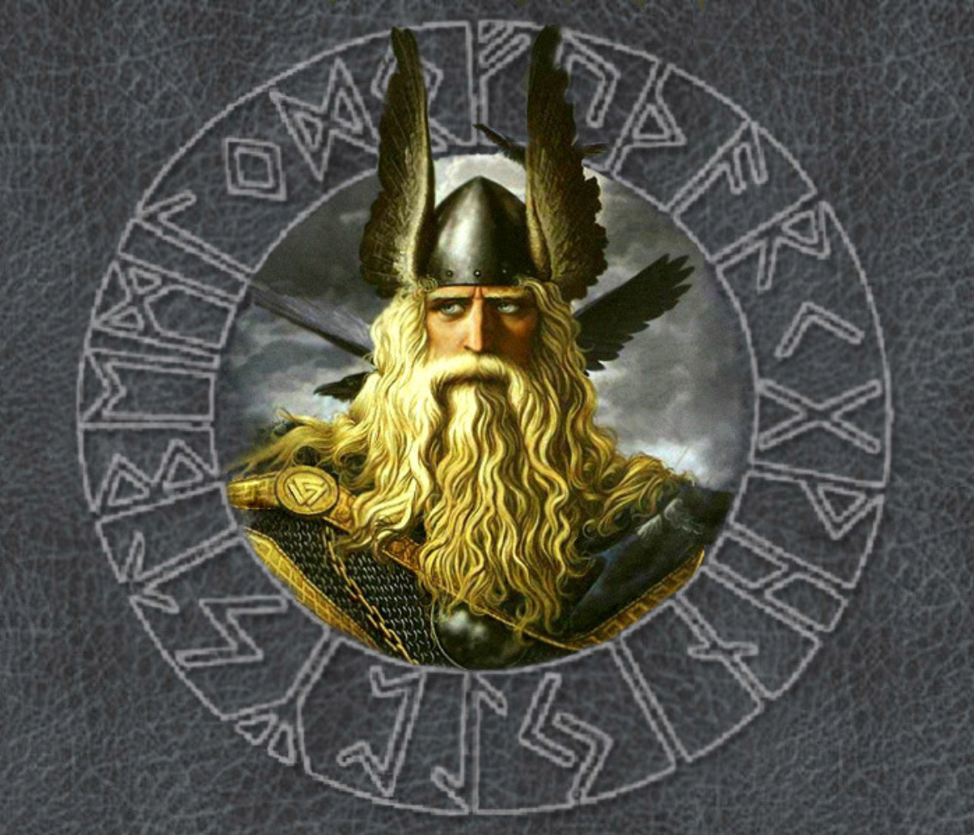
My Anglo-Saxon God

Slide 2
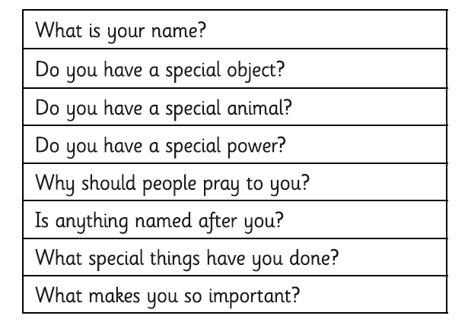
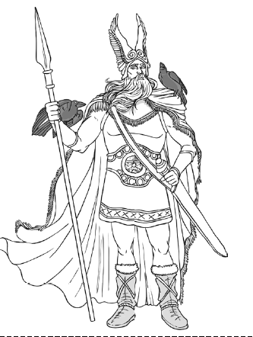

Slide 3
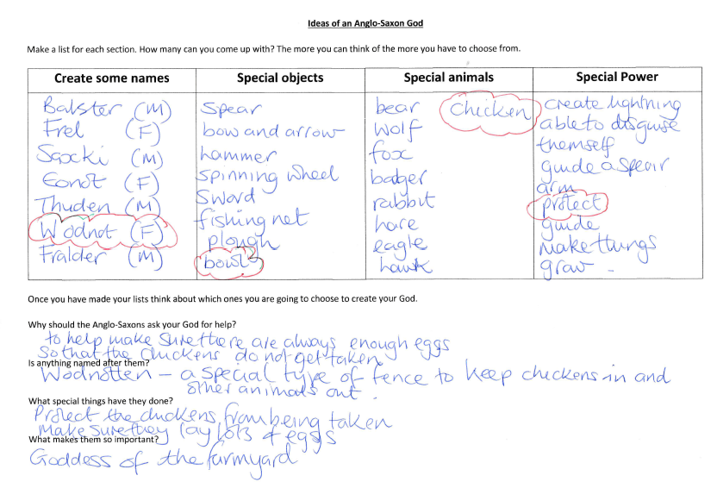

Slide 4
My Anglo-Saxon God:
Wodnot was the wife of Saxki.
She was the goddess of the farmyard where she helped protect the chickens for predators. She also made sure that there was always an abundant amount of eggs to feed everyone.
Her special object was a bowl that never ran out of feed for the chickens.
Her sacred animal was the chicken and it was believed that she wore chicken feathers in her hair.
The wodnotten, a special fence to keep chickens in and wolves and foxes out, was named after her.

Slide 5
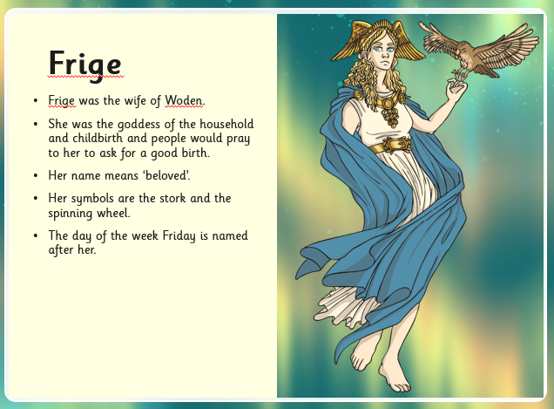

Slide 6
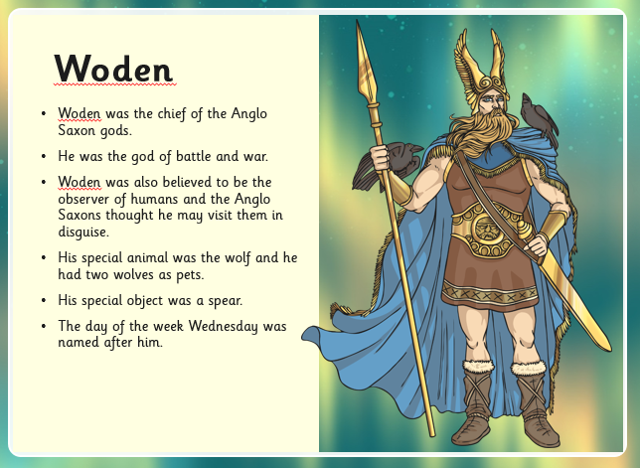

Slide 7
Now it’s your turn.

