Slide 1
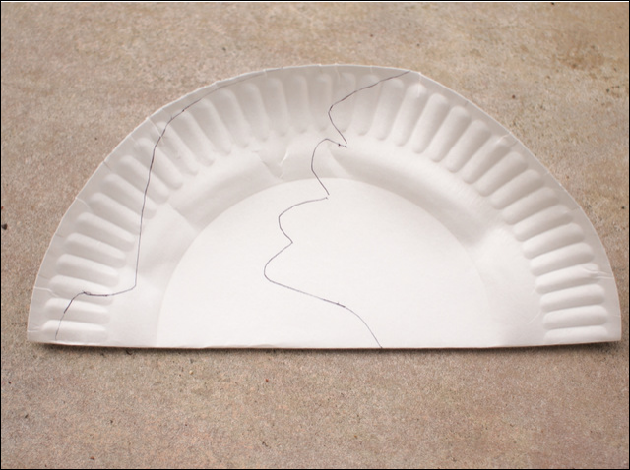
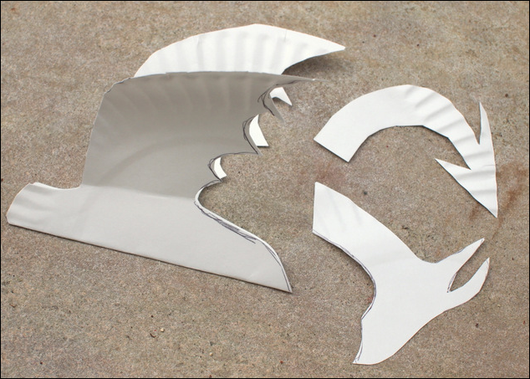
Make a Dragon
1. Fold the plate in half and trace the body. (You can make your own design, or just use the dragon template.)
If you don’t have a paper plate, don’t worry, you can use paper or card instead.
Cut out the head and tail pieces from the excess material.
Fold down our wings.

Slide 2
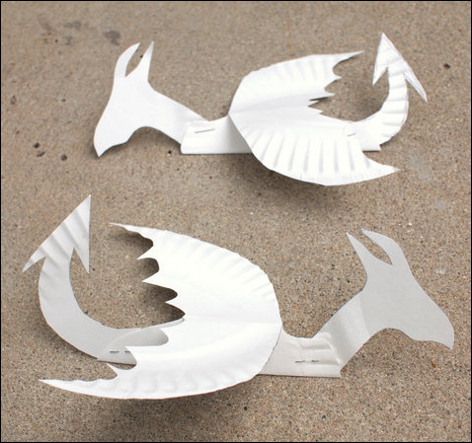
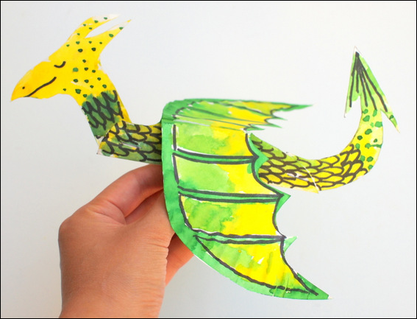
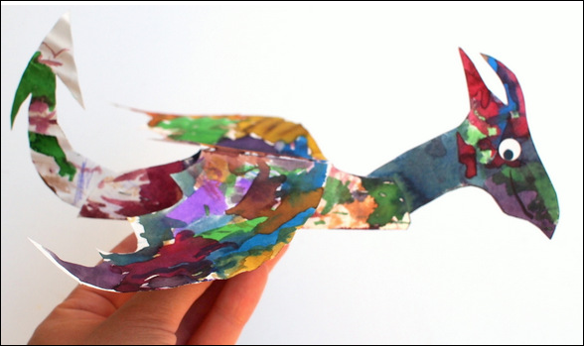
Slide the head and tail pieces between the body pieces.
Staple (or glue) everything together.
the rainbow one
Go wild decorating
Use pencils, paint, pen to decorate your dragon.

