Slide 1
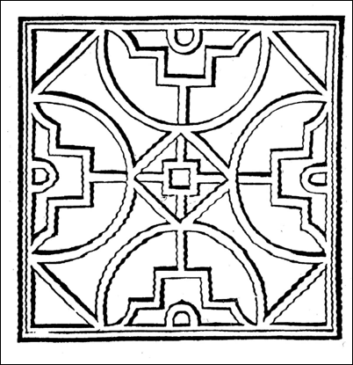
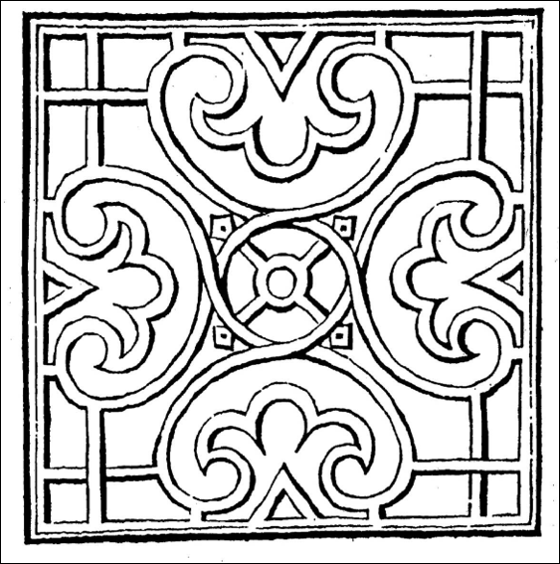
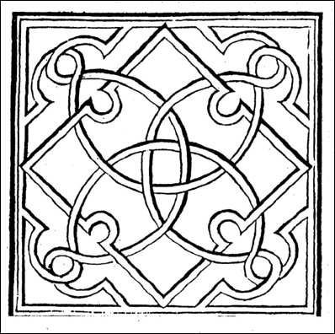
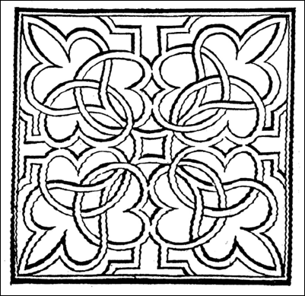
Tudor Knot Gardens
Today you are going to learn about Tudor Gardens, particularly Knot Gardens.
You will then have be able to choose one to colour in or use them to help design your own.
You will notice that they are symmetrical.

Slide 2
Tudor Knot Gardens
In the Tudor age gardens served a variety of purposes. First and foremost, they were for growing food. The ability to grow a range of foodstuffs throughout the year could mean the difference between starvation and survival. Garden crops included onions, garlic and leeks.

Slide 3
The garden was also a medicine chest when plants and herbs were the first line of defence against illness. With space often limited, the more plants in the garden that could be used for several purposes, the better. Good examples are rosemary and lavender. Rosemary, a popular herb for culinary purposes, could also be used in medicines and lotions. Lavender was even more useful – culinary and medicinal, it was additionally used for freshening linens and clothes, and even scattered in the rushes underfoot to keep them sweet.

Slide 4
For the better off, there might be sufficient space to grow plants for purely ornamental purposes, although plants we think of as purely decorative were frequently used in the home. Roses, a great favourite, were used in cookery, for making rosehip wine and also for perfumes, flower arrangements and pot pourri mixtures to keep rooms smelling sweet. Queen Katherine Parr was particularly fond of fresh flowers; ordering them for her rooms at Hampton Court.

Slide 5
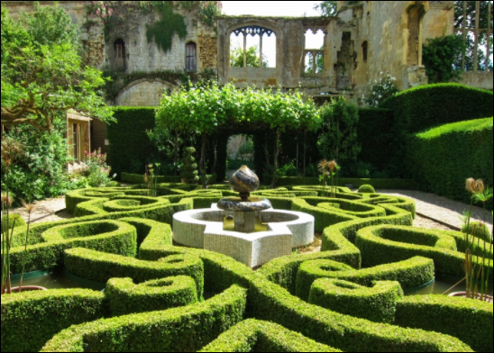
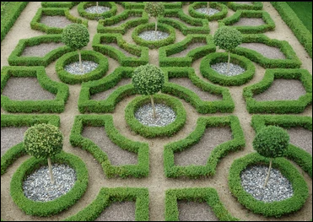
Finally, ornamental gardens were a symbol of status. The Tudor age loved order and structure - the knot garden. It became fashionable to admire gardens. Henry VIII spent both time and money in his privy gardens – he would stroll through, alone or with his wife or daughter Mary.

Slide 6
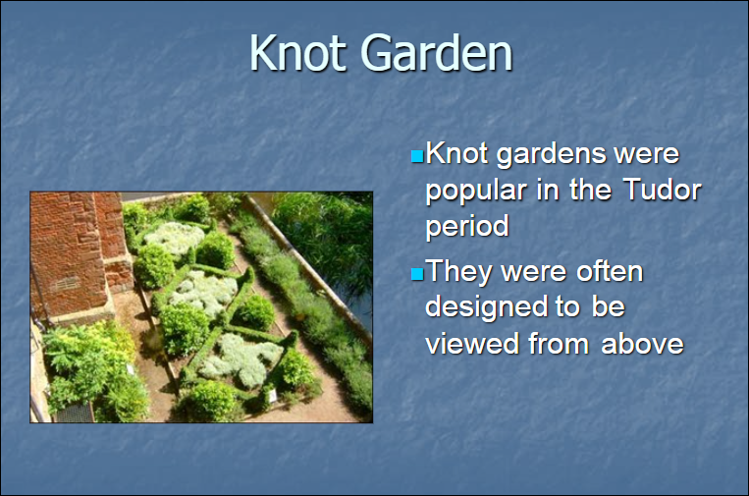

Slide 7
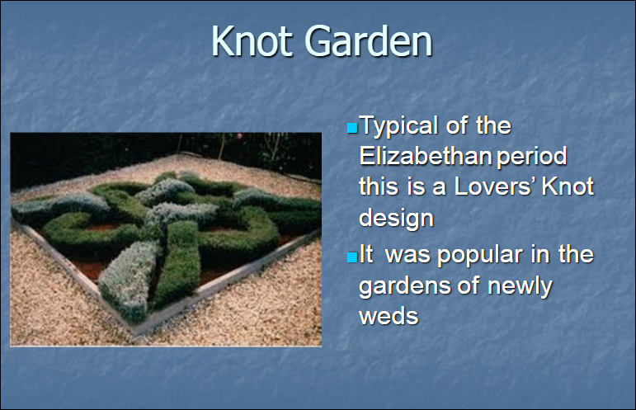

Slide 8
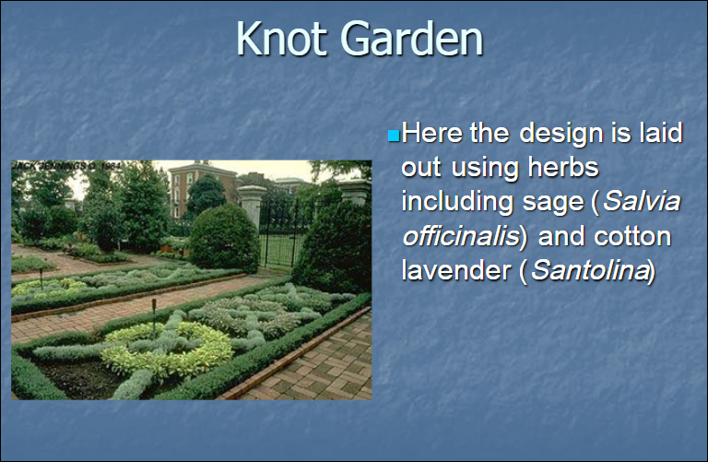

Slide 9
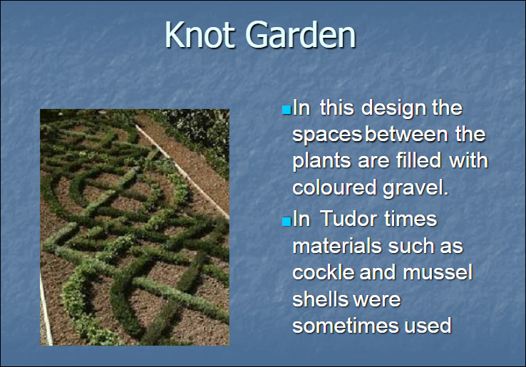

Slide 10
