Slide 1




LO: VIPERS

Slide 2
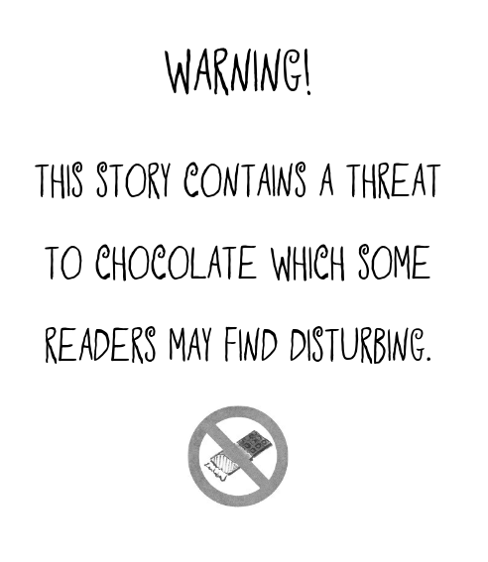
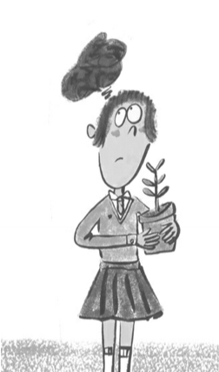

Slide 3
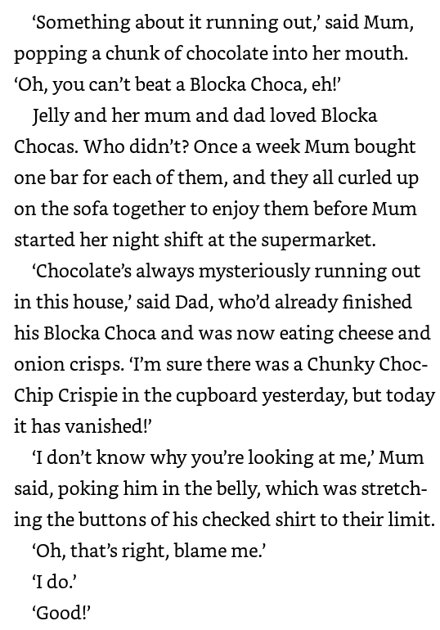
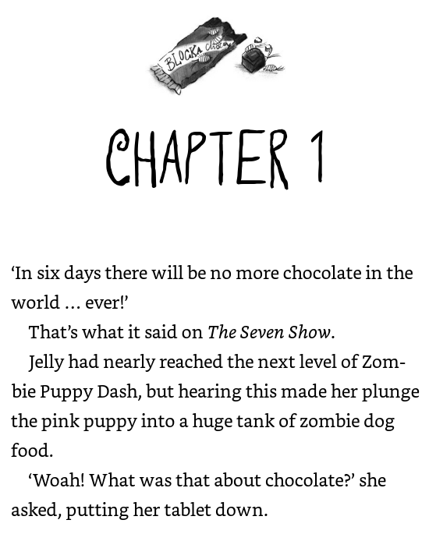

Slide 4
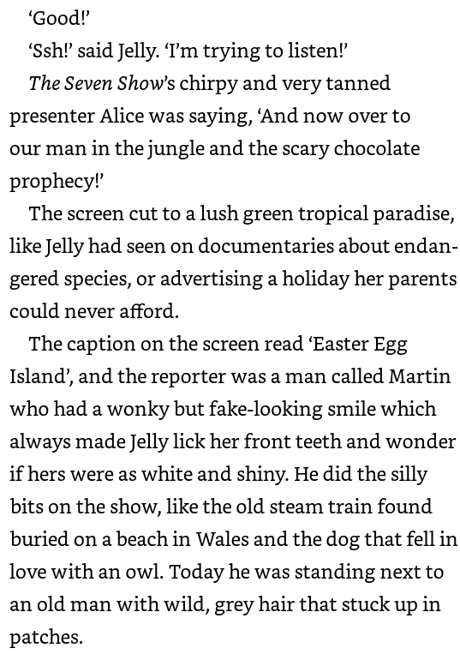
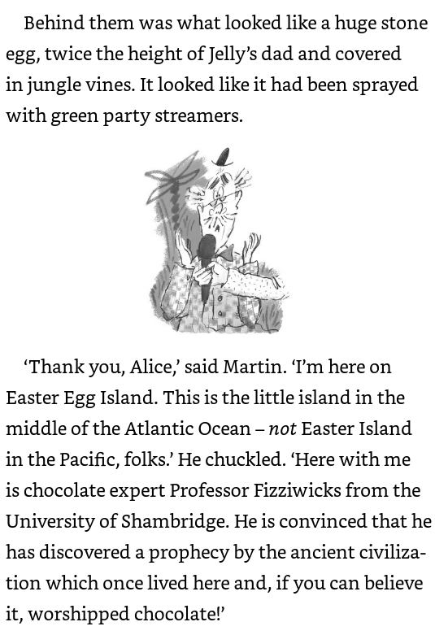

Slide 5
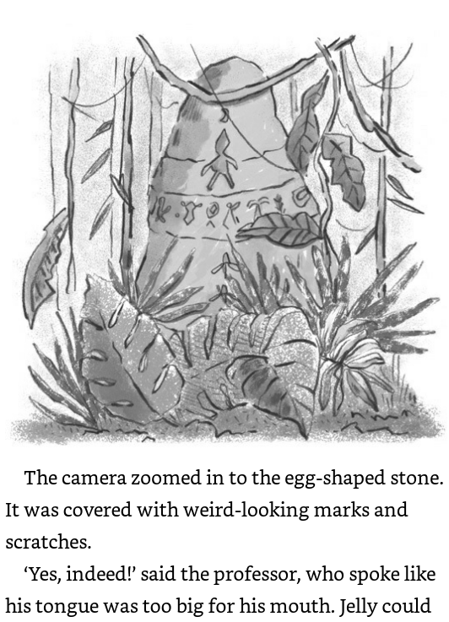
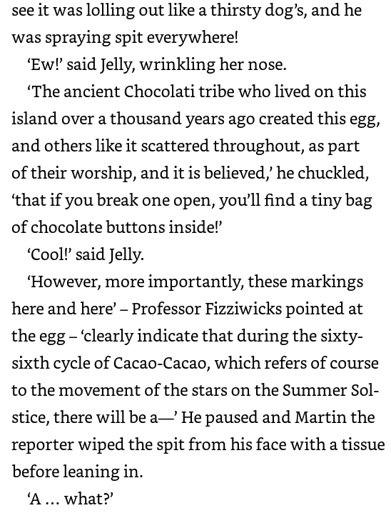

Slide 6
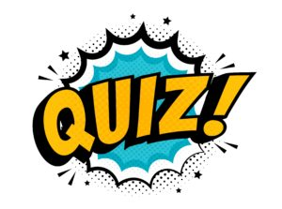

Slide 7
Jelly’s family all enjoy eating……..
Jelly
Blocka Choca
Dairy Milk

Slide 8
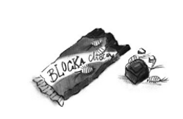
2. Blocka Choca

Slide 9
The man on The Seven Show was reporting from……
Christmas Island
Chocolate Island
Easter Egg Island

Slide 10
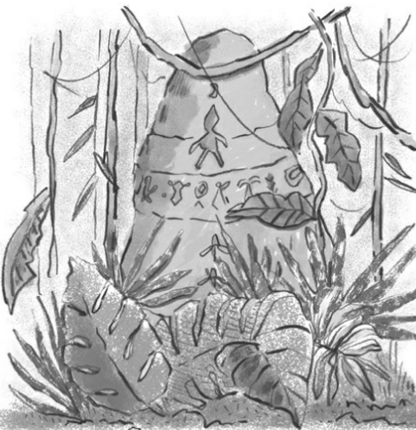
3. Easter Egg Island

Slide 11
What is believed to be inside the giant egg?
A tiny bag of chocolate buttons
A bar of Blocka Choca
A chocolate fountain

Slide 12
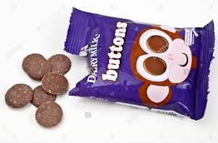
A tiny bag of chocolate buttons

Slide 13
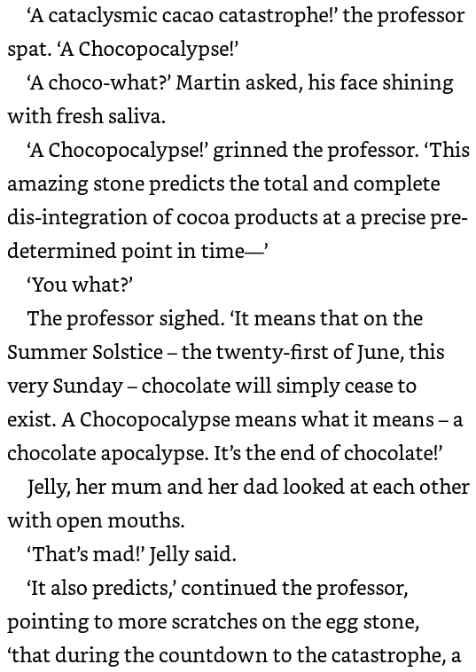
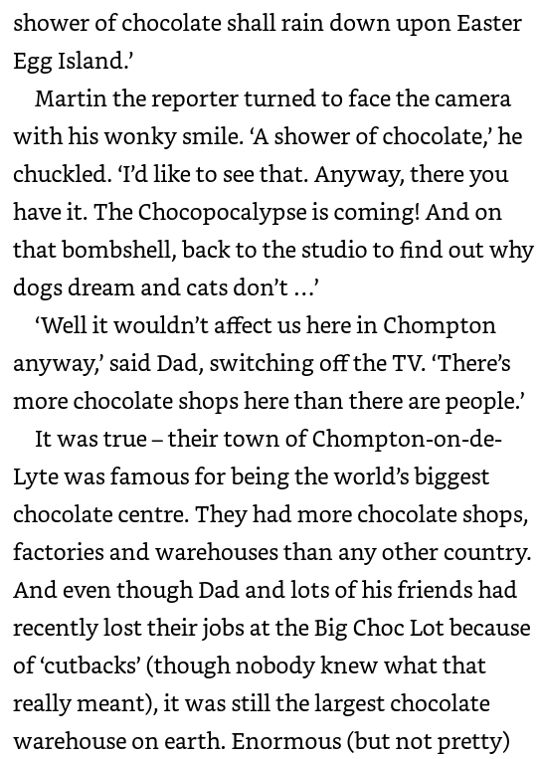

Slide 14
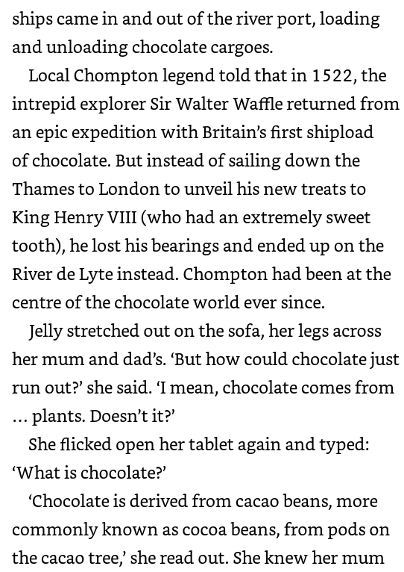
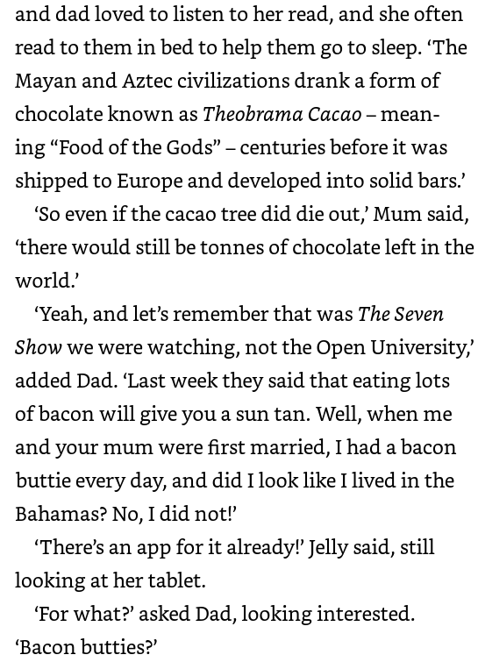

Slide 15
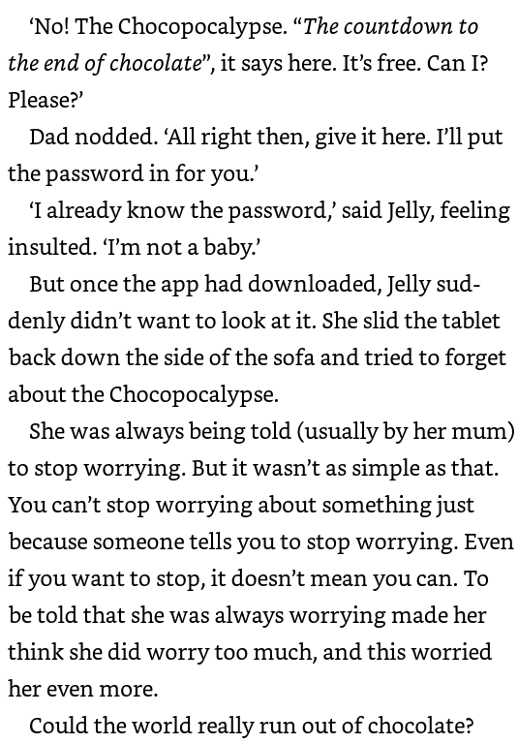
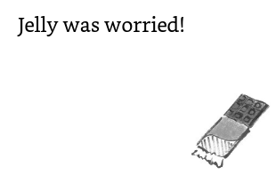

Slide 16
