Slide 1


Slide 3
1) Represent the number 513 on the chart.
2) Represent the number 5,130 on the chart.
3) Represent the number 51,300 on the chart.
4) What do you notice?
HTh | TTh | Th | H | T | O
HTh | TTh | Th | H | T | O
HTh | TTh | Th | H | T | O

Slide 4

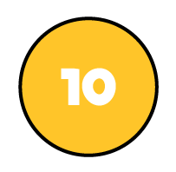

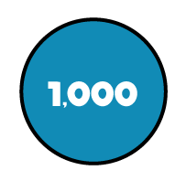
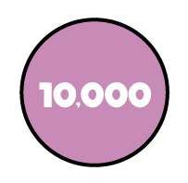
Draw the table on your whiteboard.
1) Represent the number 513 on the chart.
2) Represent the number 5,130 on the chart.
3) Represent the number 51,300 on the chart.
4) What do you notice?
HTh | TTh | Th | H | T | O
HTh | TTh | Th | H | T | O
HTh | TTh | Th | H | T | O
Same number of counters
Moved 1 column to the left

Slide 6
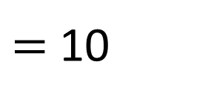

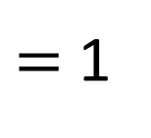
How many ones are there in 10?
$=$ 1
$=$
$=$ 10
There are 10 ones in 1 ten.

Slide 7
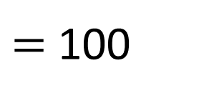

How many tens are there in 100?
$=$
$=$ 100
There are 10 tens in 1 hundred.

Slide 8
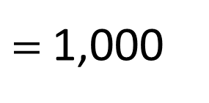

How many hundreds are there in 1,000?
$$=$$
$=$ 1,000
There are 10 hundreds in 1 thousand.

Slide 9

There are 10 ones in 1 ten.
There are 10 tens in 1 hundred.
There are 10 hundreds in 1 thousand.
HTh | TTh | Th | H | T | O
How many ten-thousands are there in 1 hundred-thousand?
What do you notice?
10
Have a think

Slide 10
There are 10 ones in 1 ten.
There are 10 tens in 1 hundred.
There are 10 hundreds in 1 thousand.
How many tens are there in 200?
20
10 tens
10 tens

Slide 11
There are 10 ones in 1 ten.
There are 10 tens in 1 hundred.
There are 10 hundreds in 1 thousand.
20
How many hundreds are there in 2,000?
10 hundreds
10 hundreds
Have a think

Slide 12
There are 10 ones in 1 ten.
There are 10 tens in 1 hundred.
There are 10 hundreds in 1 thousand.
How many hundreds are there in 5,000?
Have a think
5
There are hundreds in 1,000 and thousands in 5,000
This means there are hundreds in 5,000
10
50

Slide 13
There are 10 ones in 1 ten.
There are 10 tens in 1 hundred.
There are 10 hundreds in 1 thousand.
52
How many hundreds are there in 5,200?
Have a think

Slide 14
Have a go at questions
1 - 3 on the worksheet

Slide 15
100,000 | 200,000 | 300,000 | 400,000 | 500,000 | 600,000 | 700,000 | 800,000 | 900,000
10,000 | 20,000 | 30,000 | 40,000 | 50,000 | 60,000 | 70,000 | 80,000 | 90,000
1,000 | 2,000 | 3,000 | 4,000 | 5,000 | 6,000 | 7,000 | 8,000 | 9,000
100 | 200 | 300 | 400 | 500 | 600 | 700 | 800 | 900
10 | 20 | 30 | 40 | 50 | 60 | 70 | 80 | 90
1 | 2 | 3 | 4 | 5 | 6 | 7 | 8 | 9
What number is 10 times the size of 3?

Slide 16
100,000 | 200,000 | 300,000 | 400,000 | 500,000 | 600,000 | 700,000 | 800,000 | 900,000
10,000 | 20,000 | 30,000 | 40,000 | 50,000 | 60,000 | 70,000 | 80,000 | 90,000
1,000 | 2,000 | 3,000 | 4,000 | 5,000 | 6,000 | 7,000 | 8,000 | 9,000
100 | 200 | 300 | 400 | 500 | 600 | 700 | 800 | 900
10 | 20 | 30 | 40 | 50 | 60 | 70 | 80 | 90
1 | 2 | 3 | 4 | 5 | 6 | 7 | 8 | 9
What number is 10 times the size of 6?
What do you notice?
Have a think
If the counter moves up 1 row then the number is times the size.
10

Slide 17
100,000 | 200,000 | 300,000 | 400,000 | 500,000 | 600,000 | 700,000 | 800,000 | 900,000
10,000 | 20,000 | 30,000 | 40,000 | 50,000 | 60,000 | 70,000 | 80,000 | 90,000
1,000 | 2,000 | 3,000 | 4,000 | 5,000 | 6,000 | 7,000 | 8,000 | 9,000
100 | 200 | 300 | 400 | 500 | 600 | 700 | 800 | 900
10 | 20 | 30 | 40 | 50 | 60 | 70 | 80 | 90
1 | 2 | 3 | 4 | 5 | 6 | 7 | 8 | 9
What number is 100 times the size of 6?
What do you notice?
Have a think
If the counter moves up 2 rows then the number is times the size.
100

Slide 18
100,000 | 200,000 | 300,000 | 400,000 | 500,000 | 600,000 | 700,000 | 800,000 | 900,000
10,000 | 20,000 | 30,000 | 40,000 | 50,000 | 60,000 | 70,000 | 80,000 | 90,000
1,000 | 2,000 | 3,000 | 4,000 | 5,000 | 6,000 | 7,000 | 8,000 | 9,000
100 | 200 | 300 | 400 | 500 | 600 | 700 | 800 | 900
10 | 20 | 30 | 40 | 50 | 60 | 70 | 80 | 90
1 | 2 | 3 | 4 | 5 | 6 | 7 | 8 | 9
To find the number 1,000 times the size, the counter will move .
3 rows up

Slide 19
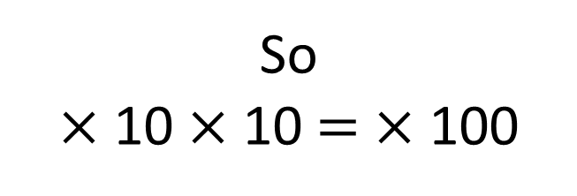
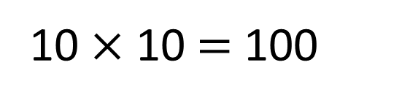
100,000 | 200,000 | 300,000 | 400,000 | 500,000 | 600,000 | 700,000 | 800,000 | 900,000
10,000 | 20,000 | 30,000 | 40,000 | 50,000 | 60,000 | 70,000 | 80,000 | 90,000
1,000 | 2,000 | 3,000 | 4,000 | 5,000 | 6,000 | 7,000 | 8,000 | 9,000
100 | 200 | 300 | 400 | 500 | 600 | 700 | 800 | 900
10 | 20 | 30 | 40 | 50 | 60 | 70 | 80 | 90
1 | 2 | 3 | 4 | 5 | 6 | 7 | 8 | 9
10 times the size
100 times the size
10 times the size
10 $×$ 10 $=$ 100
So
$×$ 10 $×$ 10 $=$ $×$ 100

Slide 20
100,000 | 200,000 | 300,000 | 400,000 | 500,000 | 600,000 | 700,000 | 800,000 | 900,000
10,000 | 20,000 | 30,000 | 40,000 | 50,000 | 60,000 | 70,000 | 80,000 | 90,000
1,000 | 2,000 | 3,000 | 4,000 | 5,000 | 6,000 | 7,000 | 8,000 | 9,000
100 | 200 | 300 | 400 | 500 | 600 | 700 | 800 | 900
10 | 20 | 30 | 40 | 50 | 60 | 70 | 80 | 90
1 | 2 | 3 | 4 | 5 | 6 | 7 | 8 | 9
What number is one-tenth the size of 430?
43 is one-tenth the size of 430

Slide 21
100,000 | 200,000 | 300,000 | 400,000 | 500,000 | 600,000 | 700,000 | 800,000 | 900,000
10,000 | 20,000 | 30,000 | 40,000 | 50,000 | 60,000 | 70,000 | 80,000 | 90,000
1,000 | 2,000 | 3,000 | 4,000 | 5,000 | 6,000 | 7,000 | 8,000 | 9,000
100 | 200 | 300 | 400 | 500 | 600 | 700 | 800 | 900
10 | 20 | 30 | 40 | 50 | 60 | 70 | 80 | 90
1 | 2 | 3 | 4 | 5 | 6 | 7 | 8 | 9
What number is one-hundredth the size of 7,200?
72
is one-hundredth the size of 7,200
Have a think

Slide 22
100,000 | 200,000 | 300,000 | 400,000 | 500,000 | 600,000 | 700,000 | 800,000 | 900,000
10,000 | 20,000 | 30,000 | 40,000 | 50,000 | 60,000 | 70,000 | 80,000 | 90,000
1,000 | 2,000 | 3,000 | 4,000 | 5,000 | 6,000 | 7,000 | 8,000 | 9,000
100 | 200 | 300 | 400 | 500 | 600 | 700 | 800 | 900
10 | 20 | 30 | 40 | 50 | 60 | 70 | 80 | 90
1 | 2 | 3 | 4 | 5 | 6 | 7 | 8 | 9
413 is the size of 413,000
one-thousandth
Have a think

Slide 23
Have a go at the rest of the worksheet

Slide 24
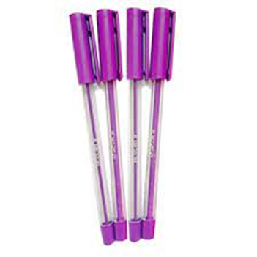
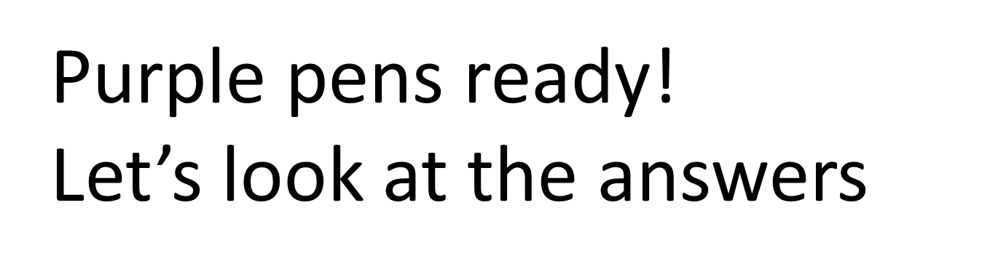

Slide 25
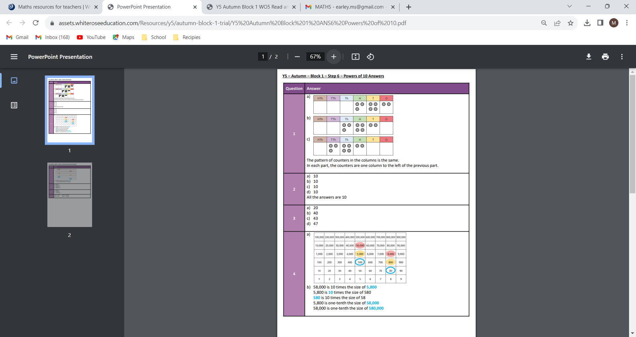

Slide 27
