Slide 2

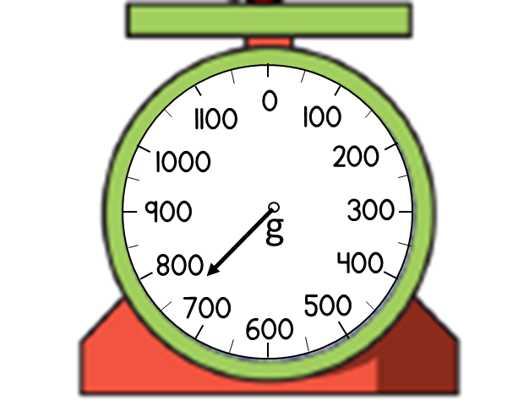
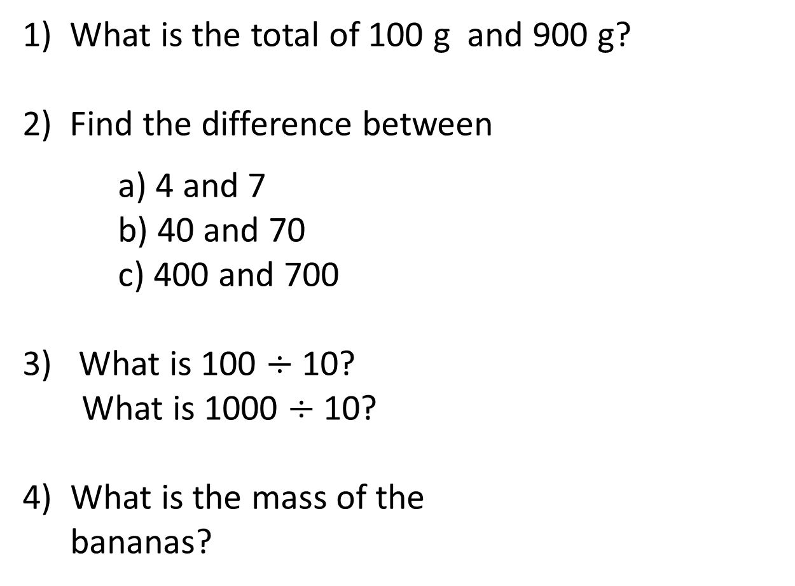
1) What is the total of 100 g and 900 g?
2) Find the difference between
a) 4 and 7
b) 40 and 70
c) 400 and 700
3) What is 100 $÷$ 10?
What is 1000 $÷$ 10?
4) What is the mass of the
bananas?

Slide 3
1) What is the total of 100 g and 900 g?
2) Find the difference between
a) 4 and 7
b) 40 and 70
c) 400 and 700
3) What is 100 $÷$ 10?
What is 1000 $÷$ 10?
4) What is the mass of the
bananas?
1000 g or 1 kg
3
30
300
10
100
750 g

Slide 5
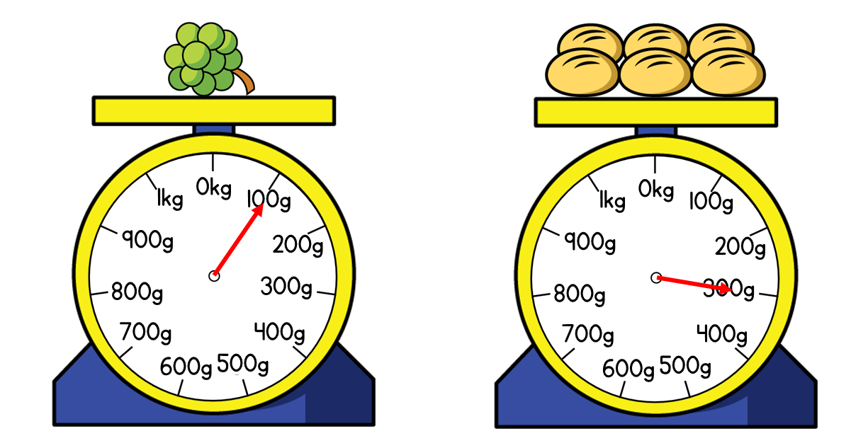

What do you notice? What can you find out?
The mass of the grapes is 100 g.
The mass of the bread rolls is 300 g.
Have a think
The total mass of the rolls and grapes is 400 g.
The rolls are 200 g heavier than the grapes.

Slide 6
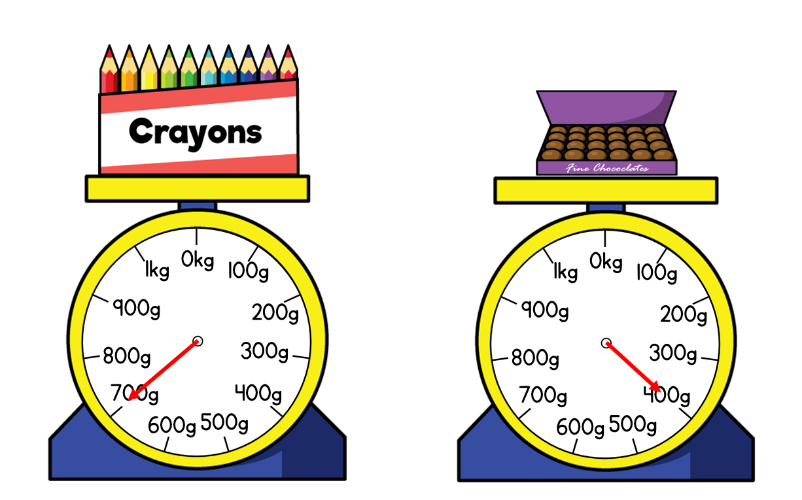
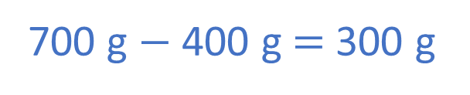
What is the difference between the mass of the crayons and the mass of the chocolates?
700 g $−$ 400 g $=$ 300 g
Have a think
300 g
0
700
800
400
500
600
700
100
200
300
400

Slide 7


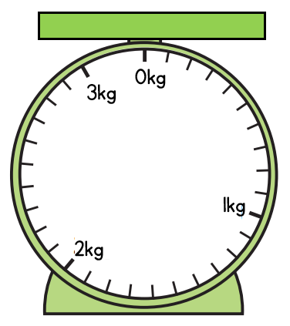
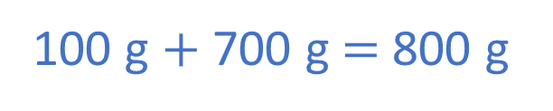
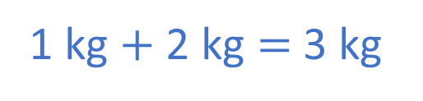
What is total mass of the vase and the fish tank?
1 kg and 100 g
2 kg and 700 g
Have a think
1 kg $+$ 2 kg $=$ 3 kg
100 g $+$ 700 g $=$ 800 g
The total mass is 3 kg and 800 g.

Slide 8

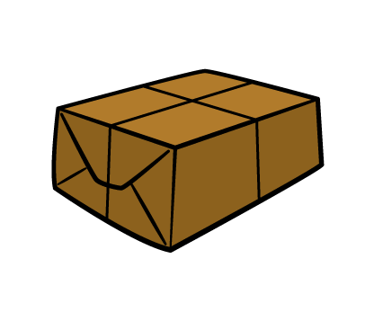
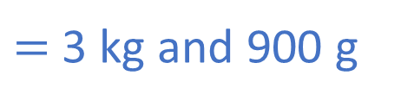
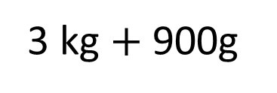
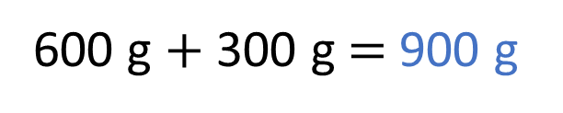
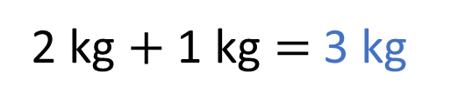
What is total mass of the tractor and the parcel?
2 kg and 600 g
1 kg and 300 g
2 kg $+$ 1 kg $=$ 3 kg
600 g $+$ 300 g $=$ 900 g
3 kg $+$ 900g
$=$ 3 kg and 900 g

Slide 9
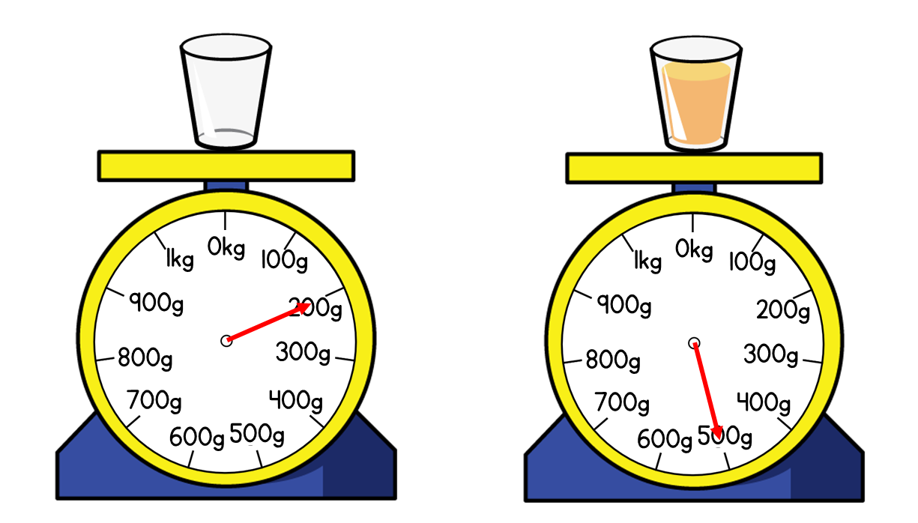
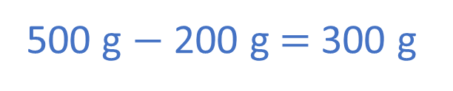
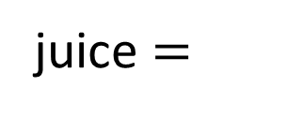


What is the mass of the orange juice?
200 g
500 g
Have a think
glass $=$ 200 g
glass $=$ 200 g
juice $=$
300 g
?
500 g $−$ 200 g $=$ 300 g
500 g

Slide 10
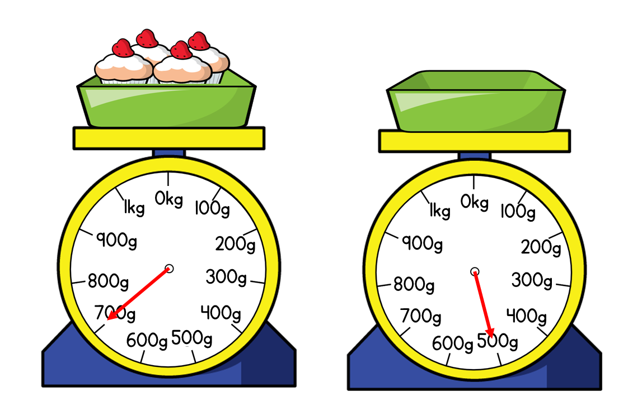
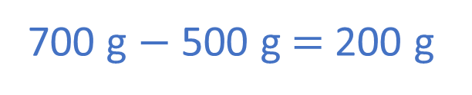
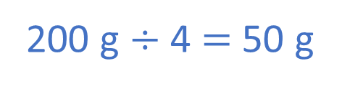
What is the mass of one cupcake?
700 g
500 g
Have a think
700 g $−$ 500 g $=$ 200 g
200 g $÷$ 4 $=$ 50 g
One cupcake has a mass of 50 g.

