Slide 1



Welcome to Year 5
Meet the Teacher
Miss Igid, Miss Spooner & Mrs Bartlett

Slide 2
Topics for the Year
Autumn 1 | Autumn 2 | Spring 1 | Spring 2 | Summer 1 | Summer 2
Japan | Out of this World - Space | Victorious Victorians | The living Planet - Life cycles | I spy you - Detectives | Greece lightning -Ancient Greeks

Slide 3




Slide 4

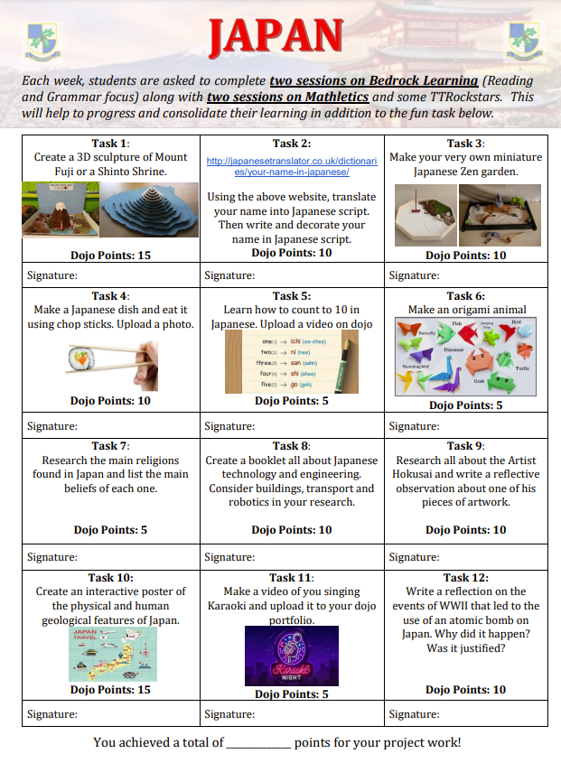


Homework books are due in on a Monday.
They are then sent home on Wednesday.
If homework has not been completed for that week, it does not need to be handed in.
Mathletics is assigned by the class teacher, we are waiting on logins.
We encourage a minimum of 4 pieces of homework to be completed across the half term.

Slide 5

Stationery
General stationery is provided by the school.
If children do bring in their own pencil case, please make sure it is small enough for their tray and does not distract from their learning.

Slide 6

Reading
Each class has a weekly library slot where they can choose a book to read for pleasure, which can be taken home.
We do weekly Vipers reading comprehension sessions as a whole class.
Reading Buddies will continue this year with Year 1’s.
Whole class reading takes place daily*.
*In various forms and subject to time.

Slide 7

Spellings
Spellings are set every Friday and shared on Dojo. These will be checked the following Friday.
During the week, tasks will be done in class linked to the spellings and the spelling rule.

Slide 8
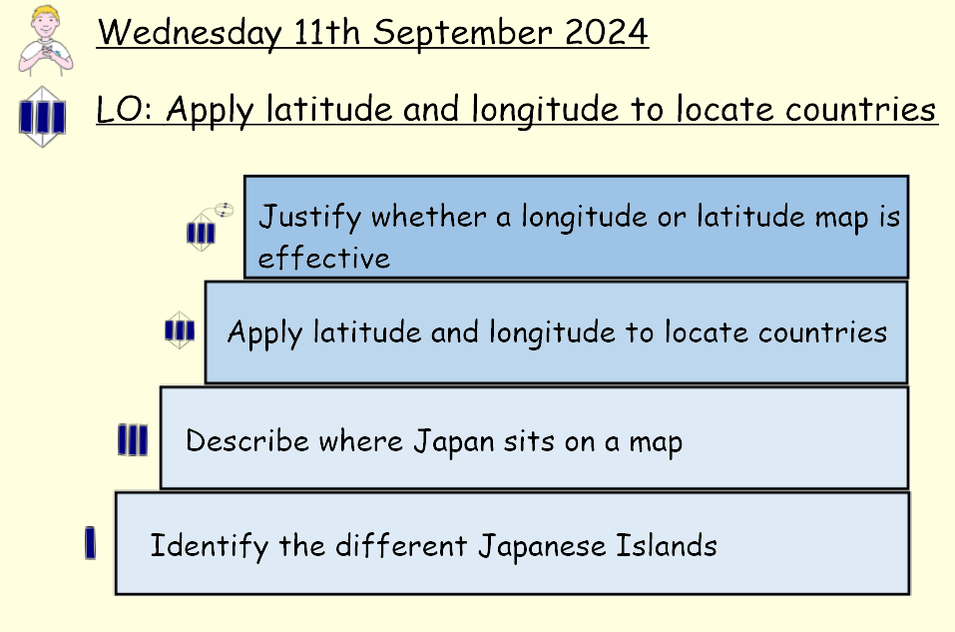

Slide 9

Dojo
Dojo is used for positive praise rewards in class and for homework tasks. These are collated and counted at the end of the week for each house.
The direct messaging section on Dojo is not used. If there is an emergency please contact the office.
If there are any last minute changes to end of the day pick-ups, please contact the office directly.

Slide 10
ASPIRE
We have a weekly Aspire assembly where up to 3 children from each class can be awarded a certificate.

Slide 11
After School Clubs and School Trips
Information regarding clubs will be sent out via Parent Pay.
During our ‘Out of this World’ topic (Autumn 2), we plan to go to the Science museum in London for our school trip.
We also intend to have a further school trip planned for some time during the rest of the school year.
More information on this will be provided nearer to the event(s).

Slide 12
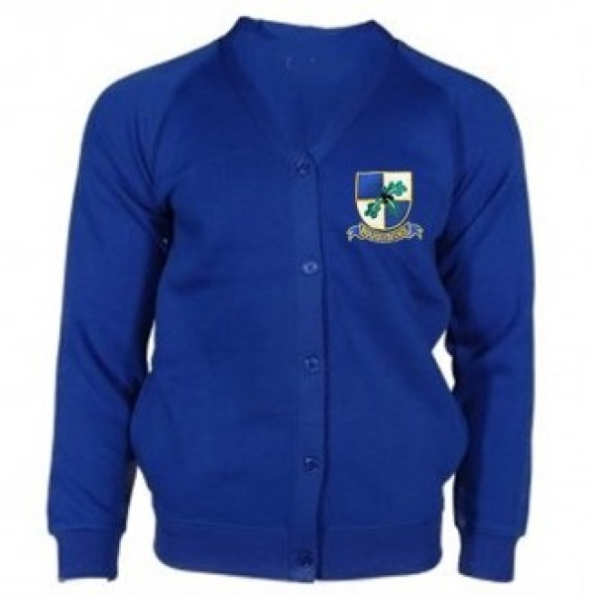

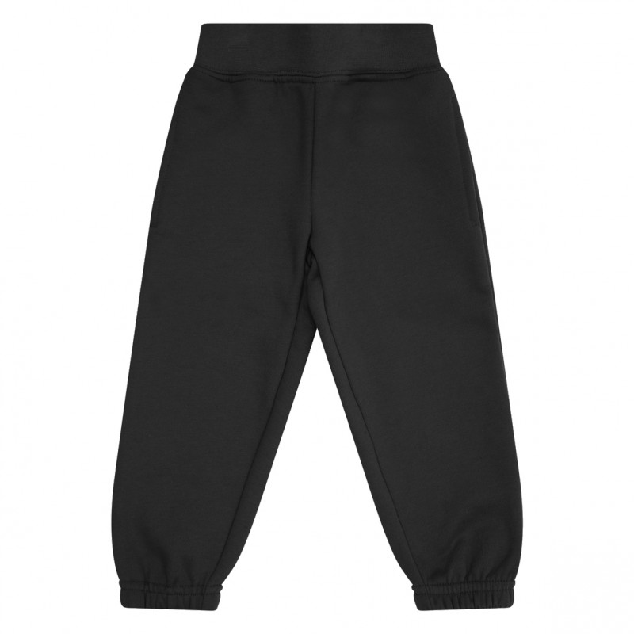
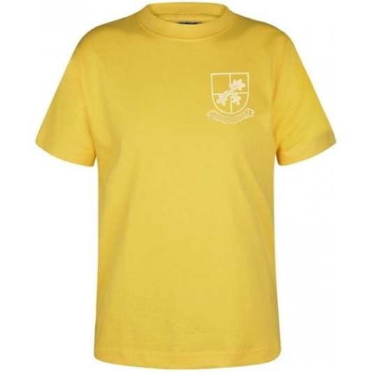
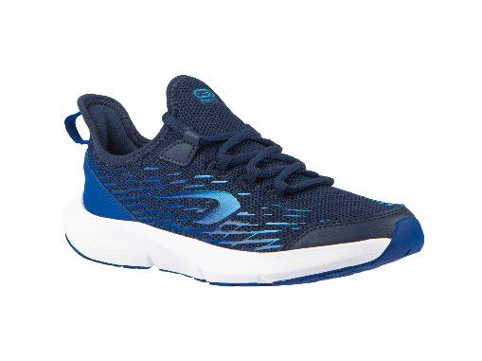
Uniform and PE
Please clearly name every piece of your child’s uniform.
Sports Day will be in July (date tbc).
On PE days, no jewellery is to be worn and earrings cannot be taped up.
Hair must be tied back.
No zips and hoodies.
This is all due to health and safety.
PE Days in Year 5 are on Tuesday and Friday.

Slide 13

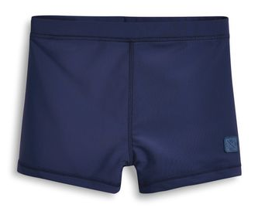

Swimming
As part of the National curriculum, during Year 5 the children will be taking swimming lessons. These are arranged and paid for by the school.
Presently, due to the demand created Post –COVID, this will be an intense course.
Swimming will start this Autumn term.
All children need to wear ‘fitted’ swimming trunks/all in one costumes. Every child must has a swimming hat and their own towel.
Please clearly name every piece of your child’s swimming gear.

Slide 14


Walking to School and Mobile phones
In Year 5 & 6, the children are allowed to walk to and from school. Please let the office know this in advance.
As children are allowed to walk to school, mobile phones are allowed to be brought. If they are brought into school, they will be given to their teacher on arrival and given back at the end of the day.

Slide 15

Any questions?

