Slide 1
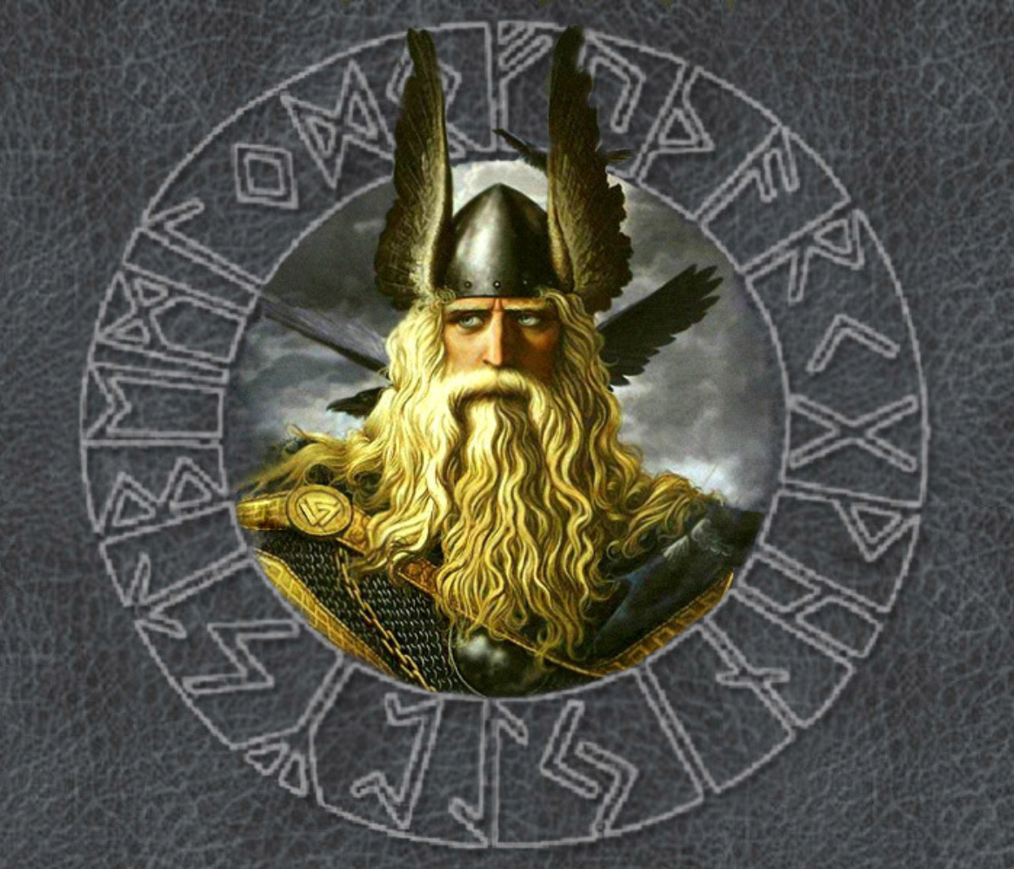

Anglo-Saxon Gods and the Days of the Week

Slide 2
The Anglo-Saxon tribes that arrived in Britain were pagan which meant they worshipped many gods, with each god controlling a particular part of their everyday life, including the family, the growing of the crops, the weather, and in particular, war and death!
The days of the week that we all recognise today are indeed named after the mainly Anglo-Saxon gods that controlled everyday life.

Slide 3
Monday – Monandæg (Moon’s day – the day of the moon)
Tuesday – Tiwesdæg (Tiw’s-day – the day of the god of war and combat. Tiw, was also known as the sky god and was recognised as the most skilled in swordplay… despite having only one hand! He was also famed for his honour, justice and courage)
Wednesday – Wodnesdæg (Woden’s day – the day of the chief Anglo-Saxon god Woden. Anglo-Saxon warriors would look to him to protect them on the battlefield. In particular they believed he could guide their spear arms, as the spear was Woden’s sacred weapon)

Slide 4
Thursday – Ðunresdæg (Thunor’s Day – the day of the god Ðunor or Thunor. Thunor is recognised as the hammer-wielding god associated with thunder and lightning. His hammer shaped amulets have been found in many an Anglo-Saxon grave)
Friday – Frigedæg (Frige’s day – the day of the goddess Frige, wife to Woden. Woden’s wife was the goddess of love and was associated with all things to do with home, marriage and children. Recognised as the mother of the earth, the Anglo-Saxons would look to her to provide a good harvest)
Saturday – Sæternesdæg (Saturn’s day – the day of the Roman god Saturn)
Sunday – Sunnandæg (Sun’s day – the day of the sun).

Slide 5
Give three things that the Anglo-Saxons believed their gods controlled.
Which god only had one hand? How do you think he may have lost it?
Which days are not named after Anglo-Saxon gods?
What was Woden’s secret weapon?
Name three things Tiw was god of.
Who could guide a spear on the battle field? Why did Anglo-Saxons believe this?
Which god wielded a hammer?
Why do you think the Anglo-Saxons believd that it was Frige who helped provide a good harvest?

Slide 6
Give three things that the Anglo-Saxons believed their gods controlled. The family, the growing of the crops, the weather, war and death (everyday life).
Which god only had one hand? How do you think he may have lost it?Tiw. He may have lost it in battle as he was the god of war.
Which days are not named after Anglo-Saxon gods? Monday, Saturday and Sunday
What was Woden’s sacred weapon? His spear
Name three things Tiw was god of. The god of war, combat and the sky
Who could guide a spear on the battle field? Why did Anglo-Saxons believe this? Woden. The spear was Woden’s sacred weapon.
Which god wielded a hammer? Thunor
Why do you think the Anglo-Saxons believed that it was Frige who helped provide a good harvest? Because she was the mother of the earth

