Slide 1
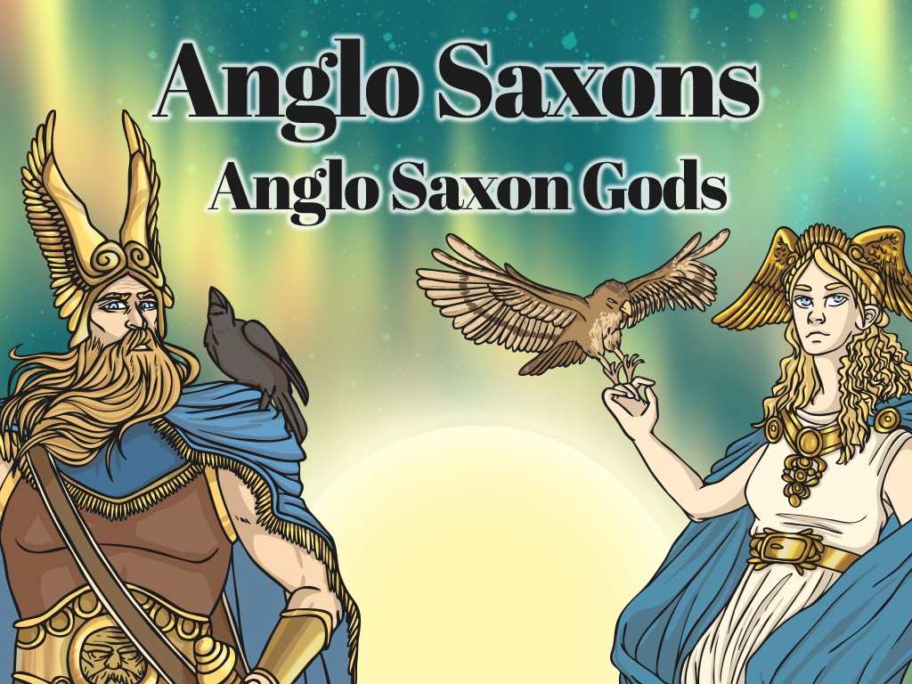


Slide 2
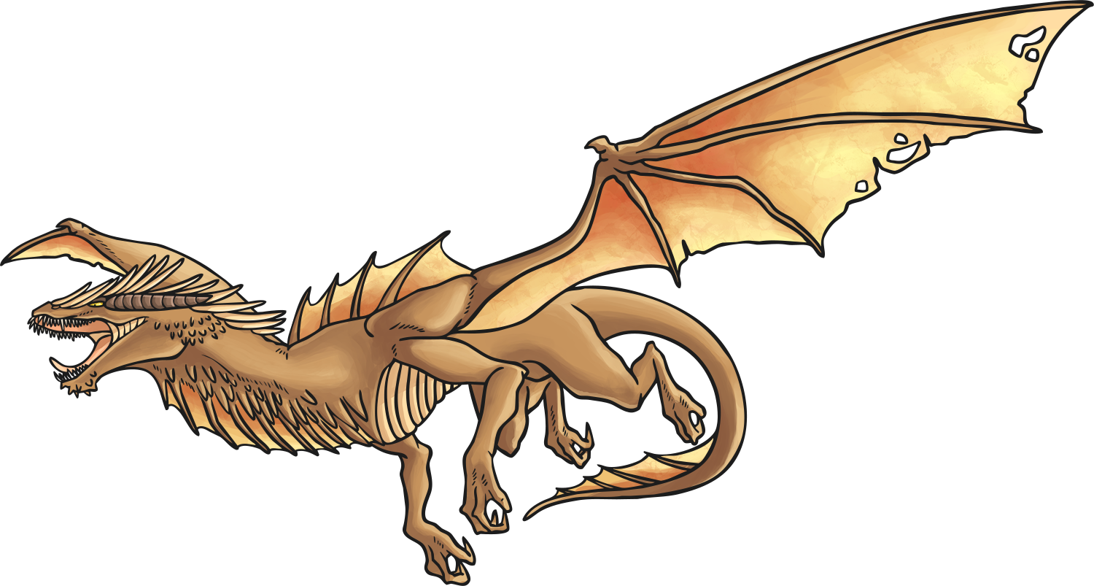

The Anglo Saxons were Pagan when they first came to Britain.
The Anglo Saxons believed in many gods.
The Anglo Saxons believed that magic spells and lucky charms would protect them.
The Anglo Saxons thought that burning down crops would keep ghosts away.
The Anglo Saxons believed in dragons and elves.

Slide 3
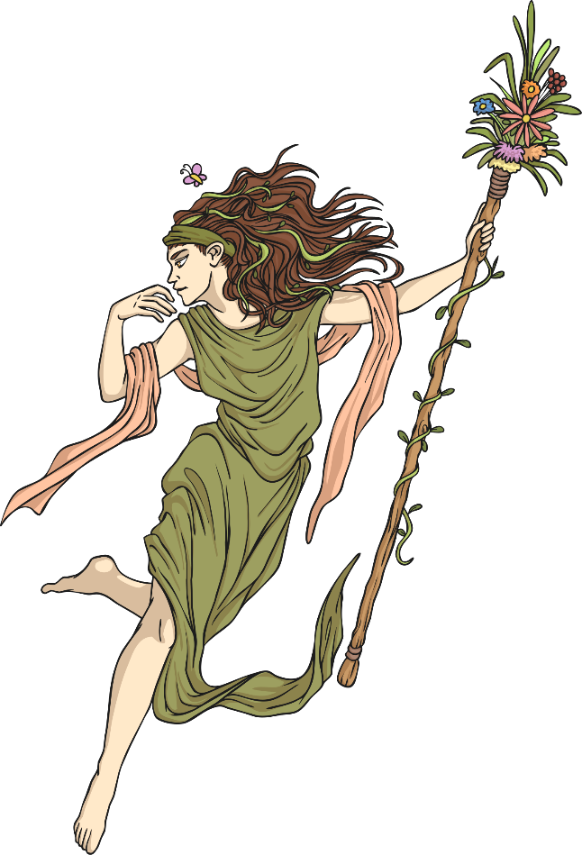
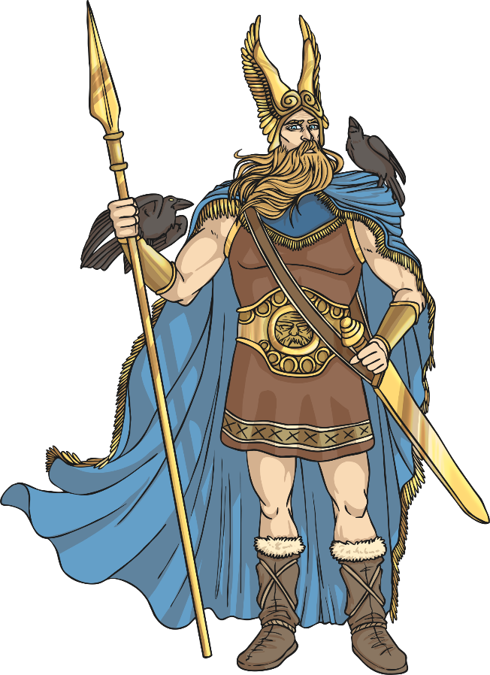
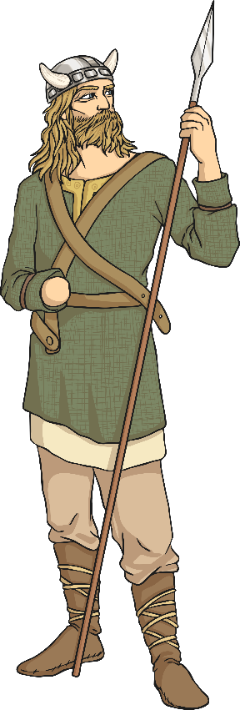
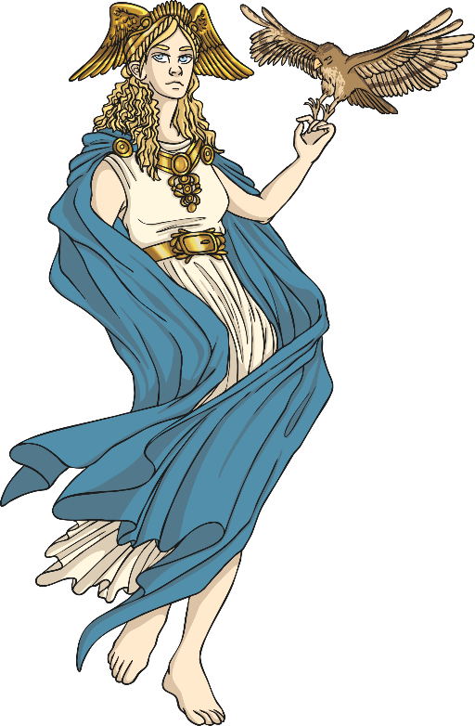
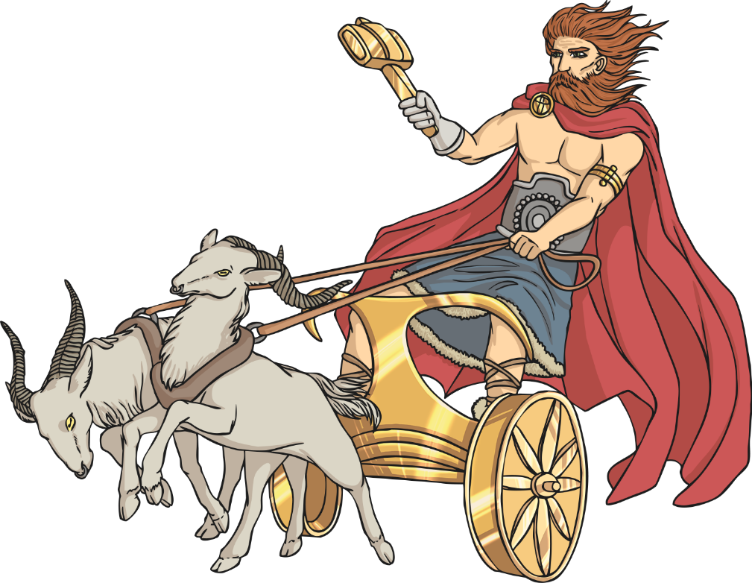
Paganism
The religion of the early Anglo Saxon people was Paganism. Paganism is a polytheistic religion, which means many gods are worshipped.

Slide 4
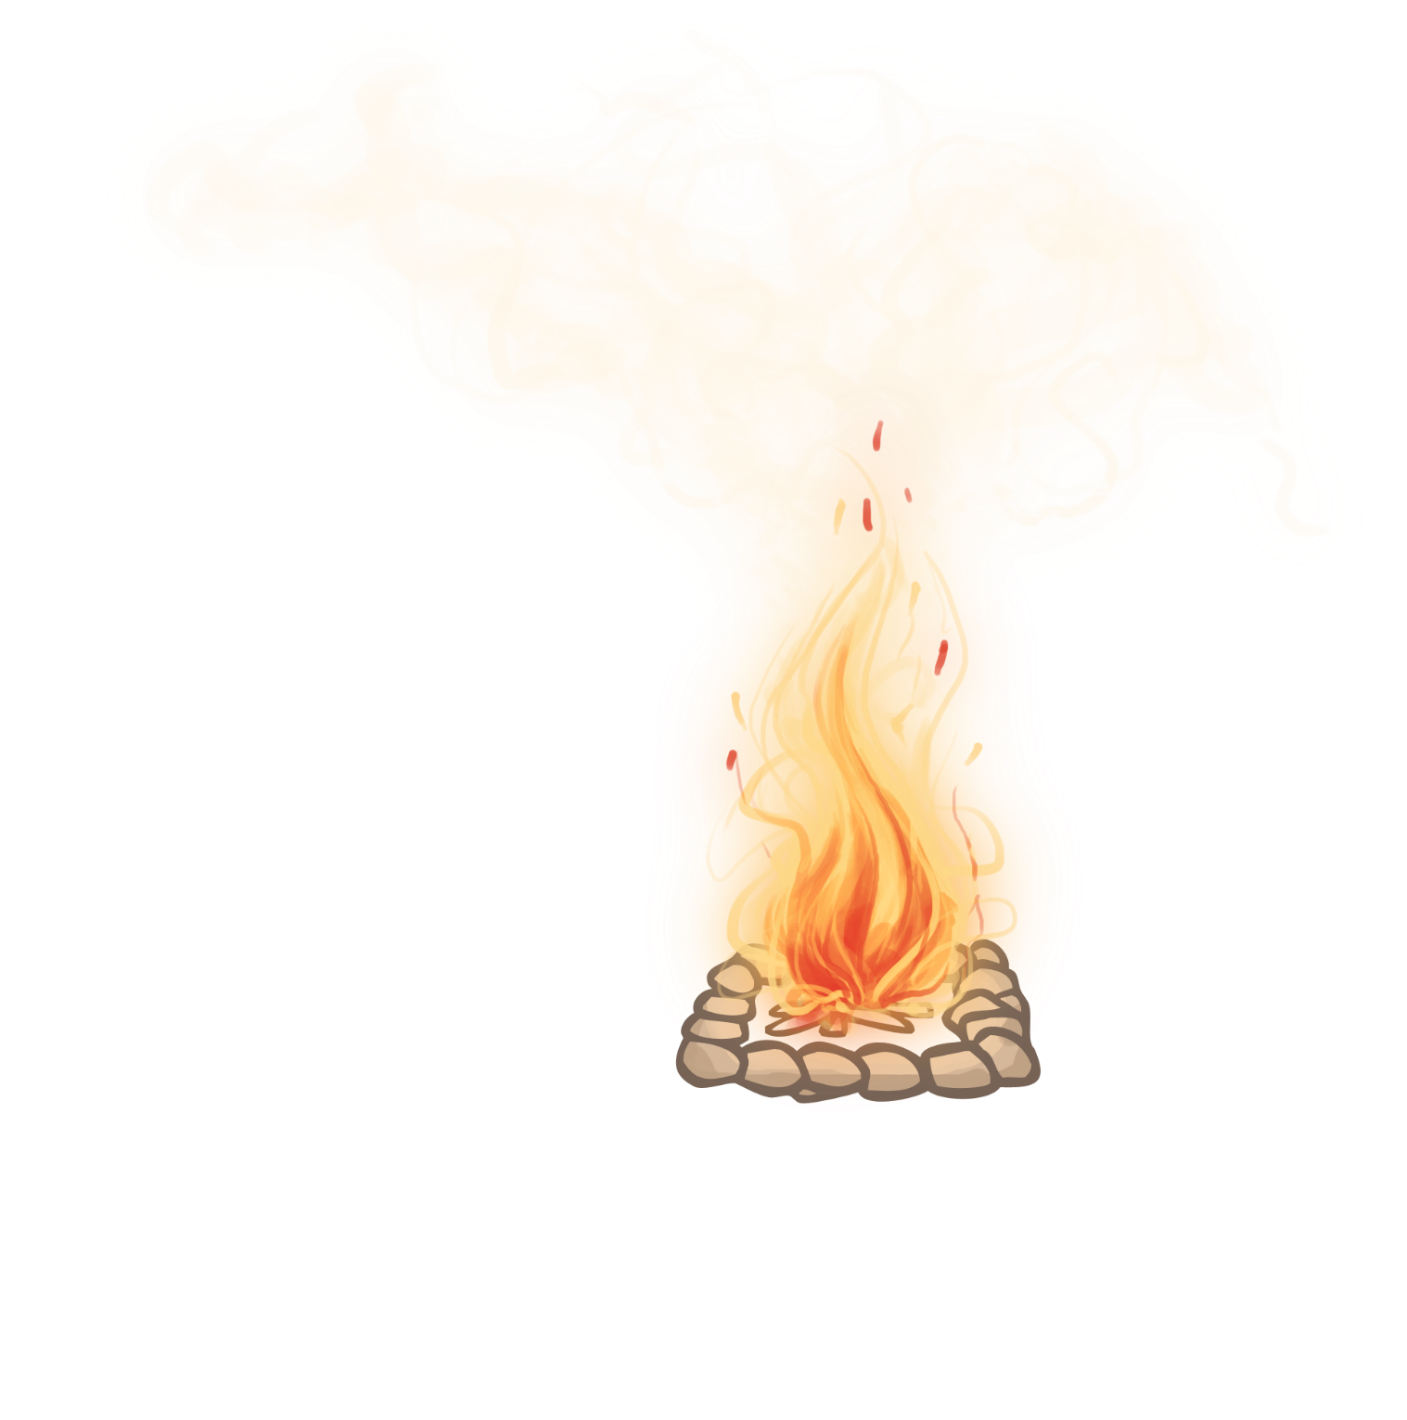
Festivals
There were many Anglo Saxon festivals throughout the year. During the festivals different gods were worshipped.
The people would pray to the gods and make sacrifices of objects and animals. It is believed that bonfires were common during the festivals and that people would dance around or over them and throw herbs and other offerings into the flames.

Slide 5
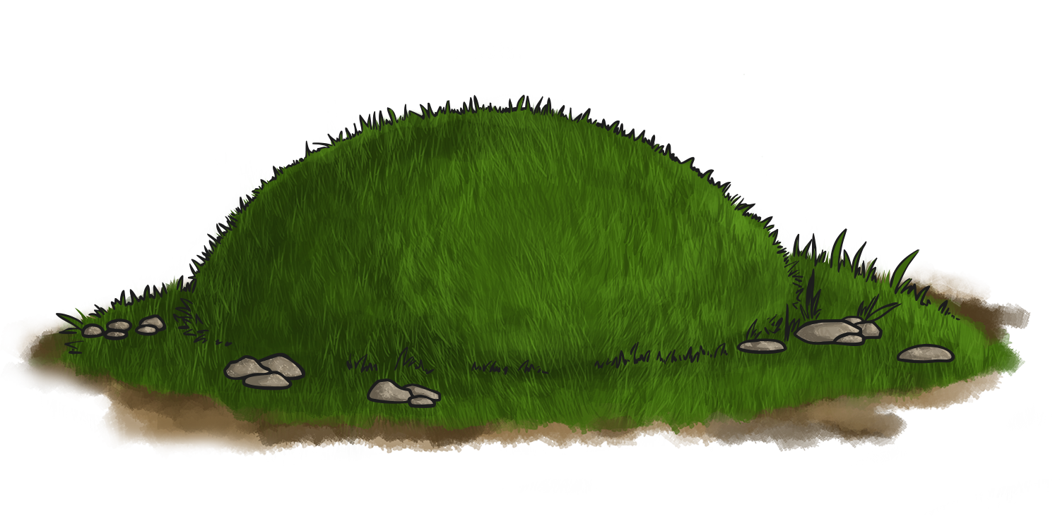
Magic and Spells
The Anglo Saxon people were very superstitious.
They believed in good and bad omens, lucky charms, spells and magic as they thought that these things could influence what happened in different aspects of their lives.
The Anglo Saxons performed many rituals that they believed would protect them in this life and the next. This was especially true about the way they dealt with the dead. It was common to bury a person with their belongings as the Anglo Saxons believed the dead person would need these in the afterlife. Some people were even buried with a slave or pet!

Slide 6



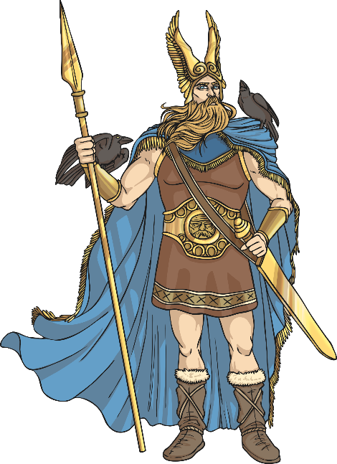
Anglo Saxon Gods
The Anglo Saxons believed in lots of different gods who they believed represented and were responsible for different things.
The people prayed to the gods in hope that they would offer protection or provide them with the things they needed.
Today we are going to learn about some of the main Anglo Saxon gods.

Slide 7

Woden
Woden was the chief of the Anglo Saxon gods.
He was the god of battle and war.
Woden was also believed to be the observer of humans and the Anglo Saxons thought he may visit them in disguise.
His special animal was the wolf and he had two wolves as pets.
His special object was a spear.
The day of the week Wednesday was named after him.

Slide 8

Frige
Frige was the wife of Woden.
She was the goddess of the household and childbirth and people would pray to her to ask for a good birth.
Her name means ‘beloved’.
Her symbols are the stork and the spinning wheel.
The day of the week Friday is named after her.

Slide 9

Thunor
Thunor was the god of thunder. He is also known as Thor.
Thunor was known as the protector of humans against threats.
He has a hammer as his symbol.
Goats are his special animal as they were believed to pull his chariot.
Thunor was the son of Woden and Frige.
The day of the week Thursday is named after him.

Slide 10

Tiw
Tiw is another god of war.
He is associated with being courageous and making sacrifices in battle.
His special animal is the wolf.
He is often shown with only one hand, as legend says a wolf bit off the other one.
The day of the week Tuesday is named after him.

