Slide 1
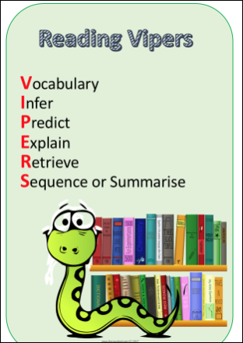



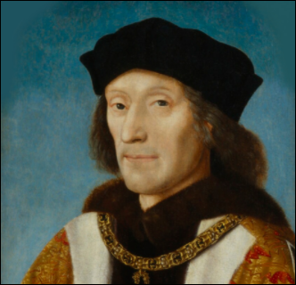
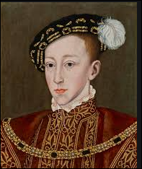
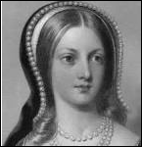
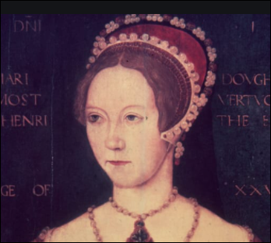
Henry VII Edward VI Lady Jane Grey Mary I

Slide 2
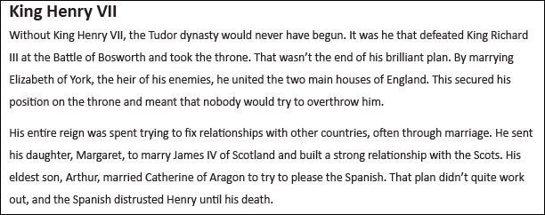
R Who did Henry VII defeat at the Battle of Bosworth?

Slide 3
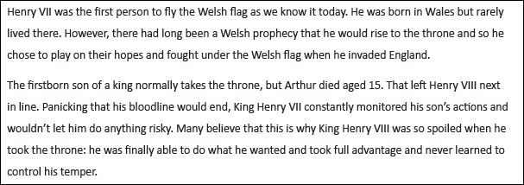
R How old was Prince Arthur when he died?
V Which word means “watched closely”?
I Why wouldn’t Henry VII (senior) let his son Prince Henry (Henry VIII) do anything risky?

Slide 4
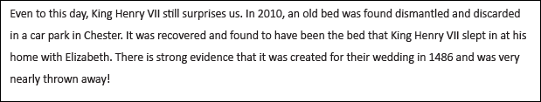
R What surprising thing happened in 2010?
I When did King Henry VII get married?

Slide 5
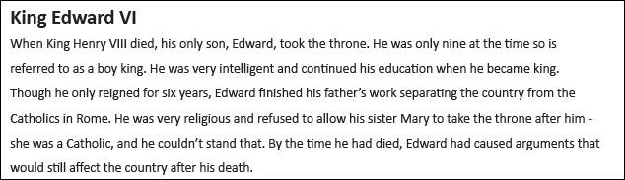
I Why was King Edward VI called the boy king?
I Who did King Edward VI dislike?

Slide 6
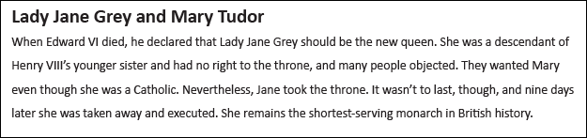
R Which monarch only reigned for 9 days?
V Find a word that tells you that people didn’t want Lady Jane on the throne.

Slide 7
QUESTIONS
R Who did Henry VII defeat at the Battle of Bosworth?
R How old was Prince Arthur when he died?
V Which word means “watched closely”?
I Why wouldn’t Henry VII (senior) let his son Prince Henry (Henry VIII) do anything risky?
R What surprising thing happened in 2010?
I When did King Henry VII get married?
I Why was he called the boy king?
I Who did King Edward VI dislike?
R Which Monarch only reigned for 9 days?
V Find a word that tells you that people didn’t want Lady Jane on the throne.

Slide 8
Answers
R Who did Henry VII defeat at the Battle of Bosworth? King Richard III
R How old was Prince Arthur when he died? 15
V Which word means “watched closely”? monitored
I Why wouldn’t Henry VII (senior) let his son Prince Henry (Henry VIII) do anything risky?
He didn’t want anything to happen to him as Prince Arthur had already died and Henry was his only other son who would become king after him.
R What surprising thing happened in 2010? King Henry VII’s bed was found in a car park
I When did King Henry VII get married? 1486
I Why was Edward VI called the boy king? Because he was only 9 when he became king.
I Who did King Edward VI dislike? Catholics
R Which monarch only reigned for 9 days? Lady Jane Grey
V Find a word that tells you that people didn’t want Lady Jane on the throne. objected

