Slide 2
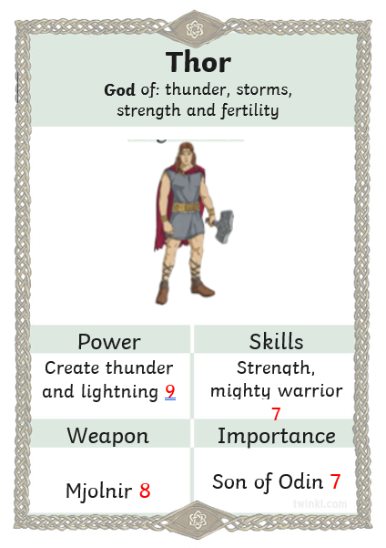
Lo: to create a top trump card for a Viking God.

Slide 3
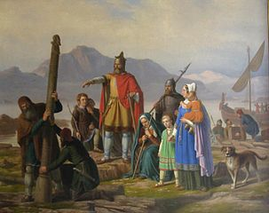
Norse Beliefs
Viking religion involved several worlds and several gods. They
also believed in an afterlife – but which afterlife you went to
depends on how you behaved in life.
Fact – Vikings were also called Norsemen.

Slide 4
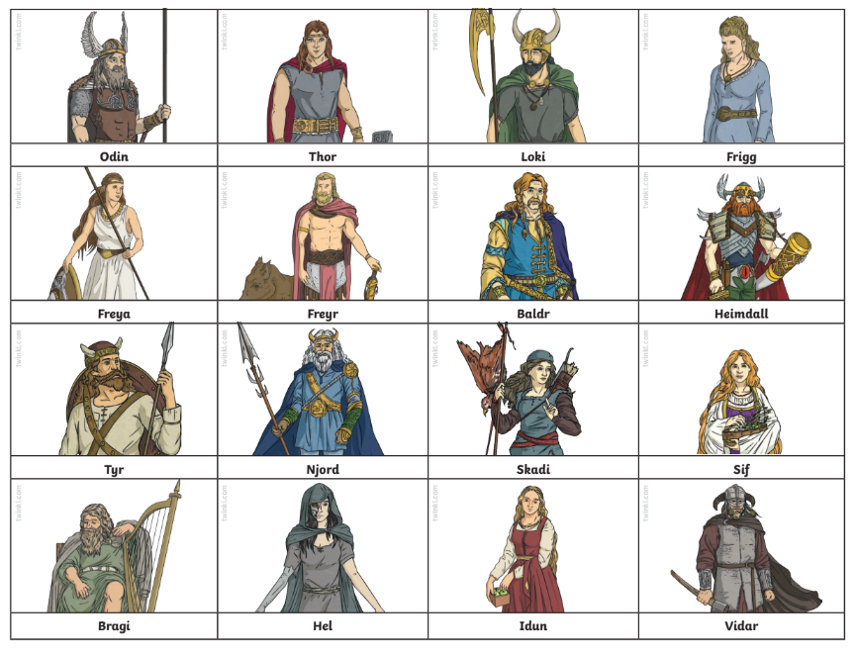

Slide 5
They believed that the world was actually a set of nine worlds.
These were called:
Midgard, the place where humans lived.
Asgard, the home of the Aesir gods and goddesses.
Vanaheim, the home of the Vanir gods and goddesses
Jotunheim, the home of the giants
Niflheim, a world of ice
Alfheim, the home of the elves
Svartalfheim, the home of the dwarves
Helheim, the home of the goddess Hel and the kingdom of the dead.

Slide 6
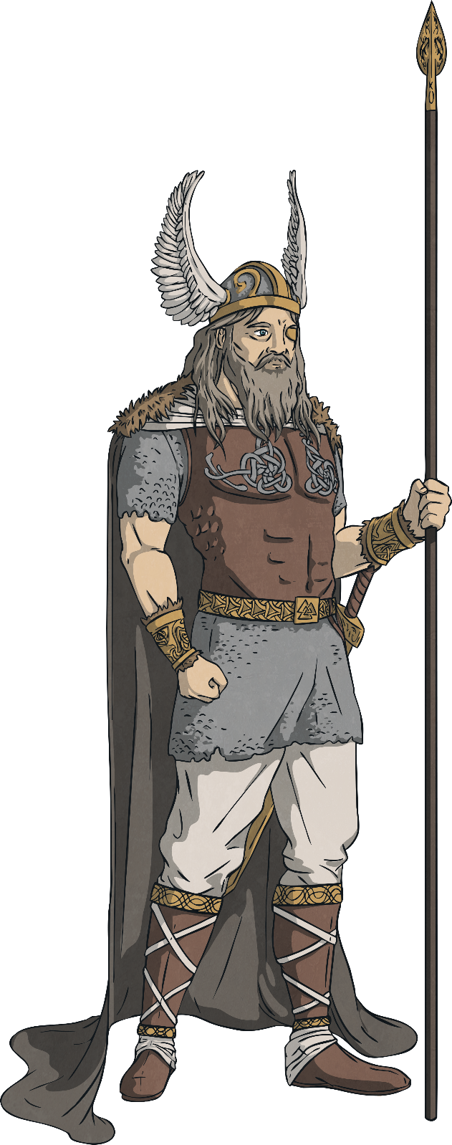
Odin
God of: Odin was the chief and most important god of them all.
He ruled in Asgard and is the father of Thor. He rode an eight-legged horse.
He liked to roam the Earth in disguise in order to be with women he fell in love with.

Slide 7
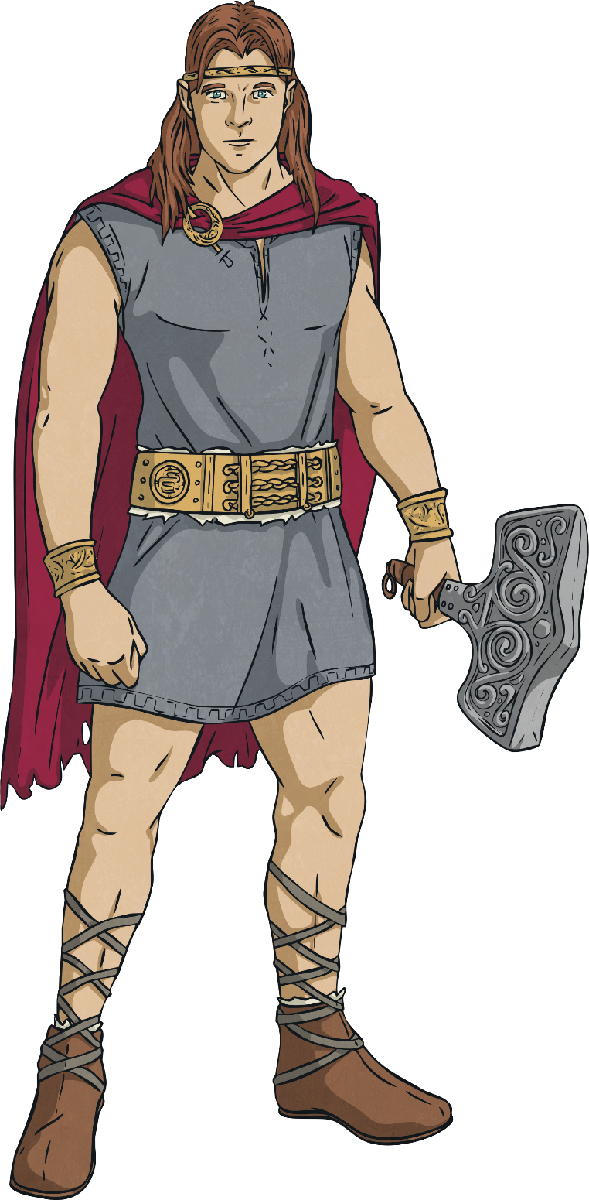
Thor
God of: thunder, fertility, the sky and law
Son of Odin and Fjorgyn, he had super strength and an enchanted hammer that could destroy most things. He was the most popular god as he has a good heart.
He is a relative of Loki.

Slide 8
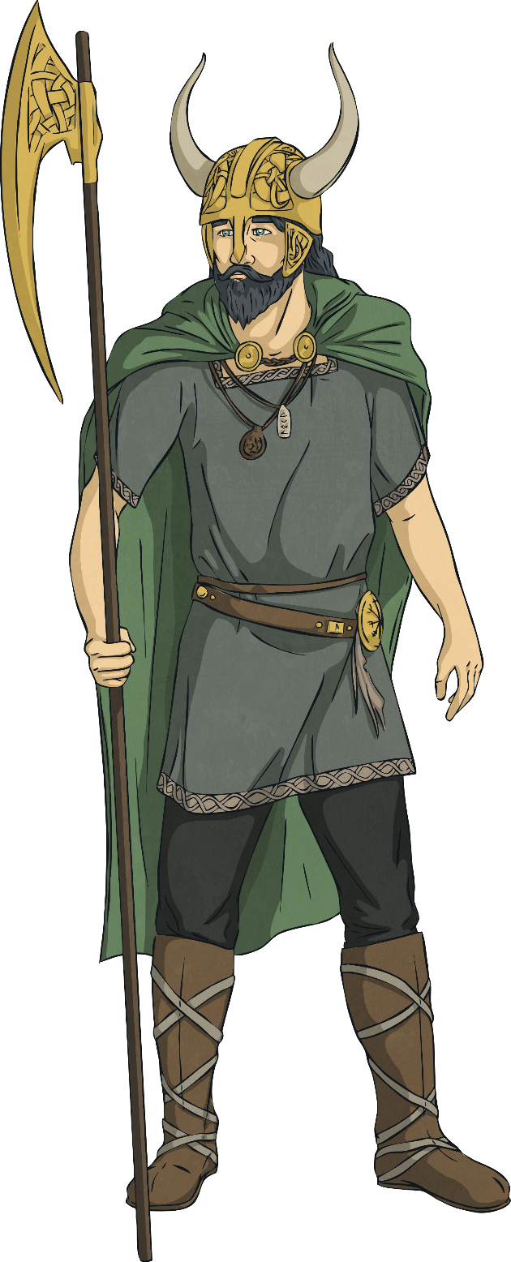
Loki
God of: mischief and chaos
Loki is known as a naughty god, who lied and betrayed the other Gods.
It was said that his relationship with Thor was a rather strange one.

Slide 9
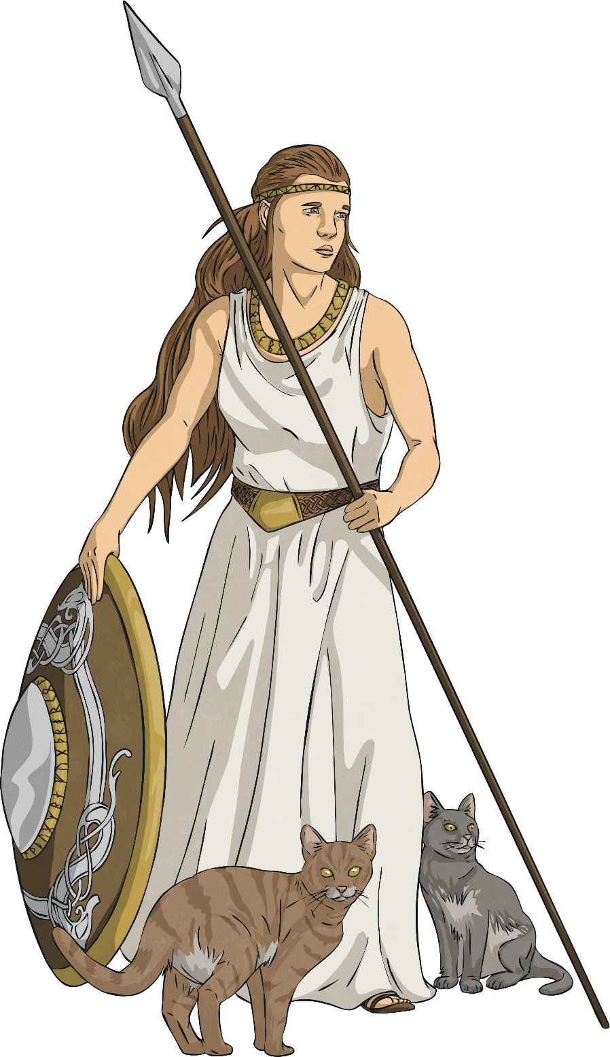
Freya
God of: love, beauty, fertility and war
She was married to the God Od, who abandoned her.
She has been known to appear as a bird to people and made sure the sun shone, rain fell and crops grew.

Slide 10
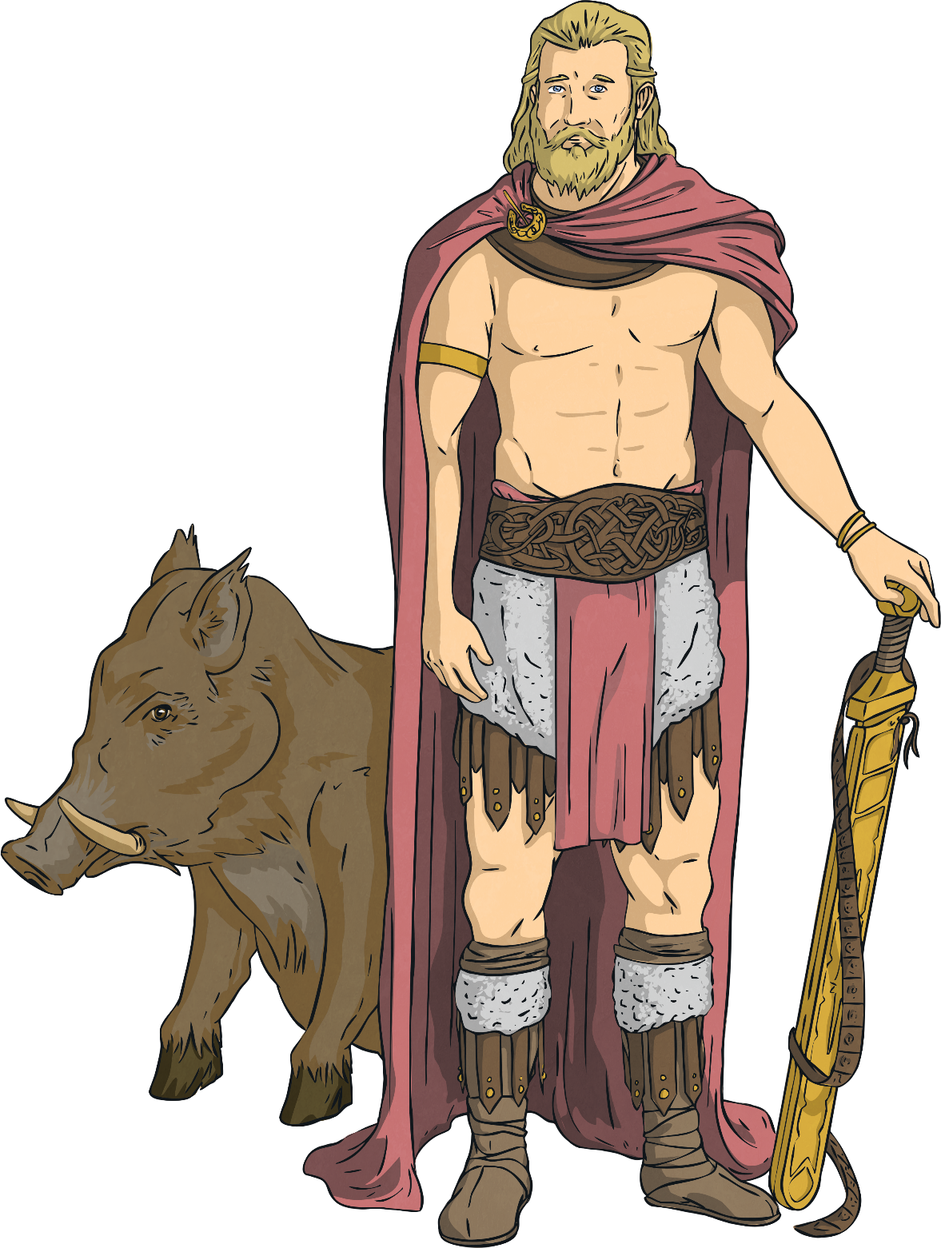
Frey
God of: fertility
He was the son of Njord. He arrived at Asgard as a hostage along with his sister Freya and his father.

Slide 11
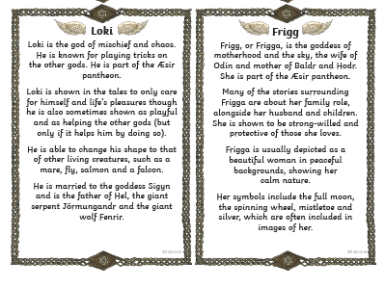

Slide 12
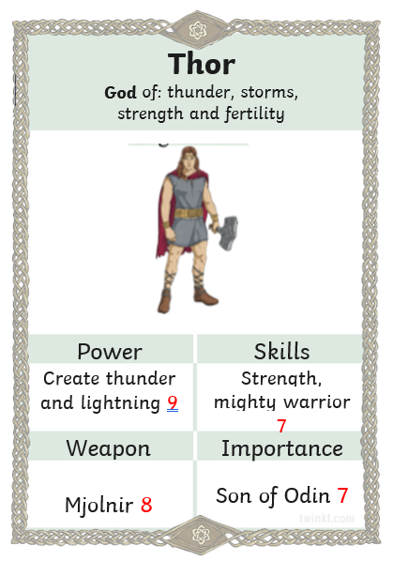

Slide 13
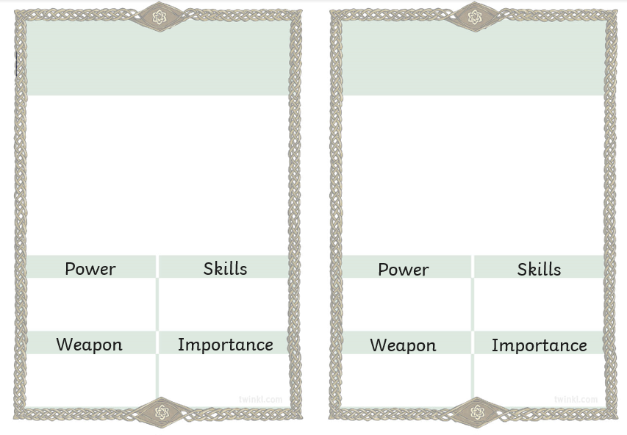

Slide 14
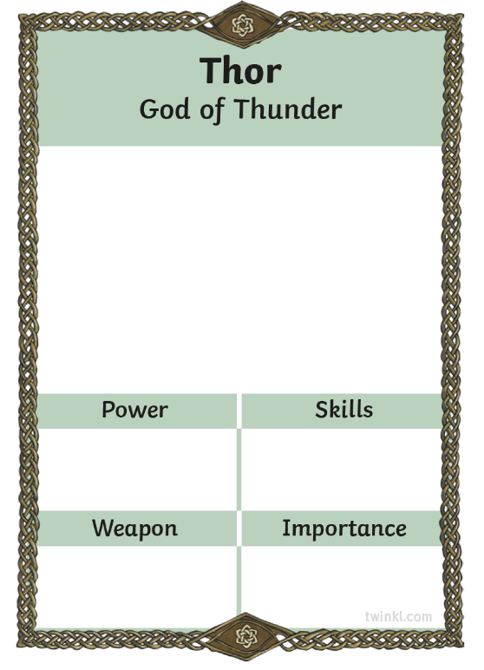

Viking Gods
When you have your information, you need to use it to fill in the scores.
Give each category a mark out of 10.
How powerful is Thor?
Does he have a special skill?
Does he have a weapon?
How important is he?

