Slide 1

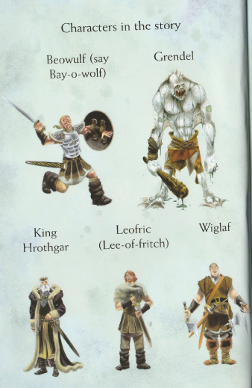
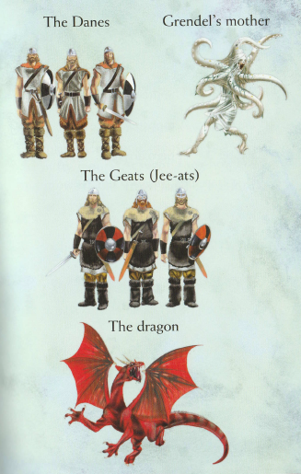
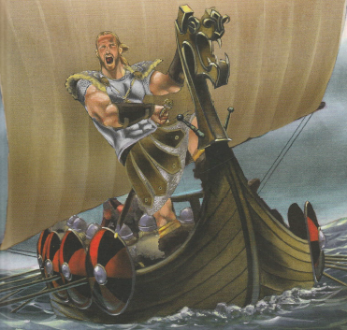

Click the sound button.

Slide 2
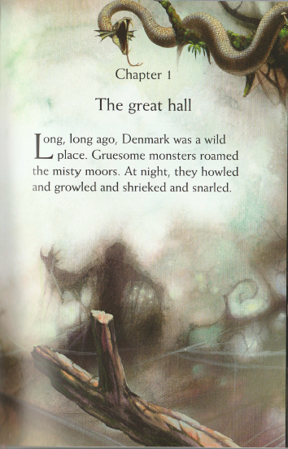
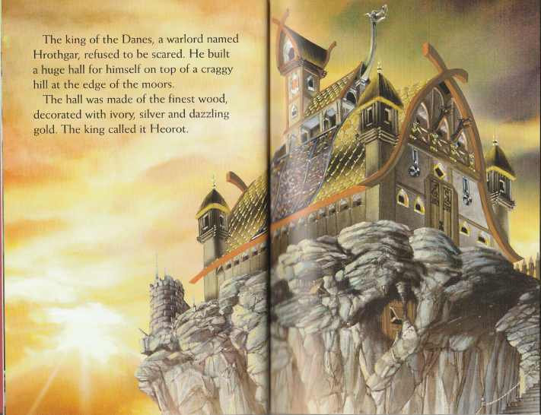
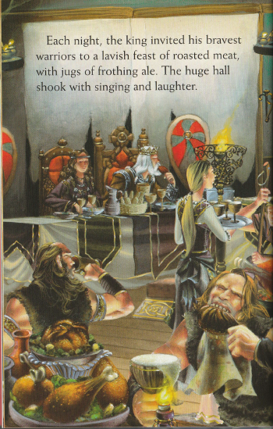
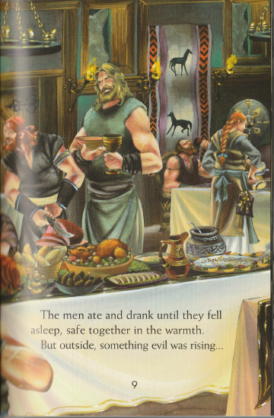
Where is the story set?
Who is the king of the Danes?

Slide 3
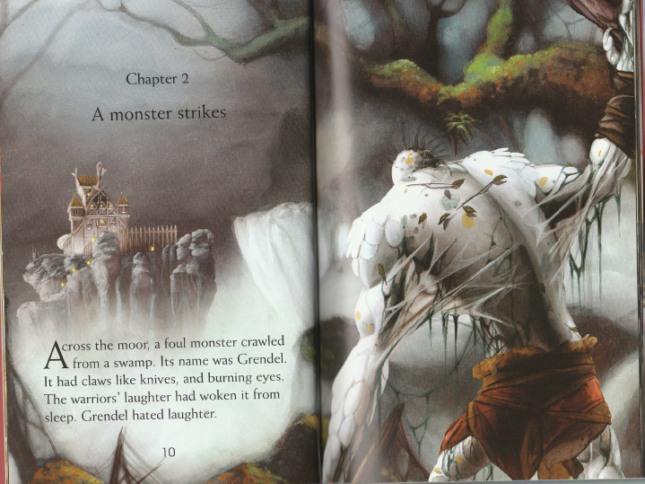
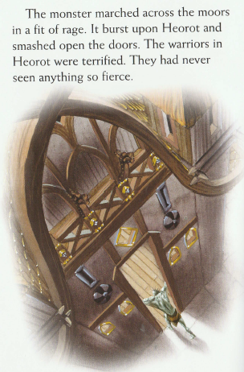
3. What woke Grendel up?

Slide 4
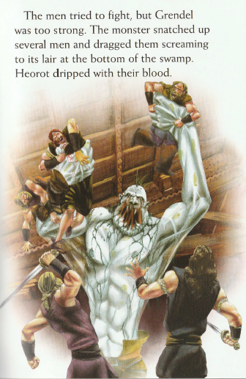
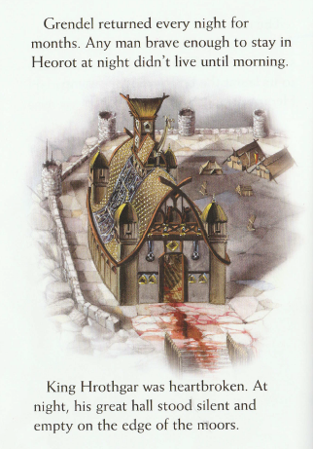
4. Why were the men brave?

Slide 5
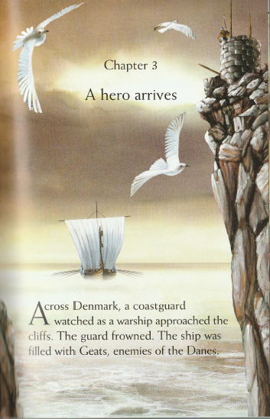
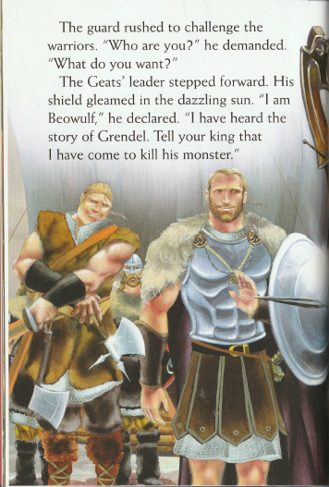
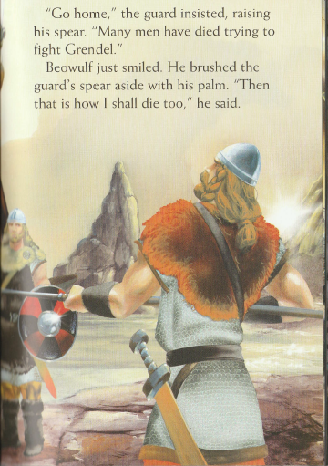
5. Why did the guard frown?

Slide 6
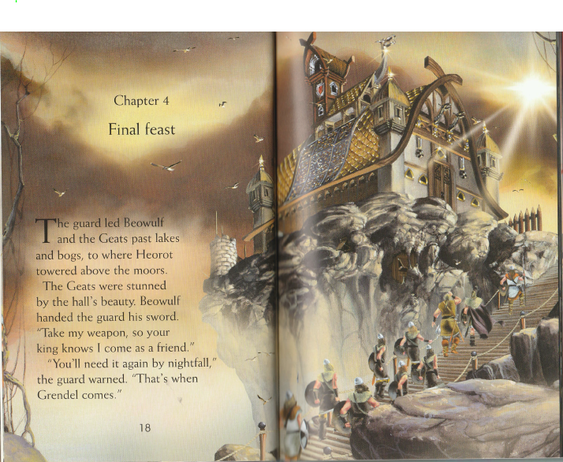
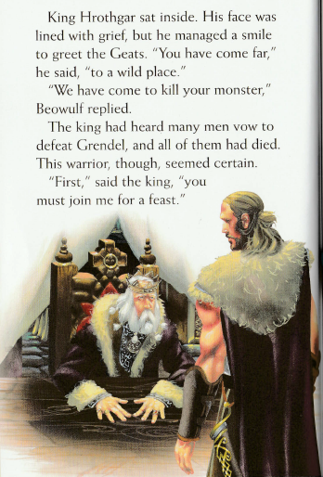
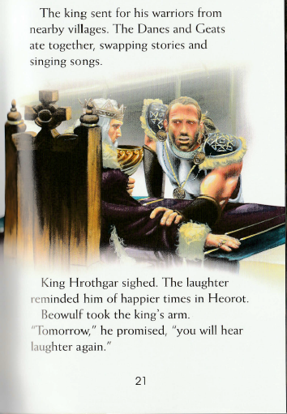
6. Find a word that means shocked or amazed.
7. Why was Hrothgar’s face lined with grief?

Slide 7
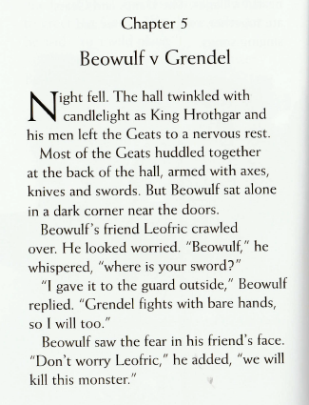
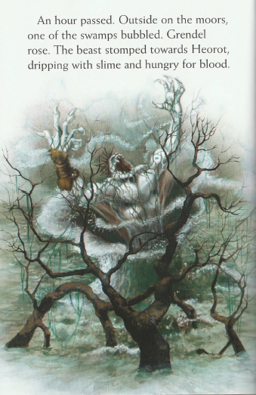
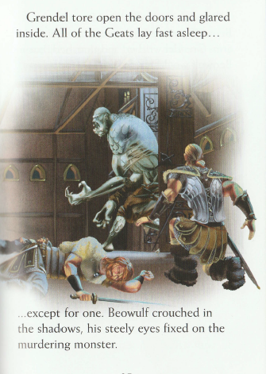
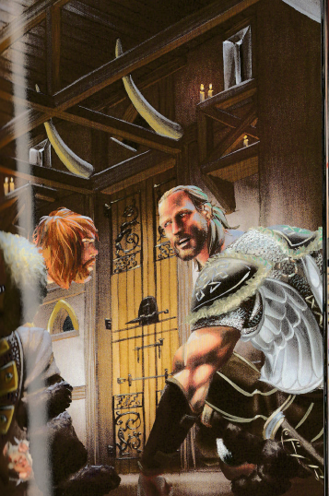
8. What does ‘nervous rest’ suggest?
9. Why was Leofric afraid?

Slide 8
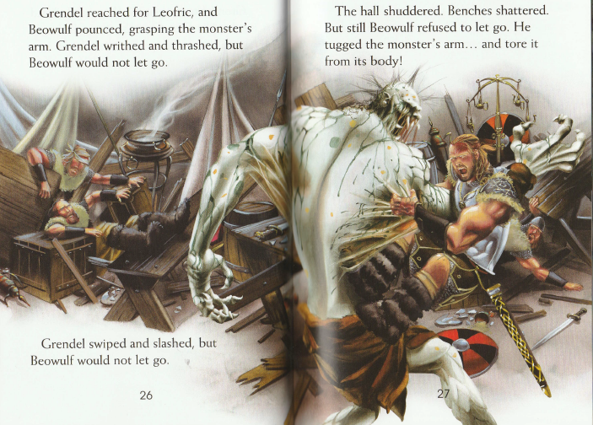
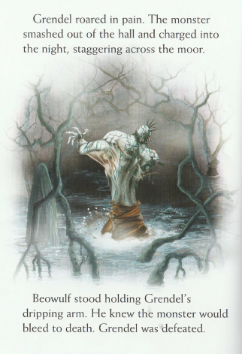
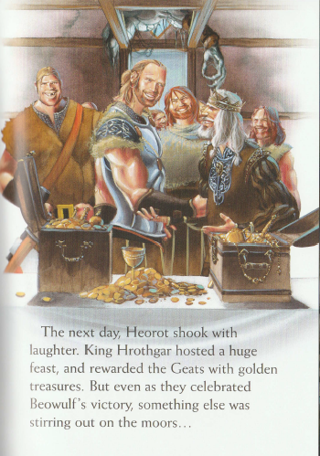
10. What might be ‘stirring out on the moors’?
THE ANSWERS ON THE NEXT SLIDE

Slide 9
ANSWERS
Where is the story set? Denmark
Who is the king of the Danes? Hrothgar
What woke Grendel up? The warrior’s laughter
Why were the men brave? Because they were likely to die
Why did the guard frown? He recognised that it was a Geat ship – enemies of the Danes
6. Find a word that means shocked or amazed. stunned
7. Why was Hrothgar’s face lined with grief? Because so many of his warrior’s had been killed
8. What does ‘nervous rest’ suggest? It means they didn’t sleep very well
9. Why was Leofric afraid? Because Beowulf had no sword (he had given it to the guard)
10. What might be ‘stirring out on the moors’? Your own ideas

