Slide 1
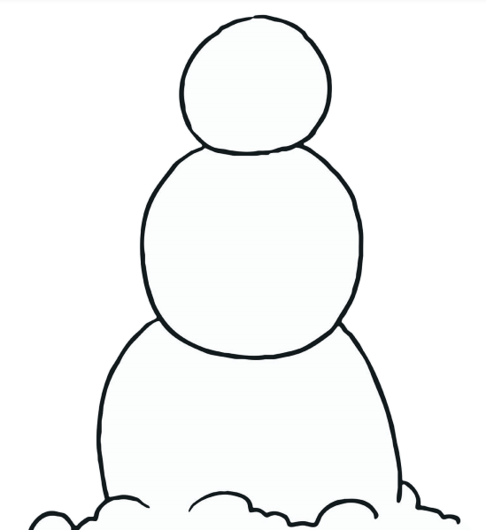

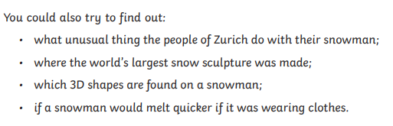
How to draw a snowman.
Follow Miss Spooner’s instructions to complete your snowman.
You will need this basic shape to start with.
Click on the sound button to hear your instructions.

