Slide 1



Early Reading at Warrender
Parent Information Session
Tuesday 26th September 2023
9am in the school hall

Slide 2
Introduction to phonics:
The first stepping stone in learning to read is for children to recognise the 26 letters in the alphabet and the 44 sounds, along with correct letter formation- this is known as phonics. Every school will use different phonics programmes to support their children to learn to read and write successfully. Here at Warrender, we use a programme called Read Write Inc.
Read Write Inc. is a systematic synthetic phonics programme created by Ruth Miskin and is validated by the Department for Education.
“Read Write Inc. Phonics teaches children to read accurately and fluently with good comprehension. They learn to form each letter, spell correctly, and compose their ideas step-by-step.”

Slide 3
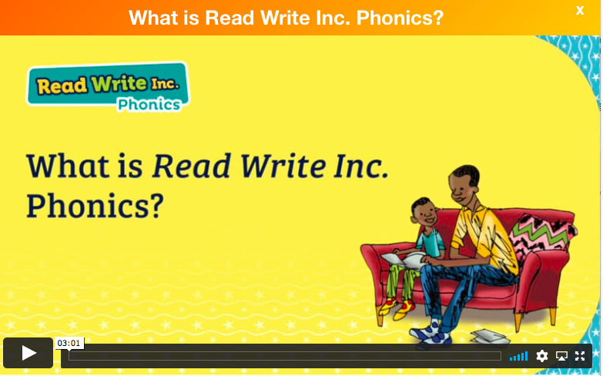
What is Read Write Inc?
https://schools.ruthmiskin.com/training/units/56

Slide 4
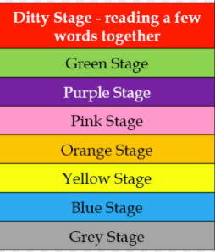
Key points:
Our daily phonics sessions are 40 minutes long and are run by both teaching staff and teaching assistants. All have been trained in delivering RWI phonic sessions and are involved in regular training and development by Mrs Blake (phonics lead).
Your child will be placed in a colour group specific to their ability. This is determined through the individual phonic assessments that take place at the start of every half term. We mix the children across KS1 and Early Years for this to ensure all children are placed in groups appropriate for their individual ability.
Here you can see an example of the progression of the colour groups:
Dependent on assessment results, most children in Reception will start off initially by learning only their single sounds, before moving onto exploring the story books too.

Slide 5
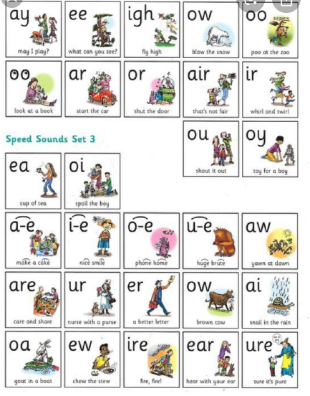
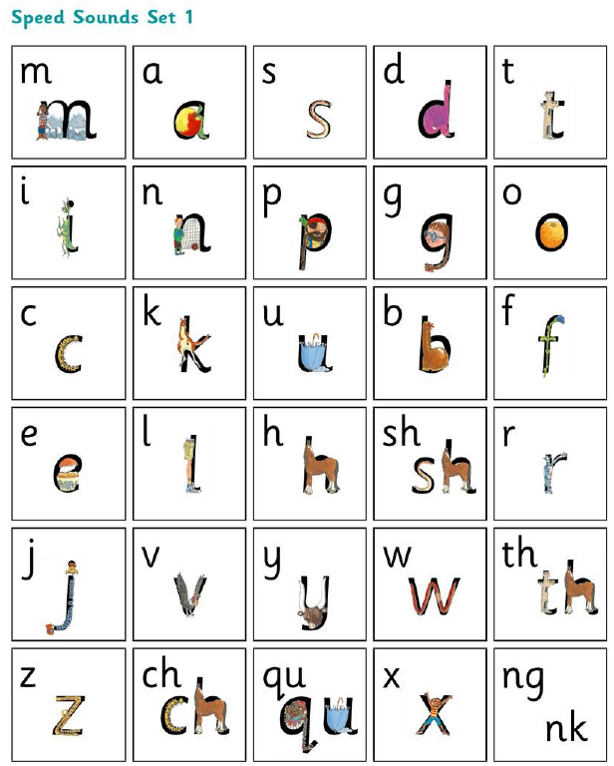
Sounds:
Here you can see the 3 different sets of sounds the children will learn as they progress through the programme.
Starting with single sounds and then progressing onto “special friends” (2 or 3 letters that make 1 sound).
There is a video on our school website which can support you with knowing how to say all the sounds correctly. We will direct you to this at the end of the presentation.

Slide 6
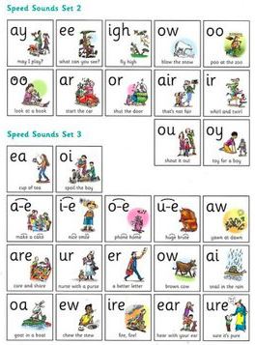

A typical phonics lesson:
Phonic sessions are run in 2 parts everyday.
Monday-Wednesday:
Part 1: Speed sounds (taught a new sound. Different groups will have different sound focus)
Part 2: Story book
Thursday and Friday:
Part 1: Speed sounds (taught a new sound. Different groups will have different sound focus)
Part 2: Writing the sounds, words and sentences (handwriting focus)
Here is an example of the 1st part of a phonics session: https://www.warrender.hillingdon.sch.uk/reading/

Slide 7


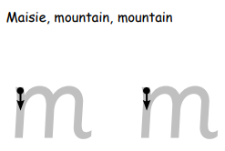

Handwriting phrases to support writing:
Within the Read Write Inc. scheme, rhymes are used to support correct letter formation.
As the children are taught the single letters in the alphabet they are also taught the rhyme to match, here you can see a few examples:
This is really important and used consistently across the school to ensure correct letter formation within writing. The rhymes are really effective in supporting the children to form letters accurately.
Please implement this at home too whenever writing with your child. You can take a copy of this home today, or you can find the document on our school website.

Slide 8


RWI sayings:
Fred talk
Sounding out the word aloud

Slide 9
c a t
Fred in your head
Sounding out the word in your head silently, before saying the word aloud
(helps to develop fluency)

Slide 10

Fred fingers
Using your fingers to identify how many sounds in a word

Slide 11
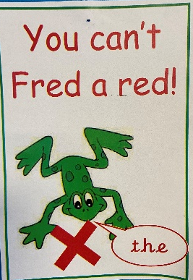

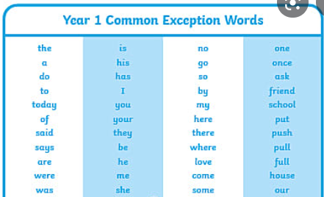
Red words
Tricky words- cannot be sounded out. Must be read by sight.

Slide 12


Special friends
When two or more letters ‘work together’ to make 1 sound.
l ou d
Sometimes the special friends are separated by another letter in the middle as ‘they are too chatty!’

Slide 13
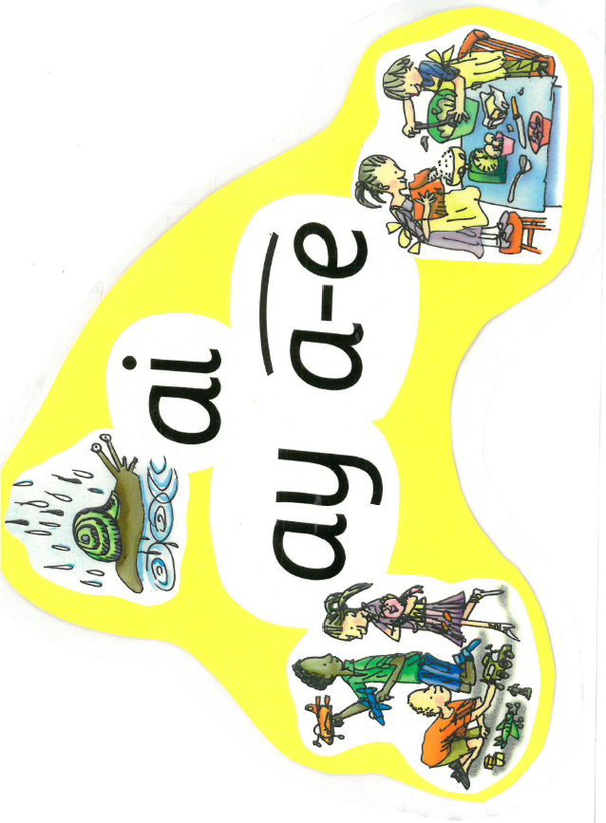

Phonics across the curriculum:
All of the strategies we have spoken about are used consistently, not only within RWI phonic sessions, but also across the curriculum.
Whenever children are reading or writing within class these resources and strategies are used and are readily available to support them when needed.
Here you can see an example of the sound display cards we have up around the room to support children with choosing the sound needed when writing a word.

Slide 14




What books will my child bring home?
Your child will bring home 4 books weekly.
1 x RWI story book
(that has been the focus that week)
1 x RWI book bag book
Reading for Pleasure
1 x Story book (optional)
(ORT- matched to level of RWI group e.g.- pink)
1 x Library books
(child chooses- encouraged to explore both fiction and non-fiction books)

Slide 15

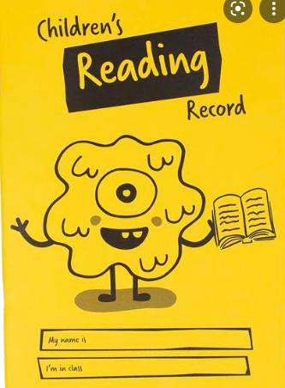
Reading record:
Your child will be given a yellow reading record, please use this to record any reading you do at home with your child and please include any comments you think will be beneficial for the class teacher to read.
School staff will not be recording reading in this book. The purpose of this reading record is for us to track the child’s exposure to reading at home only. This does not mean that the child is not reading in school, our focus time for reading with the children is during phonic sessions each morning, which will not always be with your child’s class teacher.

Slide 16

Lost books
As mentioned earlier, your child will bring home 2 RWI books each week. These are carefully recorded and monitored by the staff member leading your child’s phonics group to ensure we can keep track of all our resources. These books are expected to come back into school the following week and in the same condition it came home in.
Our RWI resources are very valuable and it is not easy to simply replace the odd 1 book. Therefore, for any book lost or badly damaged, you will be charged a £10 fee. We will allow 3 weeks for you to search for the book at home before sending a letter home with details about the payment.
During this time, your child will not bring home another RWI book until the original one is either found or paid for.

Slide 17
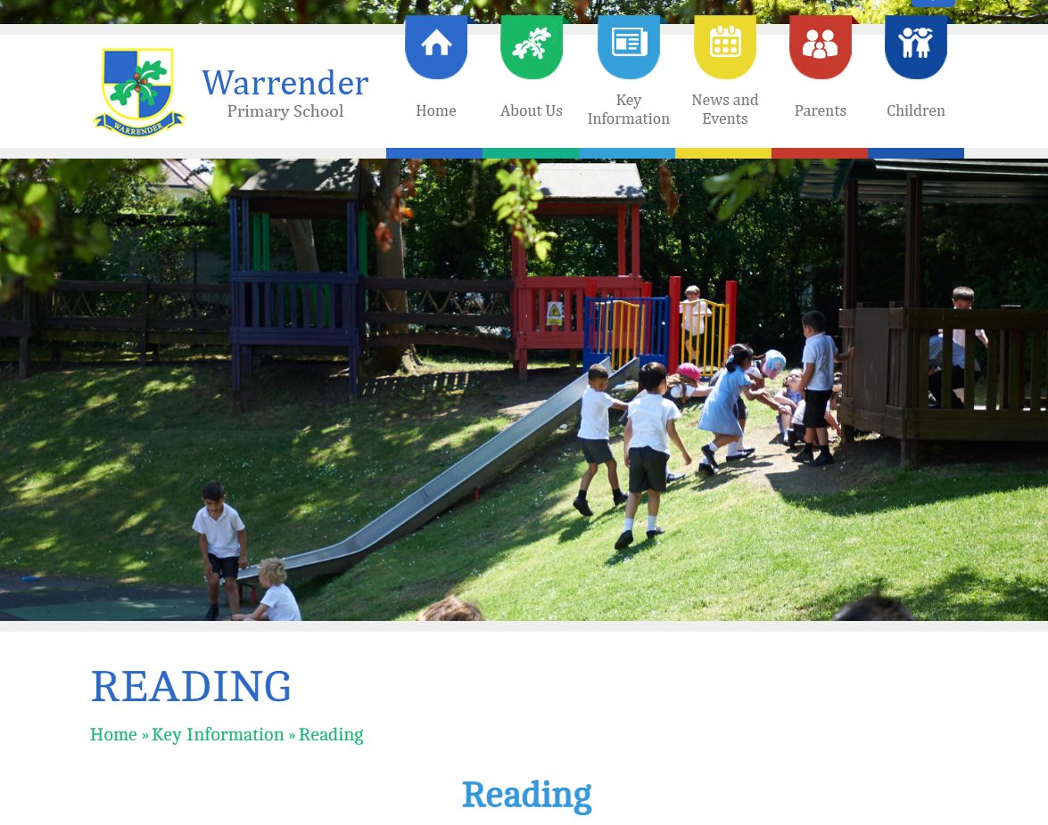
Further information:
Some of the resources mentioned in this presentation and some extra video clips for support for parents at home, can be found on our school website here:
https://www.warrender.hillingdon.sch.uk/reading/

Slide 18
Thank you for listening.
If you have any further questions, please feel free to come and have a discussion with us now.

