Slide 1


“Every child will make outstanding progress academically,
socially and emotionally – enabling them to excel at secondary school and
thrive in the world beyond.”
Our Values: Achieve, Support, Pride, Inspire, Respect, Enjoy
Year 6 School Journey
Wednesday 7th May 2025

Slide 2
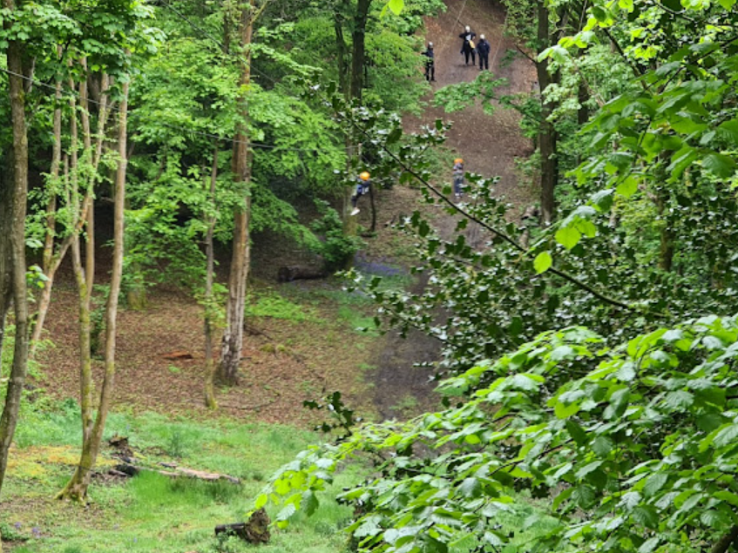
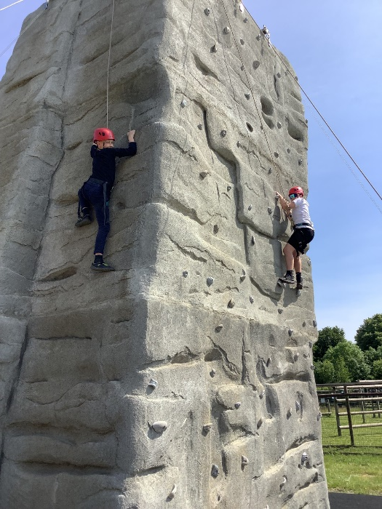
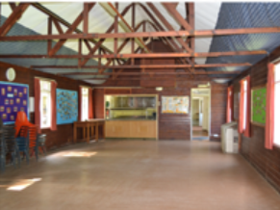
“Every child will make outstanding progress academically,
socially and emotionally – enabling them to excel at secondary school and
thrive in the world beyond.”
Our Values: Achieve, Support, Pride, Inspire, Respect, Enjoy
School Journey – PACCAR Camp in Buckinghamshire
60 acres camp site in Buckinghamshire with extensive woodlands and two large fields
Residential is from Monday 9th June to Friday 13th June – Oak Class
Monday 7th July to Friday 11th July- Sycamore
Great celebration of their primary years for Year 6
The benefits of residential are: developing their independence as they move to secondary and gain experience from living away from home, rewarding their hard work in Year 6, spending quality time with their friends, overcoming their fears, trying new activities and learning new skills and techniques, forming new relationships and having lots and lots of fun!

Slide 3
“Every child will make outstanding progress academically,
socially and emotionally – enabling them to excel at secondary school and
thrive in the world beyond.”
Our Values: Achieve, Support, Pride, Inspire, Respect, Enjoy
Roles and responsibilities on school journey
Children and staff encourage and support each other
Staff members:
  Oak: Mrs Close, Mrs Walsh and Mrs Rogan
  Sycamore: Mrs Evans, Mr Wright and Mr Hunter
  Mrs Brown will visit during the days and stay for the evening but not overnight
Both female and male instructors assigned to the group
Treat everyone with the same respect
Listen and Learn
Remembering manners at meal times
Following the same school rules
MOST of all having a great time!

Slide 4
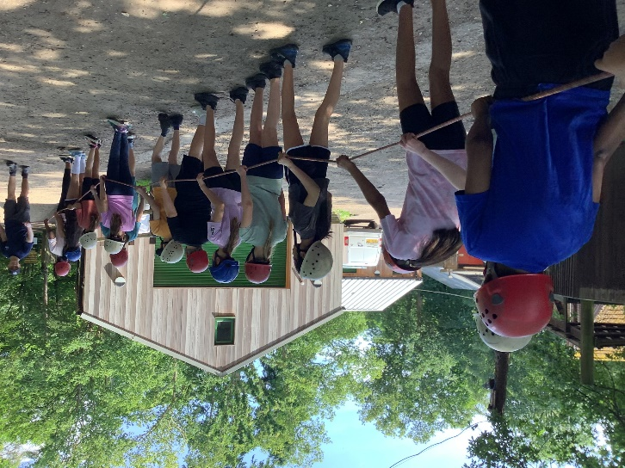
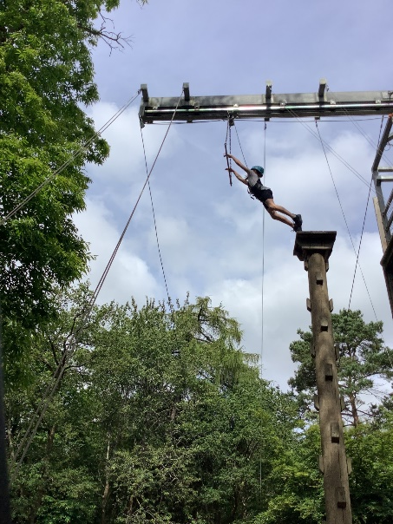
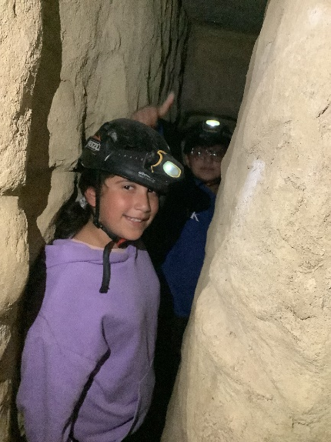
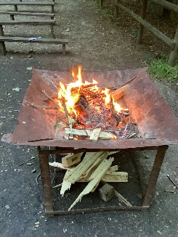
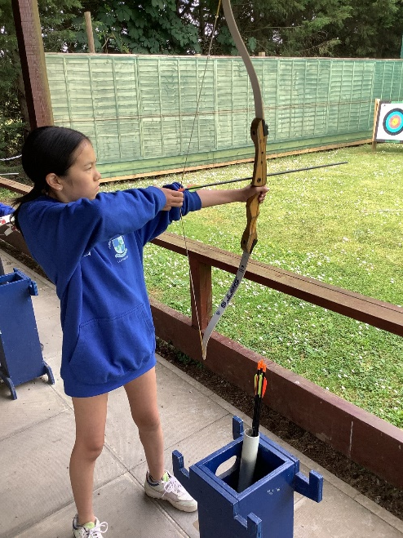
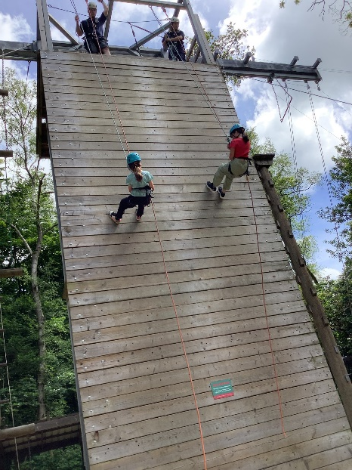
“Every child will make outstanding progress academically,
socially and emotionally – enabling them to excel at secondary school and
thrive in the world beyond.”
Our Values: Achieve, Support, Pride, Inspire, Respect, Enjoy
What activities will they do?
Daytime activities:
  Crate staking
  Nightline
  Climbing Wall
  Gladiator Challenge
  Pedal Kart
  Leap of Faith
  Archery
  Abseiling
  Caving
  3D swing
  Tomahawks
  Backwards cooking
  Quick drop
  In the evening, there will be different activities from quizzes, night navigation, campfire, scrapheap challenge!

Slide 5
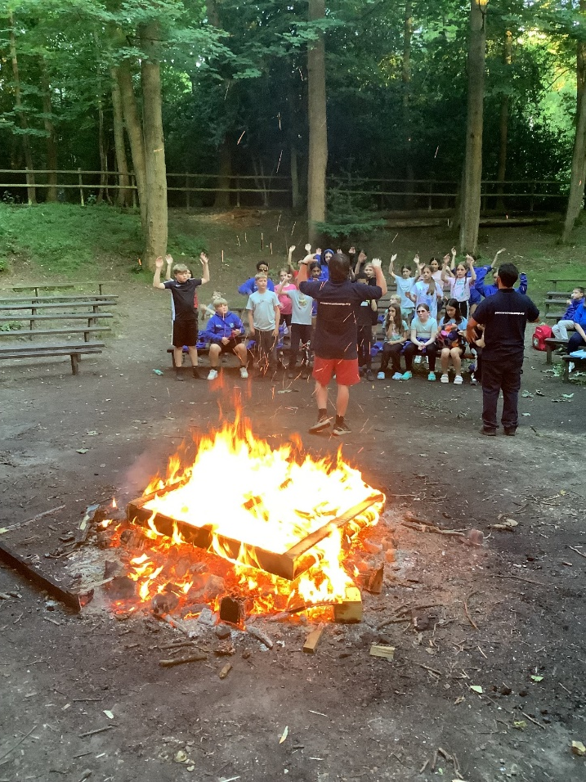
Schedule of day
“Every child will make outstanding progress academically,
socially and emotionally – enabling them to excel at secondary school and
thrive in the world beyond.”
Our Values: Achieve, Support, Pride, Inspire, Respect, Enjoy
07.00 – 0:800 Rise & Shine
08:00 – 09:00 Breakfast
09.00 – 10.00 Free time
10.30 – 11:30 Activity 1
11:30 – 13:00 Activity 2
13:00 – 14.00 Lunch Time/ Free time
14:00 – 15:30 Activity 3
15:30 – 17:00 Activity 4
17:00 – 18:00 Free time
18:00 – 19:00 Dinner
19:30- 21:00 Evening activity
22:00 Bedtime and lights out!

Slide 6
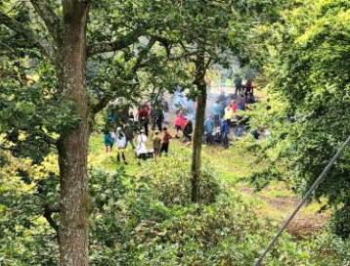
“Every child will make outstanding progress academically,
socially and emotionally – enabling them to excel at secondary school and
thrive in the world beyond.”
Our Values: Achieve, Support, Pride, Inspire, Respect, Enjoy
Essentials to pack
Luggage – please restrict this to one case plus one piece of hand luggage.
Washbag etc. (deodorants must be roll-on, no aerosols, soap, shampoo, toothbrush and toothpaste)
Bin bag for wet clothes- labelled
Reusable drinks bottle
1 towel- 1 for showering
Sleeping bag or duvet and pillow and bottom sheet
2 pairs of trainers (old)
1 pair of dry shoes
Flipflops/sliders to go to the toilet block
5 sets old clothes- no jeans
One Warmer set of clothes for the evening
Underwear and socks
Tops and Waterproof jacket – T-Shirts, waterproof jacket, jumpers (no denim)
Trousers or legging/shorts (no very short shorts due to harnesses)
No crop tops
Please name EVERYTHING you bring with you.

Slide 7
“Every child will make outstanding progress academically,
socially and emotionally – enabling them to excel at secondary school and
thrive in the world beyond.”
Our Values: Achieve, Support, Pride, Inspire, Respect, Enjoy
Essentials to pack
Sunglasses, sun cream and hat in summer
Leavers’ Hoodies
Books, playing cards, torch and other quiet activities
Money for snacks and souvenirs in the Camp shop
No packed lunch needed on Monday as we have lunch when we arrive
You can pack a few snacks for the rooms- no nut products please. There will be plenty of food available so you don’t need to packs lots!

Slide 8
What not to pack
“Every child will make outstanding progress academically,
socially and emotionally – enabling them to excel at secondary school and
thrive in the world beyond.”
Our Values: Achieve, Support, Pride, Inspire, Respect, Enjoy
Anything electronic – A week of no screen is brilliant for wellbeing!
  Mobile phone (there is no reception – except in a couple of staff areas)
  SMART watches (they will get lost / damaged)
  Digital camera
  Games consoles
  Music players
  Anything else!
Too many sweets / treats

Slide 9
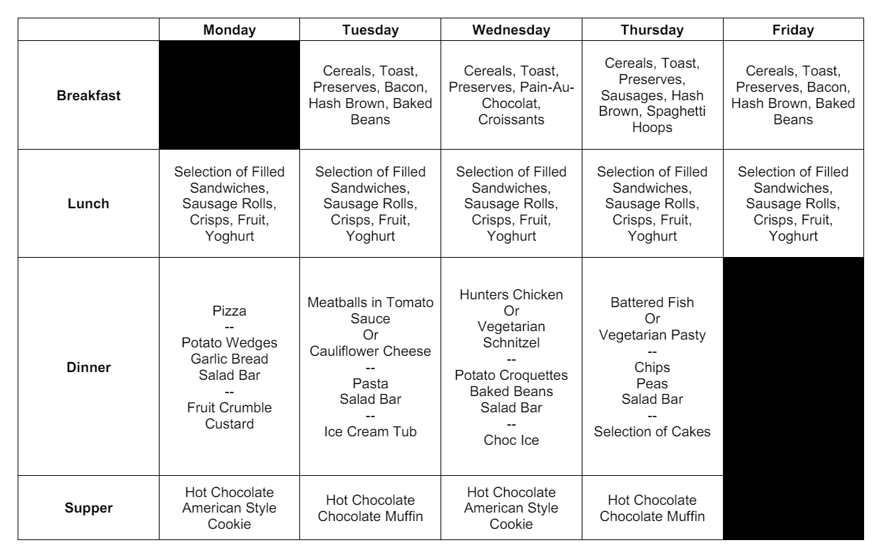
“Every child will make outstanding progress academically,
socially and emotionally – enabling them to excel at secondary school and
thrive in the world beyond.”
Our Values: Achieve, Support, Pride, Inspire, Respect, Enjoy
Sample Menu

Slide 10
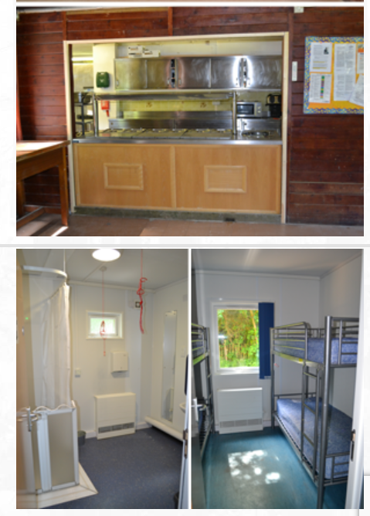
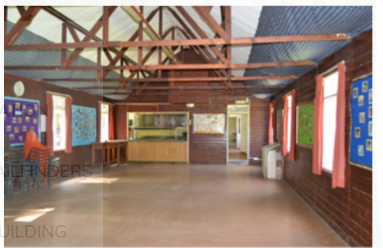
Dormitories
“Every child will make outstanding progress academically,
socially and emotionally – enabling them to excel at secondary school and
thrive in the world beyond.”
Our Values: Achieve, Support, Pride, Inspire, Respect, Enjoy
Each room has two sets of bunk beds enabling up to 4 children to share
The bunkhouse will only have Warrender children in
There is a central hall space within the bunkhouse to be used in down time and for hot chocolate and biscuit before bedtime!
It contains its own showers and toilets for the children to use- rooms do not have ensuite.

Slide 11
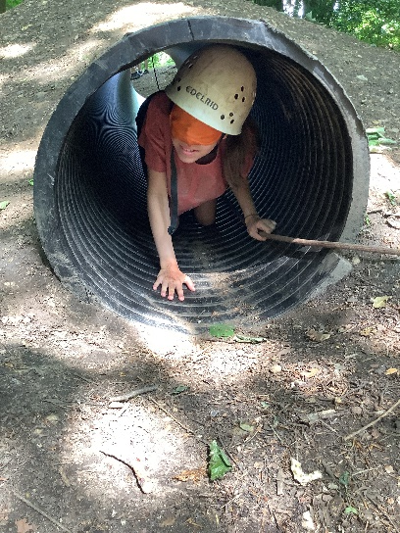
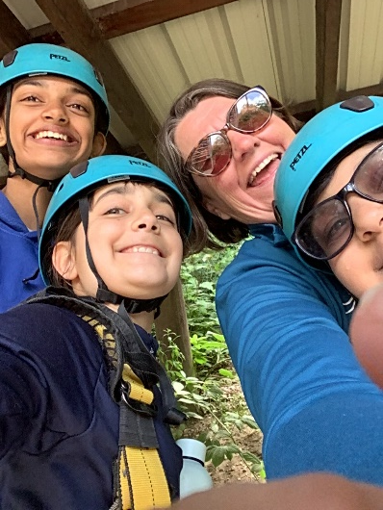
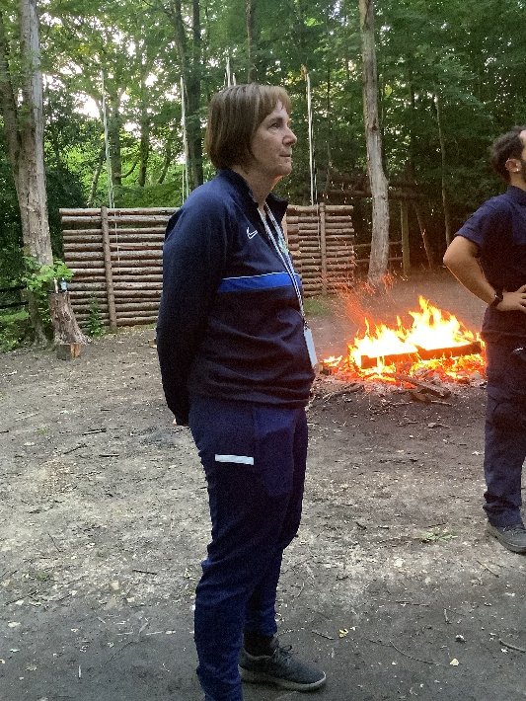
“Every child will make outstanding progress academically,
socially and emotionally – enabling them to excel at secondary school and
thrive in the world beyond.”
Our Values: Achieve, Support, Pride, Inspire, Respect, Enjoy
Camp Shop
The shop stocks drinks, sweets, ice creams, hot drinks, PACCAR souvenirs and cheap toys
There are also vending machines (accessible 24/7) that sell sweets, drinks and hot drinks.
Children will have an opportunity to visit the shop during their opening times.
Max £10 – parents will be given back any additional money

Slide 12

“Every child will make outstanding progress academically,
socially and emotionally – enabling them to excel at secondary school and
thrive in the world beyond.”
Our Values: Achieve, Support, Pride, Inspire, Respect, Enjoy
Behaviour
We expect our children to behave in the manner they do at school.
We will follow our school rules of rewards and consequences.
If children make poor choices, they will be asked to sit out of activities. In very extreme cases, if children considered to be a safety risk, we will request parents to collect from the residential.

Slide 13
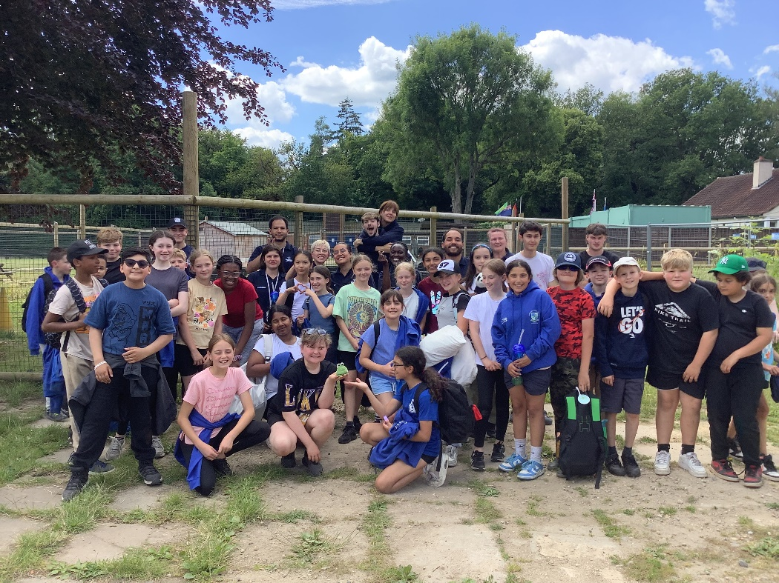
“Every child will make outstanding progress academically,
socially and emotionally – enabling them to excel at secondary school and
thrive in the world beyond.”
Our Values: Achieve, Support, Pride, Inspire, Respect, Enjoy
Monday Departure
Arrive at 9am
Photos and medical in the hall
Parents to drop off
You can come back to wave the coach off- we will confirm the departure time.

Slide 14
You children will return with…
“Every child will make outstanding progress academically,
socially and emotionally – enabling them to excel at secondary school and
thrive in the world beyond.”
Our Values: Achieve, Support, Pride, Inspire, Respect, Enjoy
Amazing stories
Energy and excitement
New-found confidence
Exhaustion (perhaps don’t plan too much the first weekend back!)
A realisation that they can survive 5 days without a phone / iPad / TV / internet!
LOTS of dirty washing!

