Slide 1
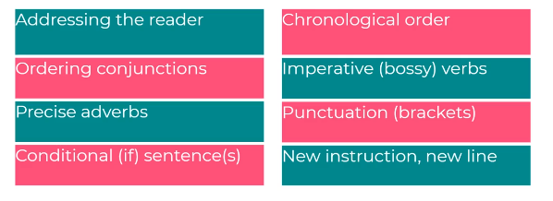
To write our instructions
How to catch a dragon
Are you having trouble with a dragon? Need help to catch that monstrous nightmare? When a dragon is on the loose in your kingdom, you can be left in a bit of a sticky wicket. Follow these set of instructions and you will never have to fear a dragon again! (SIGNPOST SENTENCES )
You will need:
fire-proof armour, sword and shield
100 kg sack of pepper
a rope
bottle of dreamy, sleepy, nighty snooze
iPod with speakers and remote
‘Puff the Magic Dragon’ song installed
Instructions
First, put on your fire-proof armour. This will be rather heavy and arm yourself with a sword and shield.
Next, approach the dragon’s lair cautiously, armed with your sword and shield and place the iPod and speakers at the entrance.
Tip-toe silently to a position above the entrance of the cave.
Now, build up your courage, and press play on your iPod remote to play ‘Puff the Magic Dragon’. (Dragons hate this tune!!!)
The dragon should run out roaring! As soon as it reaches the entrance, throw the sack of pepper onto the ground in front of it. This will cause the dragon to sneeze uncontrollably.
Now, quickly jump on its back and pour the entire contents of dreamy, sleepy, nighty snooze down its throat, just as the dragon is about to sneeze. AHHHHHHH C………
In 5 seconds, the dragon will be fast asleep…snoring. Tie the dragon up. (Use a double knot because dragons are escape masters!)
Finally, pack up your iPod and speaker. Sit back and relax. You’ve caught your first dragon.
Ordering conjunctions
Imperative (bossy) verbs
Precise adverbs

Slide 2
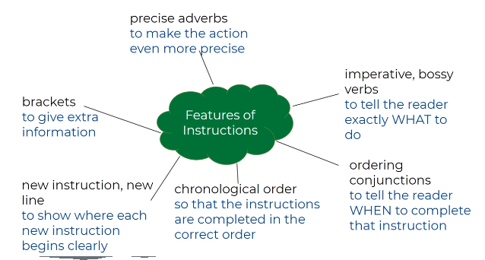

Slide 3
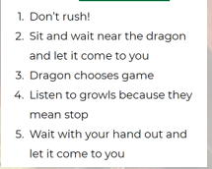
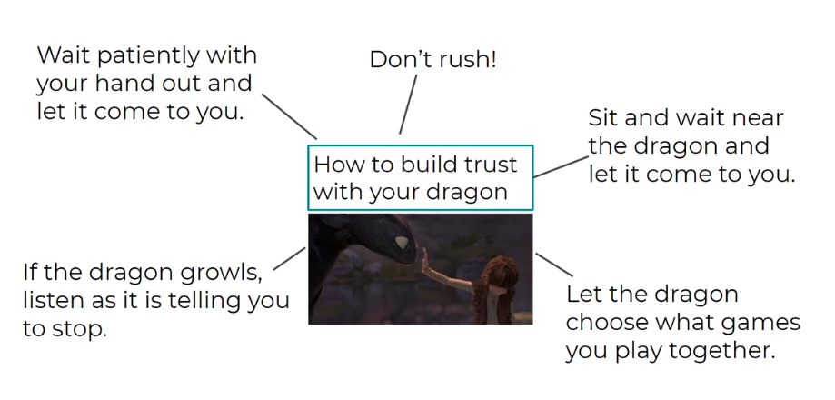
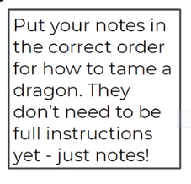

Slide 4

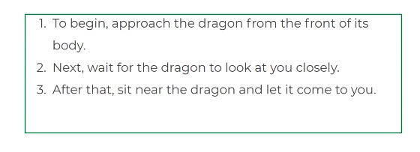
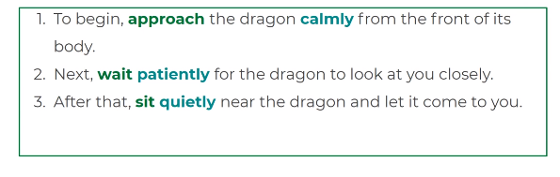
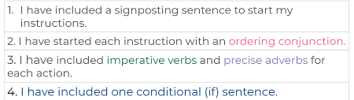
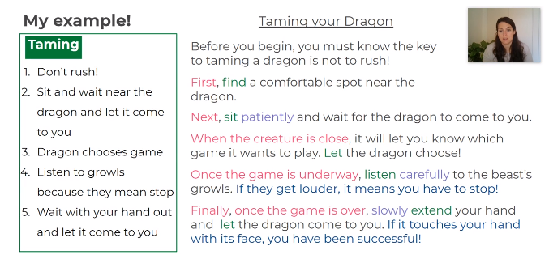

Slide 5
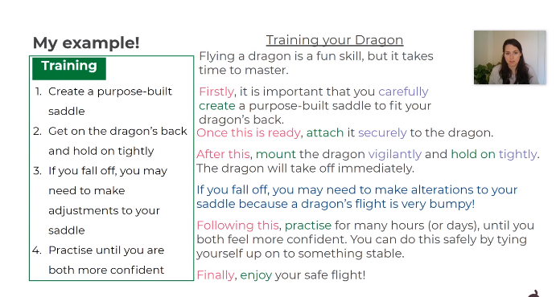

Slide 6
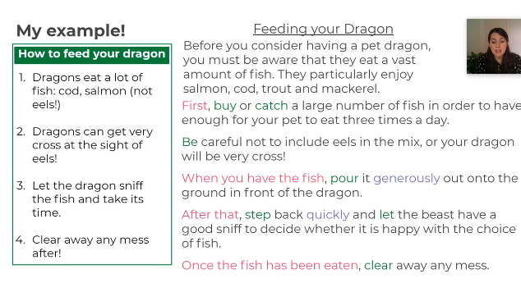
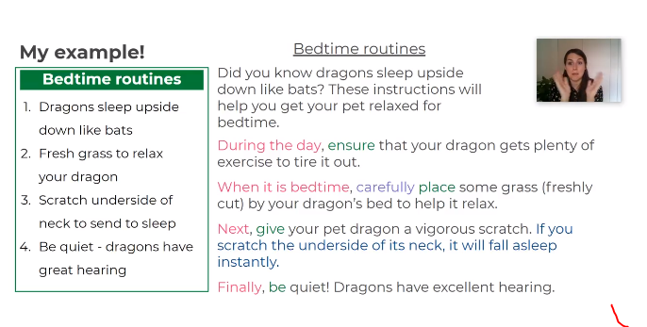

Slide 7
To write our instructions
How to catch a dragon
Are you having trouble with a dragon? Need help to catch that monstrous nightmare? If a dragon is on the loose in your kingdom, you can be left in a bit of a sticky wicket. Follow these set of instructions and you will never have to fear a dragon again! (SIGNPOST SENTENCES )
You will need:
fire-proof armour, sword and shield
100 kg sack of pepper
a rope
bottle of dreamy, sleepy, nighty snooze
iPod with speakers and remote
‘Puff the Magic Dragon’ song installed
Instructions
First, put on your fire-proof armour. This will be rather heavy and arm yourself with a sword and shield.
Next, approach the dragon’s lair cautiously, armed with your sword and shield and place the iPod and speakers at the entrance.
Tip-toe silently to a position above the entrance of the cave.
Now, build up your courage, and press play on your iPod remote to play ‘Puff the Magic Dragon’. (Dragons hate this tune!!!)
The dragon should run out roaring! As soon as it reaches the entrance, throw the sack of pepper onto the ground in front of it. This will cause the dragon to sneeze uncontrollably.
Now, quickly jump on its back and pour the entire contents of dreamy, sleepy, nighty snooze down its throat, just as the dragon is about to sneeze. AHHHHHHH C………
In 5 seconds, the dragon will be fast asleep…snoring. Tie the dragon up. (Use a double knot because dragons are escape masters!)
Finally, pack up your iPod and speaker. Sit back and relax. You’ve caught your first dragon.

