Slide 1
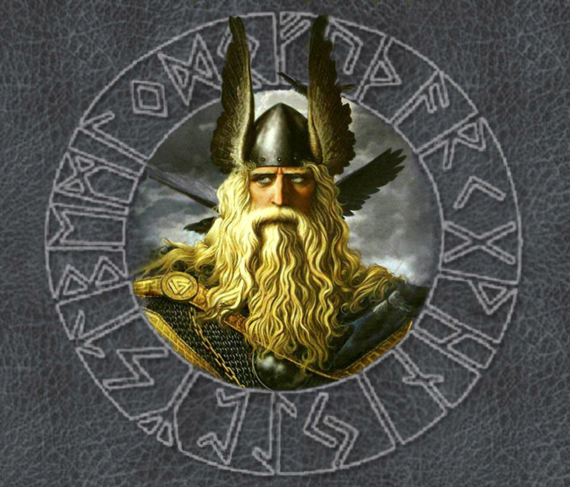
Creating an Anglo-Saxon God

Slide 2
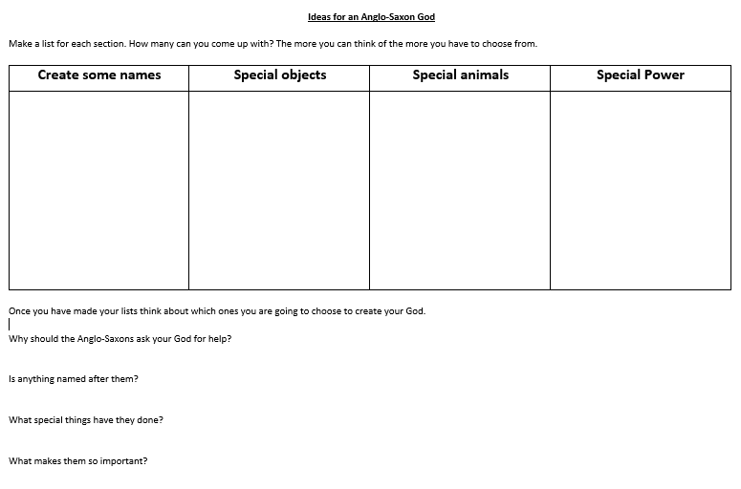

Slide 3
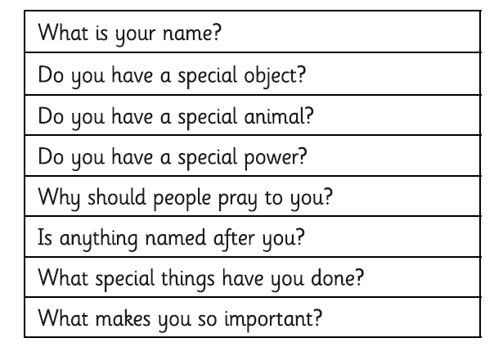
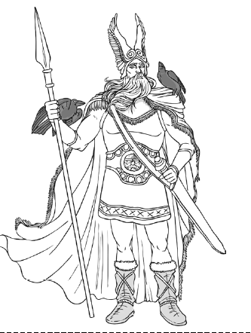

Slide 4
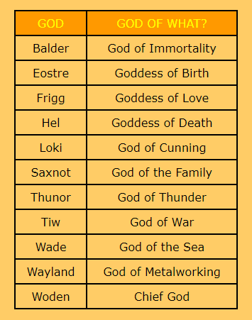
What is their name? How many can you come up with?
Balster
Frel
Saxki
Eonot
Thuden

Slide 5
Special Object
On your sheet make a list of as many ideas as you can.
spear hammer sword plough bow and arrow spinning wheel fishing net
Special Power
create lightning able to disguise themselves guide a spear arm protect
guide make things grow

Slide 6
Special Animal
wolf goat bear
fox badger
Think about the animals you may see in Britain. How many can you come up with?

Slide 7
Why should the people ask you for help, guidance or protection?
Each god controlled a particular part of everyday life: the family, growing crops, love, healing, wisdom, metalworking, the weather, war, day & night.
What other parts of everyday life could their be a god for?
Think about what you found out about the different jobs there were in Anglo-Saxon times and what their life was like.
Here are some ideas:
jewellers cooking grinding flour
feeding chickens weaving collecting eggs
firewood hunting

Slide 8
Once you have made your lists think about which ones you are going to choose to create your God.
Why should the Anglo-Saxons ask your God for help?
Is anything named after them?
What special things have they done?
What makes them so important?

