Slide 1


Slide 3
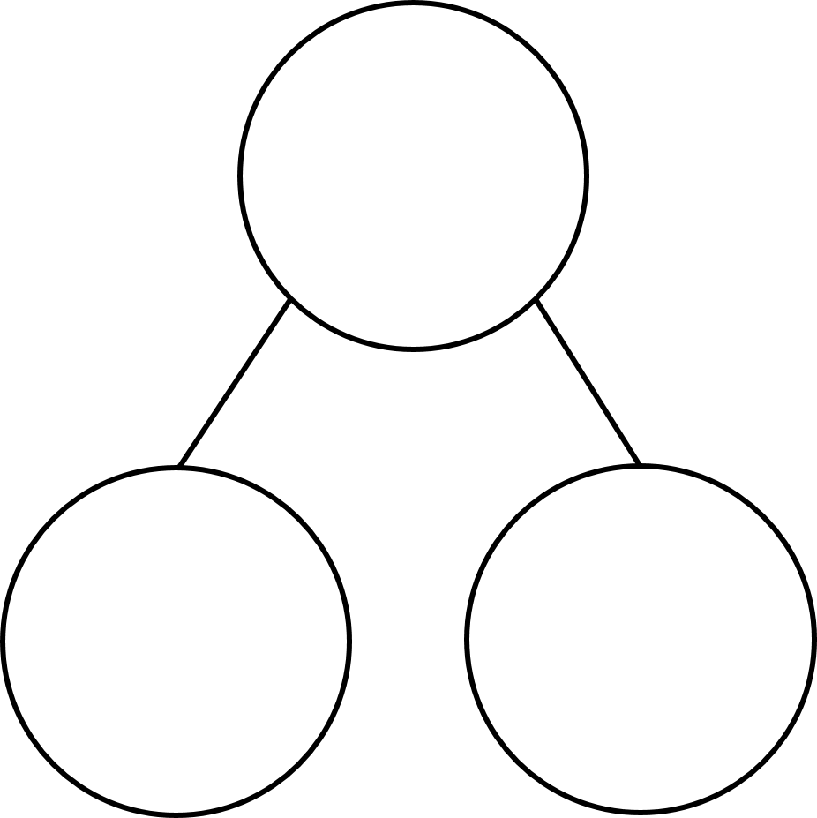





$\frac{\text{7}}{\text{7}}$ $=$ 1 $=$ $\frac{\text{5}}{\text{5}}$
2 $=$ $\frac{\text{14}}{\text{7}}$ $\frac{\text{10}}{\text{5}}$ $=$
$\frac{\text{7}}{\text{5}}$ $=$ whole $+$ fifths
d
$\frac{\text{4}}{\text{5}}$
$\frac{\text{6}}{\text{7}}$
$\frac{\text{2}}{\text{5}}$
$\frac{\text{2}}{\text{7}}$

Slide 4


5
$\frac{\text{7}}{\text{7}}$ $=$ 1 $=$ $\frac{\text{5}}{\text{5}}$
2 $=$ $\frac{\text{14}}{\text{7}}$ $\frac{\text{10}}{\text{5}}$ $=$
$\frac{\text{7}}{\text{5}}$ $=$ whole $+$ fifths
d
1
14
2
1
2
$\frac{\text{4}}{\text{5}}$
$\frac{\text{4}}{\text{7}}$
$\frac{\text{6}}{\text{7}}$
$\frac{\text{2}}{\text{5}}$
$\frac{\text{2}}{\text{5}}$
$\frac{\text{2}}{\text{7}}$

Slide 6


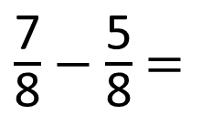
$\frac{\text{7}}{\text{8}}$ $−$ $\frac{\text{5}}{\text{8}}$ $=$
$\frac{\text{2}}{\text{8}}$
Have a think

Slide 7
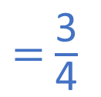

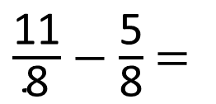
$\frac{\text{11}}{\text{8}}$ $−$ $\frac{\text{5}}{\text{8}}$ $=$
$\frac{\text{6}}{\text{8}}$
$=$ $\frac{\text{3}}{\text{4}}$

Slide 8
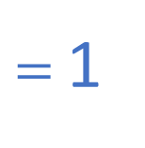

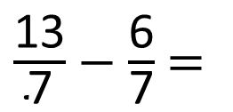
$\frac{\text{13}}{\text{7}}$ $−$ $\frac{\text{6}}{\text{7}}$ $=$
$\frac{\text{7}}{\text{7}}$
$=$ 1
Have a think

Slide 9
Group 2 – complete questions 1-3
Group 1 – complete questions 1-6 (there is no question 4)
Challenge questions 7-8

