Slide 1


DREAMS AND GOALS
Today you are going to create a recipe for success.
Think about what you might need or have to do to achieve a goal you have.

Slide 2









AGREE DISAGREE
Where would you put the above statements?

Slide 3
AGREE DISAGREE

Slide 4
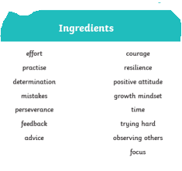
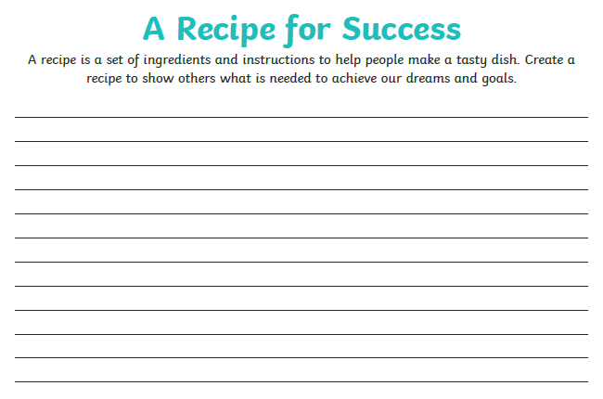
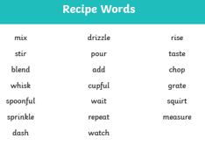
Create a recipe for success list, using the ingredients and recipe words.
The recipe words are imperative (bossy) verbs like commands telling someone what to do and very good to use when writing instructions.
Here are a couple of ideas to get you started.
Sprinkle in a crumble of advice when needed.
Pour in a lot of time to practise and improve your skills.
Add a few mistakes along the way to learn from.
What ideas can you come up with?

