Slide 1
Some PE games you can play indoors (with permission from parents)

Slide 2
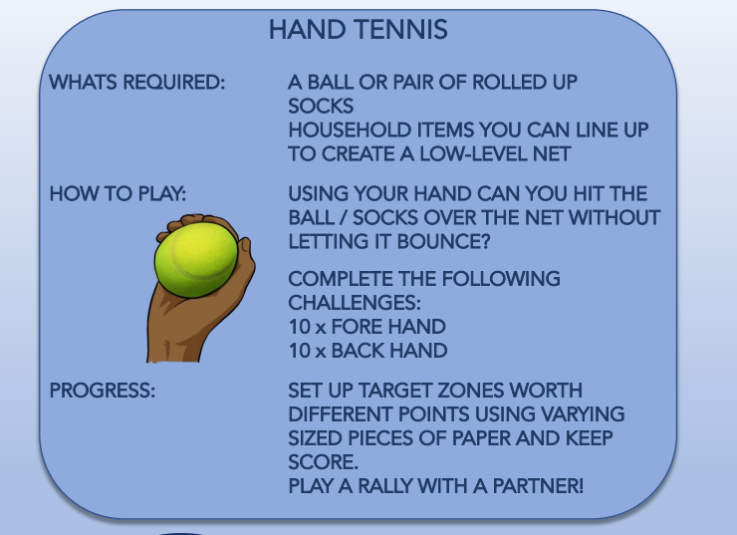

Slide 3
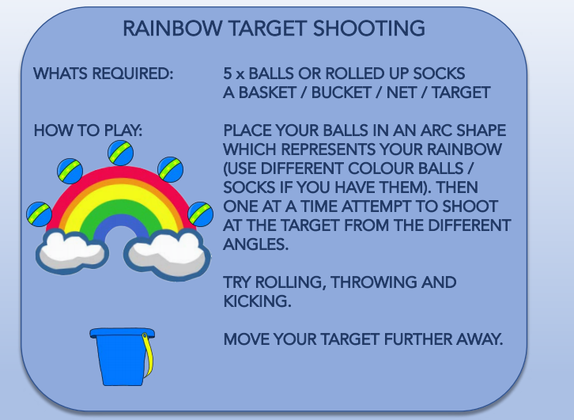

Slide 4
