Slide 1
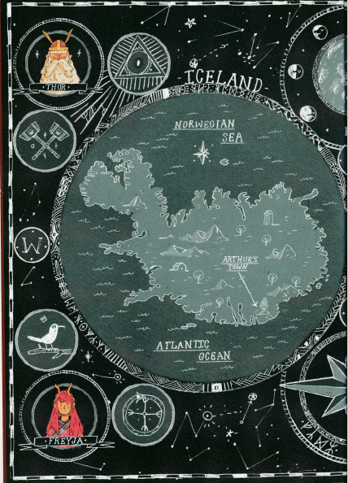
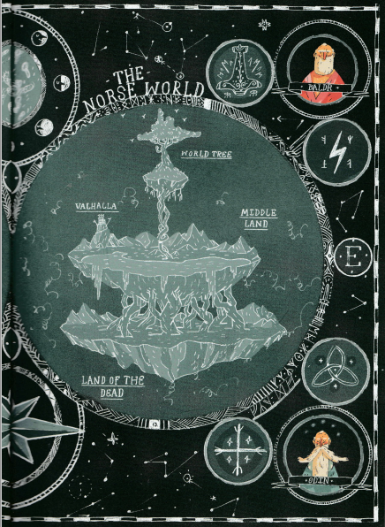

Slide 2
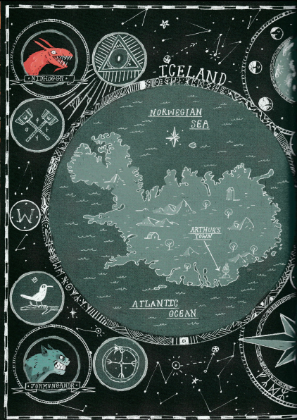
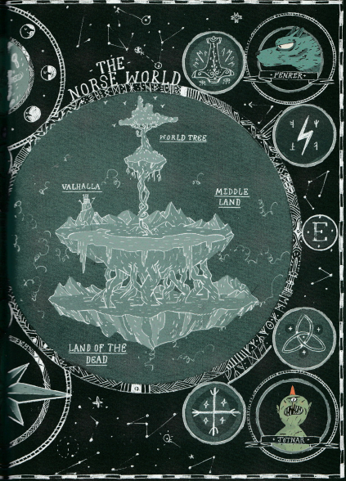

Slide 3
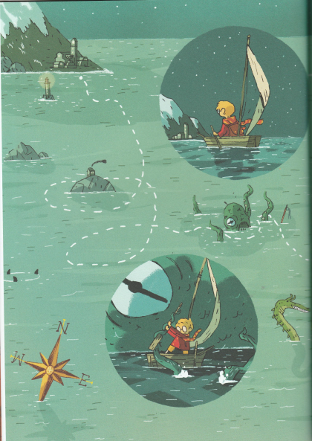
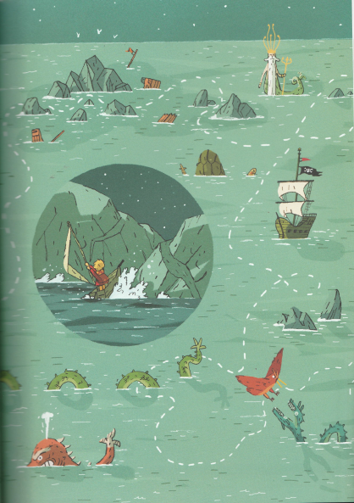
Make a list
What Arthur passed or had to avoid or contend with on his journey to the land of the Viking gods:

Slide 4
What Arthur passed or had to avoid or contend with on his journey to the land of the Viking gods:
god of the sea
pirate ship
sea serpents (various colours and sizes)
sharks
Giant octopus or squid
A house on an island firing boulders
treacherous rocks
shipwrecks
the wind dying down

Slide 5
sail move battle avoid
navigate twist fight miss
glide swerve contend with
turn

Slide 6
sail move battle avoid
navigate twist fight miss
glide swerve contend with dodge
float turn attack duck
ride soar engage escape
drift skate wrestle circumvent (go round)
coast spin argue
hover twirl
bend

Slide 7
What Arthur passed or had to avoid or contend with on his journey to the land of the Viking gods:
god of the sea
pirate ship
sea serpents (various colours and sizes)
sharks
Giant octopus or squid
A house on an island firing boulders
treacherous rocks
shipwrecks
the wind dying down
sail move battle avoid
navigate twist fight miss
glide swerve contend with dodge
float turn attack duck
ride soar engage escape
drift skate wrestle circumvent (go round)
coast spin argue
hover twirl
bend

Slide 8
Choose at least three of the things that Arthur had to pass and write a set of instructions telling him what to do. Use our list of imperative (bossy) verbs to start your sentences.
Here’s two examples to get you started.
Instructions for Arthur
Pray that the gods are on your side
Twist and turn your way across the sea towards the land of the gods.
Avoid the terrifying pirate ship on your left (rumour has it they are cannibals).
Sail right past them, don’t even breathe in their direction.
Battle them at your peril.
Float right past the treacherous rocks (they are really the scales of a rock monster with a taste for boats).
Swerve away from the singing rocks (that is the monster trying to lure you in.)
Dodge the claws that hide beneath the crashing waves.

