Slide 1
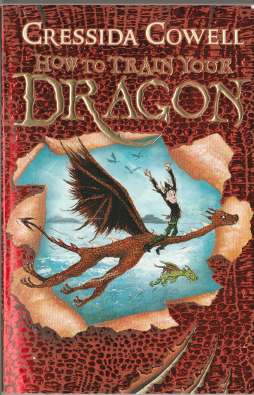
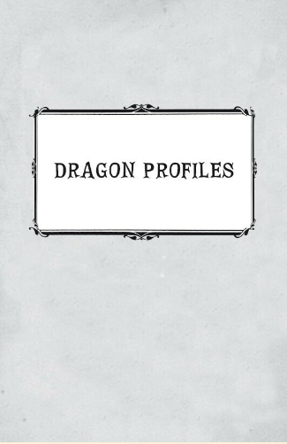
You are going to be creating your own dragon to add to the book ‘Viking Dragons and their eggs’.

Slide 2
Colours | Armed with (weaponry) | Special skill | ideal for? | statistics (want to use) | good vocabulary (words/phrases)
gaudy orange changes bright chilli red pale aquamarine transparent stripy spotty midnight blue turquoise (slimy and goo) | camouflage swivelling drill talons mouth with powerful suction projectile fire rockets finger-lightning explosive burn-streams electricity hook on tail | create a dreadful stink sting like a hornet bloodsucker lays eggs in bird nests nanodragon light source starting forest fires special call (summons other dragons) burrowing holes | guarding cutting wood hunting attacking enemy tracker dragons (like bloodhounds) family pet go in lanterns spy dragons | colours armed with fear factor attack speed size disobedience | defence indescribably awful stinky mist drench absolutely furious phenomenon highly sensitive nanodragon aggressive nocturnal bloodsucking invisible repulsive tentacle mysterious
Use this to help you add to the ideas you have come up with.

Slide 3
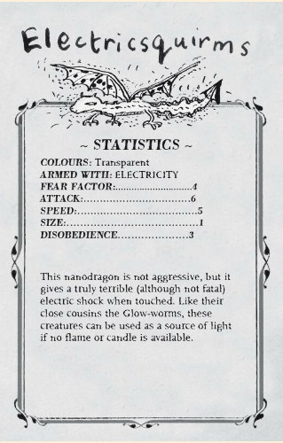
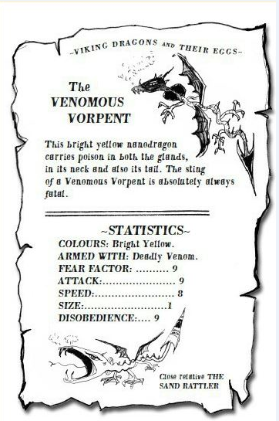
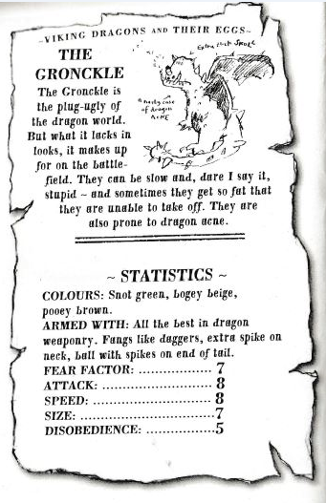

Slide 4
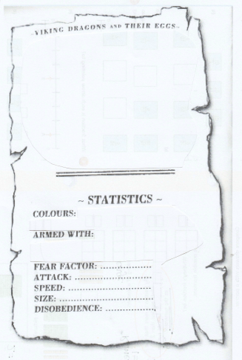
Using your planning and all your ideas you have come up with, create your own dragon entry to go in the book.
You can use this template or draw your own based on this.
Remember you are going to have to come up for a great name too.

