Slide 1


Slide 2
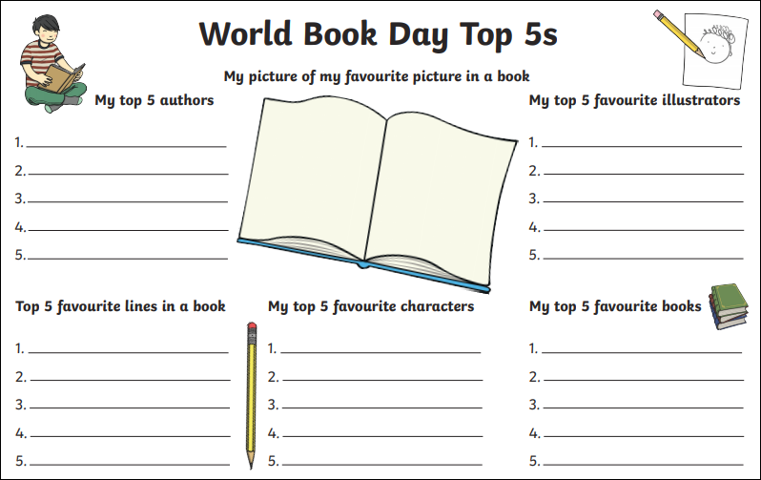
How much can you fill in?

Slide 3
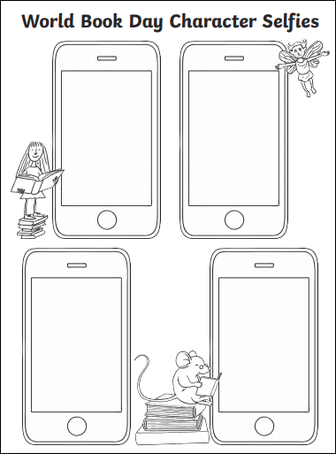
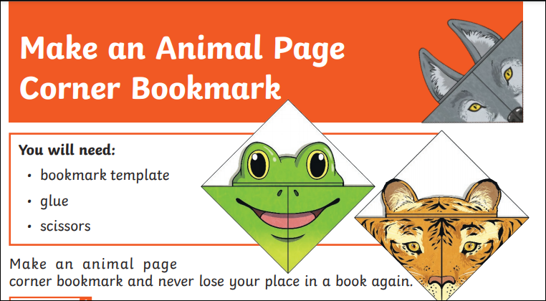
Illustrations and Art
Make your own animal page corner bookmark, there are a few different templates to choose from.
Draw your favourite characters taking a selfie!

Slide 4
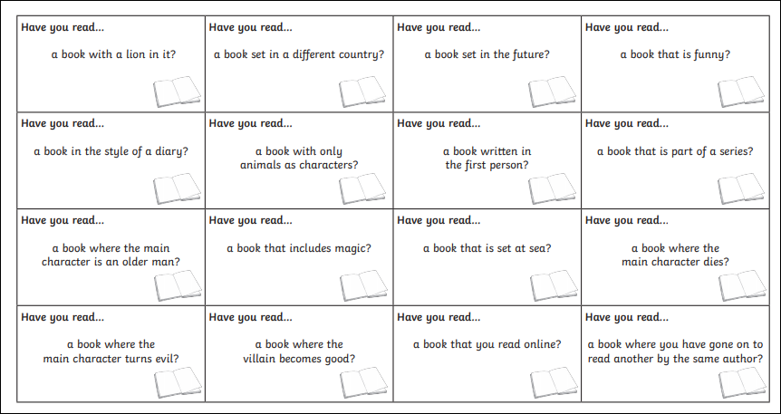
How many of the books can you colour in?
Name the book if you can remember its title!

Slide 5
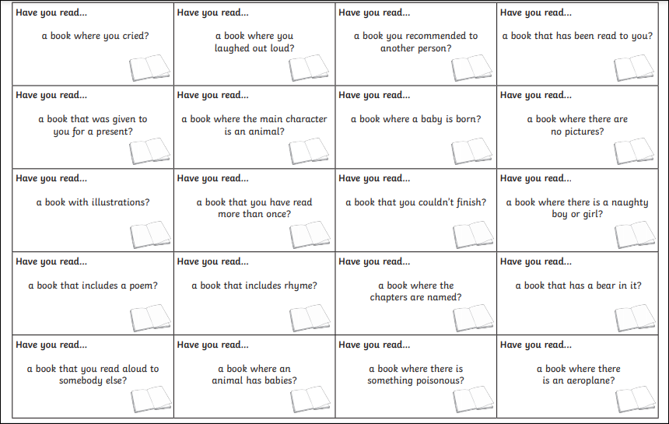

Slide 6
