Slide 1
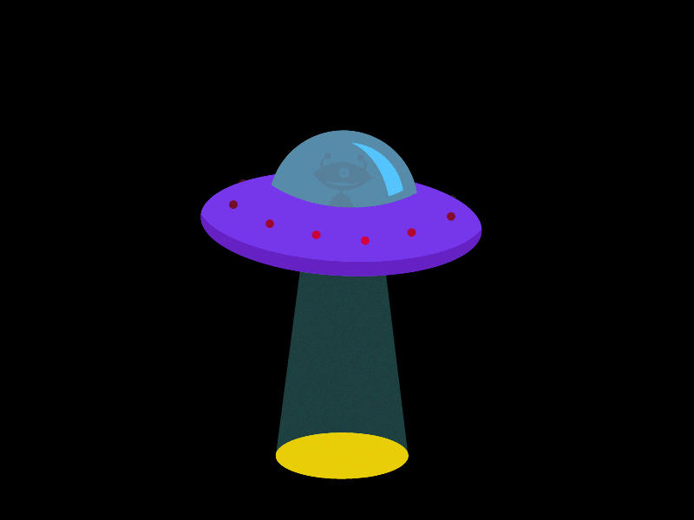
Alien red words

Slide 2
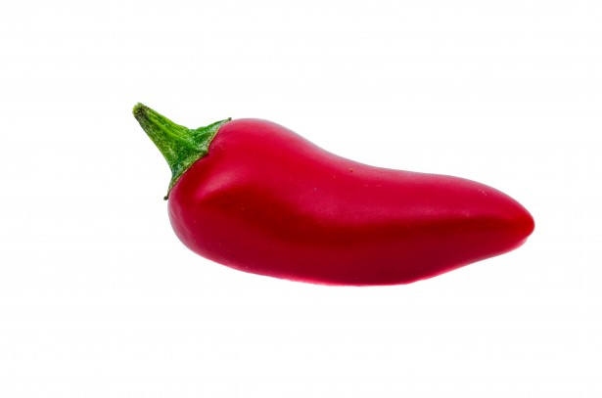
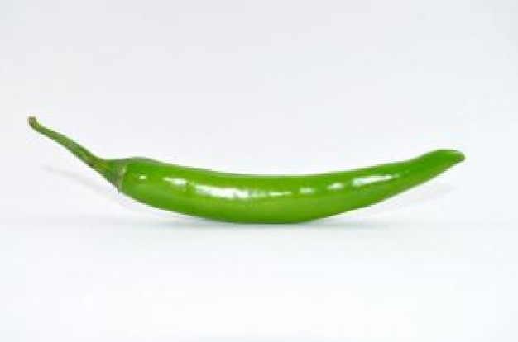
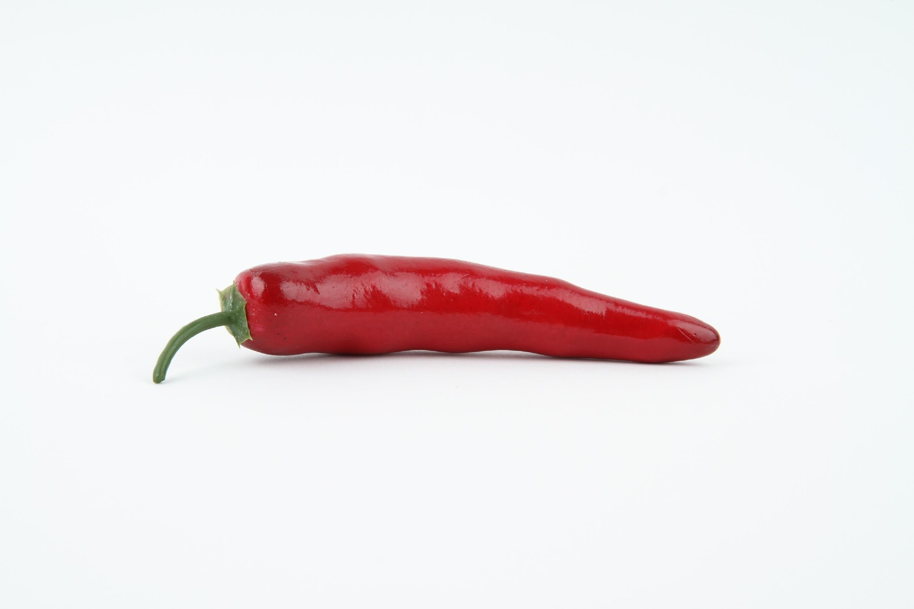
Read the tricky words on set 2 slides
Mild
Sizzling
Hot
Read the tricky words on set 1 slides
Read the tricky words on set 3 slides

Slide 3
Let’s play!
For this game you will need colouring pens and paper. Start by drawing an alien head and body like below…

Slide 4
Now we need to copy the 6 words (on the next slide) onto little pieces of paper so they are individual cards. These will be our playing cards.

Slide 5
was like some what all they
Mild
Sizzling
Hot
was
the
are
you
said
my
anyone
does
people
asked
should
through

Slide 6
Instructions
Face your cards down so you cannot see them.
Pick a card, read it and then draw the matching body part on your alien (see the next slide). Repeat this 10 times in total.

Slide 7
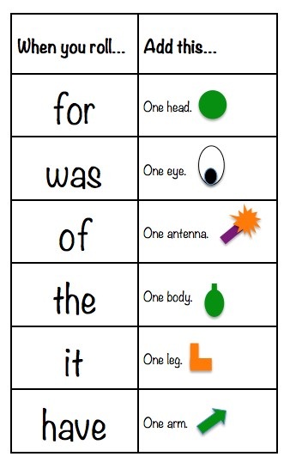

was like some what all they
Mild
Sizzling
Hot
When you pick this card…
When you pick this card…
When you pick this card…
was
the
are
you
said
my
One nose
One nose
anyone
does
people
asked
should
through
One nose
One mouth
One mouth
One mouth

Slide 8
What does your alien look like?

