Slide 1
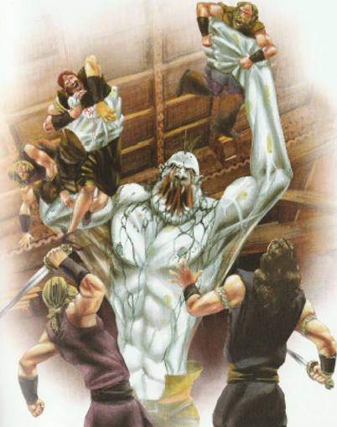
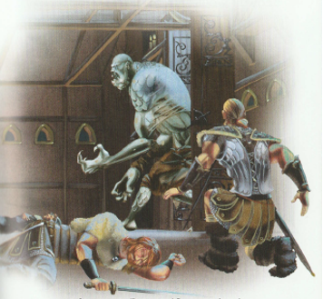

LO: generate words and sentences (using fronted adverbials).
Today you are going to come up with words telling how you, as a warrior, felt when you were waiting for and then had to confront Grendel.

Slide 2
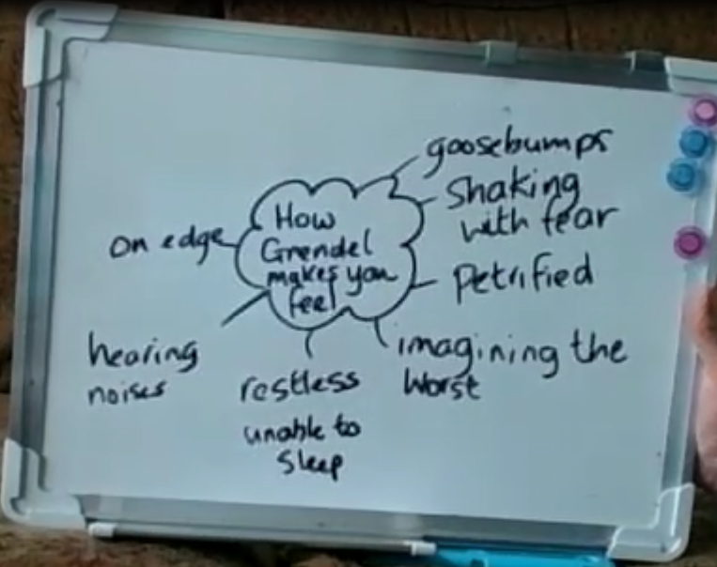
Create your own spider’s web of ideas

Slide 3
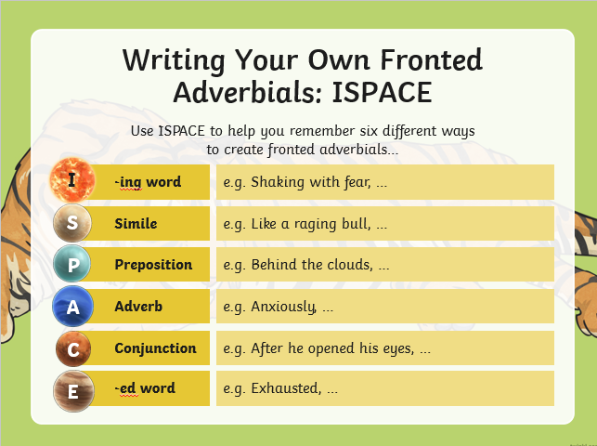
Different ways to start sentences

Slide 4
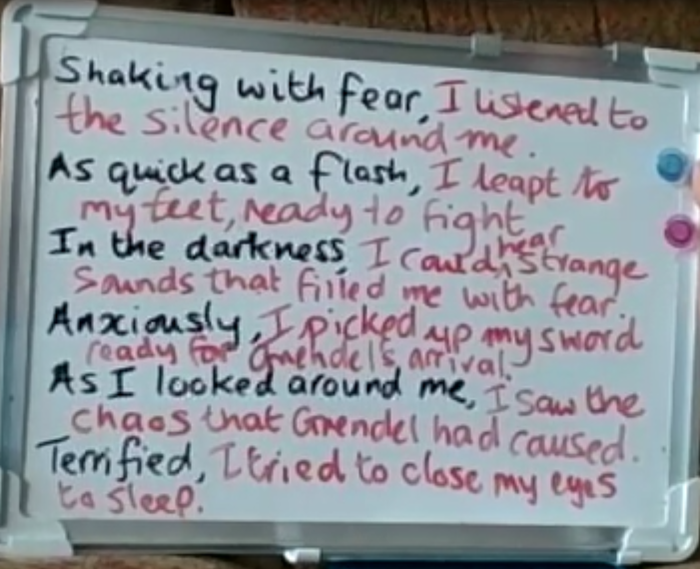
Create sentences using fronted adverbials. Here are my examples.

Slide 5
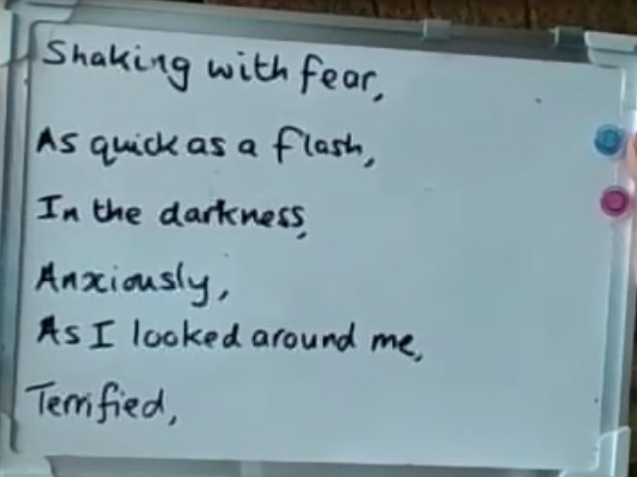
Create sentences using fronted adverbials. Finish the sentences with your own ideas.

Slide 6
Can you spot any fronted adverbials?
Tiw – Mighty God of War,
Thank you for watching over and protecting us this night and giving us the strength to overcome that vile monster Grendel. The Danes said he was an unworldly beast with claws like daggers and a roar that could shake the earth. They were right!
As we lay there in the darkness, no-one dared speak but I knew we were all feeling the same. We were scared, we were on edge, we were frightened. An uneasy silence filled the air, our ears listened out for any sign of what was to come. Every noise made us jump, the shadowy corners hid scurrying animals and made our imagination fear the worse.
Questions had filled my head, why had Beowulf brought us here? Would I be brave? Would I prove myself? And yet, I knew I would play my part. My belief in Beowulf would see me through, it would give me the strength I needed. My sword was ready.
I felt the ground shake beneath me. I heard the roar coming from the other side of the wooden door. The moment had arrived …

