Slide 1


Slide 3

4 $+$ $=$ 9
4 $+$ $=$ 13
4 $+$ $+$ 5 $=$ 15
$\frac{\text{13}}{\text{7}}$ $=$ whole $+$ sevenths
$\frac{\text{3}}{\text{5}}$ $+$ $\frac{\text{1}}{\text{5}}$ $=$

Slide 4



5
4 $+$ $=$ 9
4 $+$ $=$ 13
4 $+$ $+$ 5 $=$ 15
$\frac{\text{13}}{\text{7}}$ $=$ whole $+$ sevenths
$\frac{\text{3}}{\text{5}}$ $+$ $\frac{\text{1}}{\text{5}}$ $=$
9
$\frac{\text{7}}{\text{7}}$
6
$\frac{\text{6}}{\text{7}}$
1
6
$\frac{\text{4}}{\text{5}}$

Slide 6

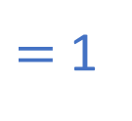

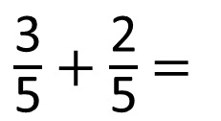
$\frac{\text{3}}{\text{5}}$ $+$ $\frac{\text{2}}{\text{5}}$ $=$
$\frac{\text{5}}{\text{5}}$
$=$ 1
Have a think

Slide 7
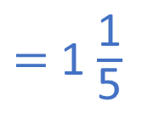

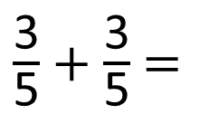
$\frac{\text{3}}{\text{5}}$ $+$ $\frac{\text{2}}{\text{5}}$ $=$
$\frac{\text{5}}{\text{5}}$
$=$ 1
$\frac{\text{3}}{\text{5}}$ $+$ $\frac{\text{3}}{\text{5}}$ $=$
$\frac{\text{6}}{\text{5}}$
$=$ 1 $\frac{\text{1}}{\text{5}}$
Have a think

Slide 8
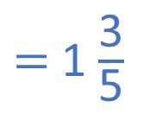

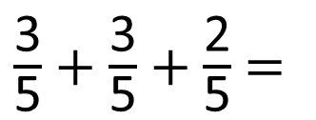
$\frac{\text{3}}{\text{5}}$ $+$ $\frac{\text{3}}{\text{5}}$ $+$ $\frac{\text{2}}{\text{5}}$ $=$
$\frac{\text{8}}{\text{5}}$
$=$ 1 $\frac{\text{3}}{\text{5}}$
Have a think

Slide 9
$\frac{\text{3}}{\text{5}}$ $+$ $\frac{\text{3}}{\text{5}}$ $+$ $\frac{\text{2}}{\text{5}}$ $=$
$\frac{\text{8}}{\text{5}}$
$=$ 1 $\frac{\text{3}}{\text{5}}$
Method A
Method B

Slide 10
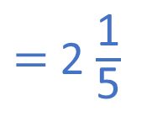

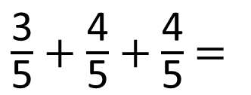
$\frac{\text{3}}{\text{5}}$ $+$ $\frac{\text{4}}{\text{5}}$ $+$ $\frac{\text{4}}{\text{5}}$ $=$
$\frac{\text{11}}{\text{5}}$
$=$ 2 $\frac{\text{1}}{\text{5}}$
Have a think

Slide 11
Have a go at questions 1 – 4 on the worksheet
Remember you can draw bar models and divide them into the fraction you are using to help you see what it looks like.

Slide 12

Challenge
2
$\frac{\text{4}}{\text{7}}$ $+$ $\frac{\text{2}}{\text{7}}$ $=$ $\frac{\text{6}}{\text{7}}$

Slide 13
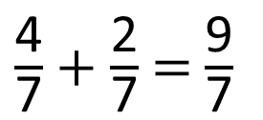
2
$\frac{\text{4}}{\text{7}}$ $+$ $\frac{\text{2}}{\text{7}}$ $=$ $\frac{\text{6}}{\text{7}}$
5
$\frac{\text{4}}{\text{7}}$ $+$ $\frac{\text{2}}{\text{7}}$ $=$ $\frac{\text{9}}{\text{7}}$
Have a think

Slide 14
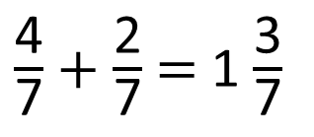
6
$\frac{\text{4}}{\text{7}}$ $+$ $\frac{\text{2}}{\text{7}}$ $=$ 1 $\frac{\text{3}}{\text{7}}$

Slide 15
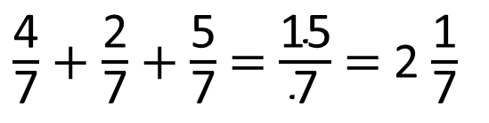
6
15
$\frac{\text{4}}{\text{7}}$ $+$ $\frac{\text{2}}{\text{7}}$ $+$ $\frac{\text{5}}{\text{7}}$ $=$ $\frac{\text{15}}{\text{7}}$ $=$ 2 $\frac{\text{1}}{\text{7}}$
Have a think

Slide 16
Have a go at the challenges on the worksheet

