Slide 1
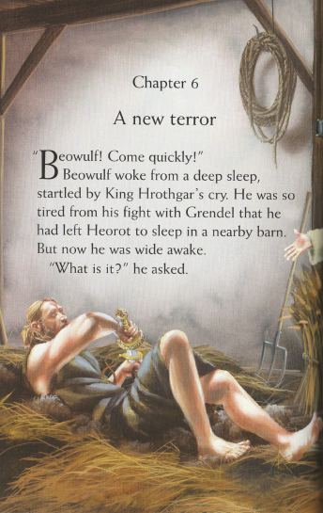
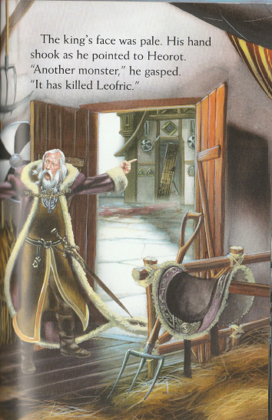

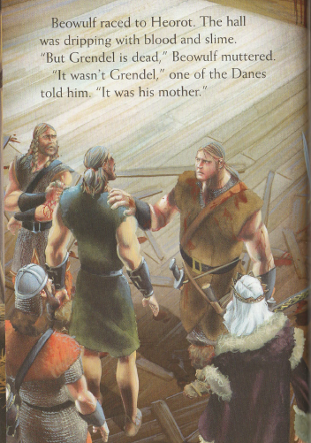
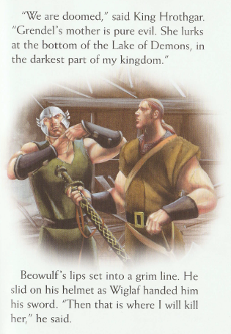
Why do you think Beowulf chose to sleep in the barn rather than Heorot?
Make sure you listen to both.

Slide 2
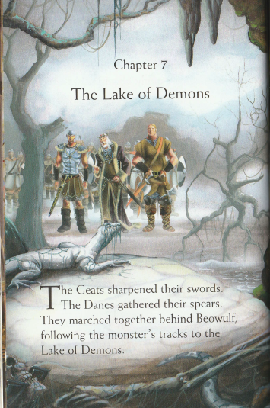
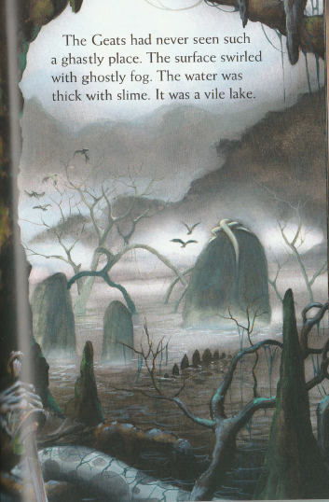
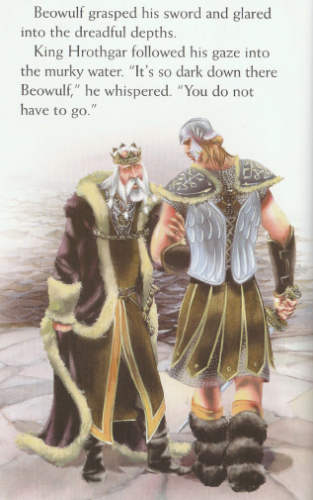
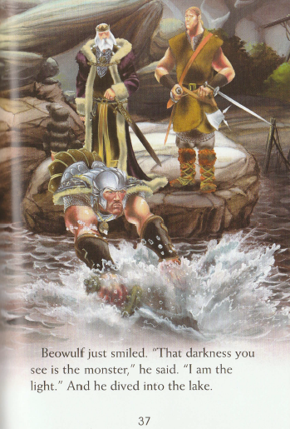
2. What type of place was it?
3. What swirled on the surface of the lake?

Slide 3
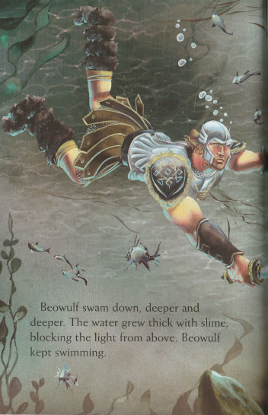
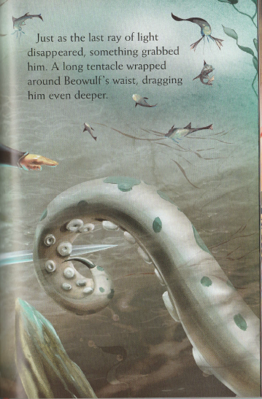
4. What was blocking the light from above?
5. When was Beowulf grabbed around the waist?

Slide 4
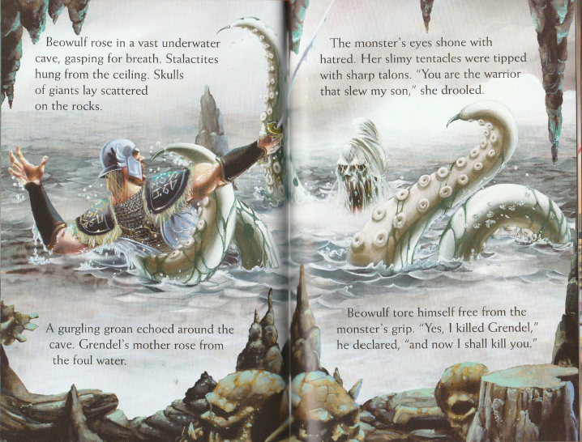
6. Find a word that means enormous or immense.
7. What does slew mean in the story?

Slide 5
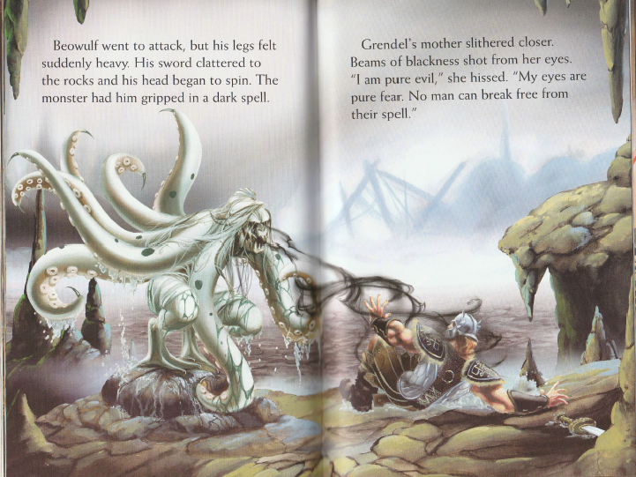
8. What shot from Grendel’s mother’s eyes?

Slide 6
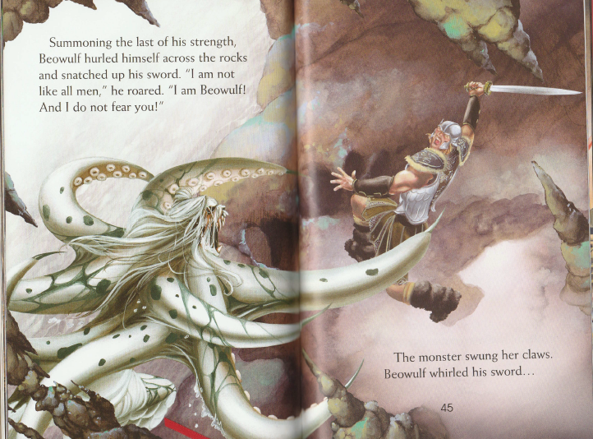

Slide 7
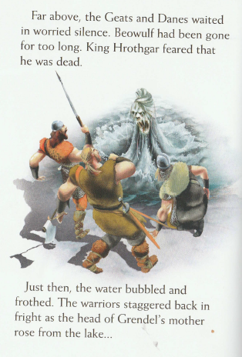
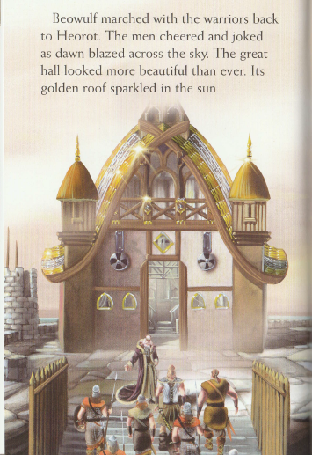
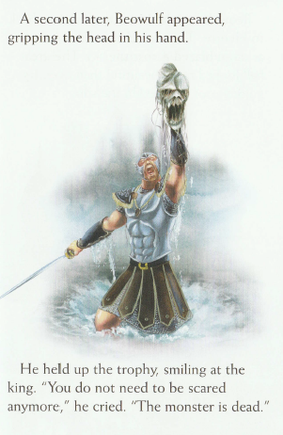

Slide 8
ANSWERS
Why do you think Beowulf chose to sleep in the barn rather than Heorot? Because it might be noisy as they would be celebrating their victory over Grendel.
What type of place was it? ghastly
What swirled on the surface of the lake? a ghastly fog
What was blocking the light from above? The slime because it was so thick.
When was Beowulf grabbed around the waist? ‘Just as the last ray of light disappeared’
Find a word that means enormous or immense. vast
What does slew mean in the story? slayed/killed
What shot from Grendel’s mother’s eyes? beams of blackness

