Slide 1
Dreams and Goals
Michael loved to play basketball. He liked playing it with his older brother and their friends. They were much taller than he was. One boy called Mark wouldn’t let him join in because he said that Michael was too small. This made Michael feel sad so he asked his Mum how he could get taller.
She said, “We can put salt in your shoes. That will help you grow.”

Slide 2
It was a strange thing to say. Michael stopped going to the park and stayed home to practise so when he was taller he would be even better at basketball. After a few months, Michael hadn’t grown at all.
His Dad said, “ Being taller might help you be a better player but your practise and determination have already made you great.”

Slide 3
Michael ran off to the park to join in with the basketball game. When he arrived, Mark wouldn’t let him join in but then another boy got injured and one of the teams needed a new player. This was Michael’s chance. He took the place in the team and scored the winning basket.
He didn’t need to grow to be a better player.
Notice how his hard work, determination and perseverance made a difference. He showed resilience when things didn’t go his way to begin with.
Have you worked out yet who Michael might be?

Slide 4
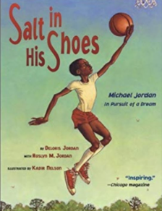
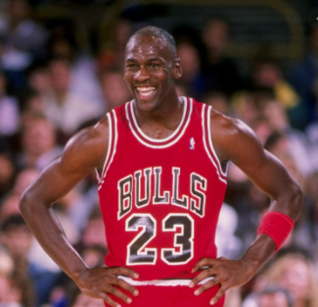
Michael Jordan – professional basketball player
Chicago Bulls
https://www.youtube.com/watch?v=2ULzeWIlamA
Salt in His Shoes – Michael Jordan in Pursuit of a Dream

Slide 5



On a piece of paper shaped like a leaf, write or draw one of your dreams and how this makes them feel. Decorate it however you want.
What dream do you have?
How might you achieve your dream?
How does having a dream make you feel?

