Slide 1

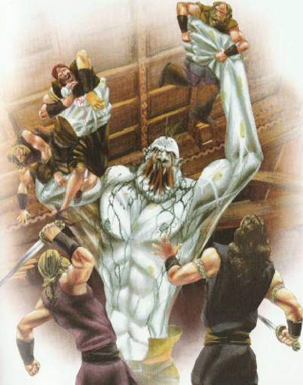
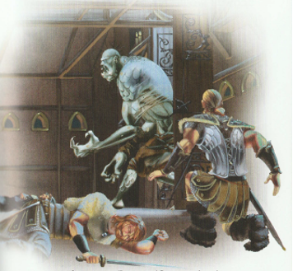

LO: to plan and begin writing diary entry
Think
Use the images from the story
Use your words describing how you as warrior were feeling
Use the sentences that you came up with yesterday

Slide 2
LO: to plan and begin writing diary entry
How are you going to start your diary?
What events do you want to write about?
What feelings are you going to share?

Slide 3
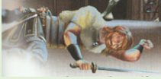
Maybe you want to write about how you were feeling waiting there for Grendel.
What were you thinking?
How were you feeling?
What were you doing?
What could you see/hear?
Perhaps you are going to recall what it was like when Grendel entered the hall and what happened then.

Slide 4
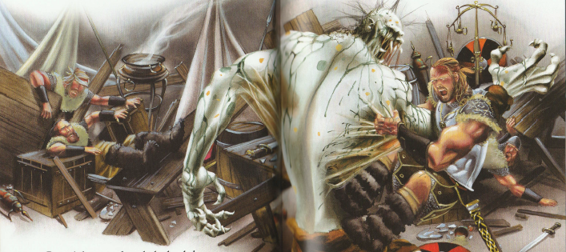
May be you are going to retell your part in defeating Grendel.
How you helped Beowulf defeat him.
What were you feeling?
What did you do?
What did you see happen?

Slide 5
Which part of that night are you going to write in your diary?
Use the words and sentences you have already come up with to help you plan.
When you are ready – start writing. Remember you have today and tomorrow to do it.
Think about:
Introduction
Events (what happened)
Feelings

Slide 6
Remember my diary only recalled the part up to where Grendel arrived. What will yours be like?
Tiw – Mighty God of War,
Thank you for watching over and protecting us this night and giving us the strength to overcome that vile monster Grendel. The Danes said he was an unworldly beast with claws like daggers and a roar that could shake the earth. They were right!
As we lay there in the darkness, no-one dared speak but I knew we were all feeling the same. We were scared, we were on edge, we were frightened. An uneasy silence filled the air, our ears listened out for any sign of what was to come. Every noise made us jump, the shadowy corners hid scurrying animals and made our imagination fear the worse.
Questions had filled my head, why had Beowulf brought us here? Would I be brave? Would I prove myself? And yet, I knew I would play my part. My belief in Beowulf would see me through, it would give me the strength I needed. My sword was ready.
I felt the ground shake beneath me. I heard the roar coming from the other side of the wooden door. The moment had arrived …

