Slide 1
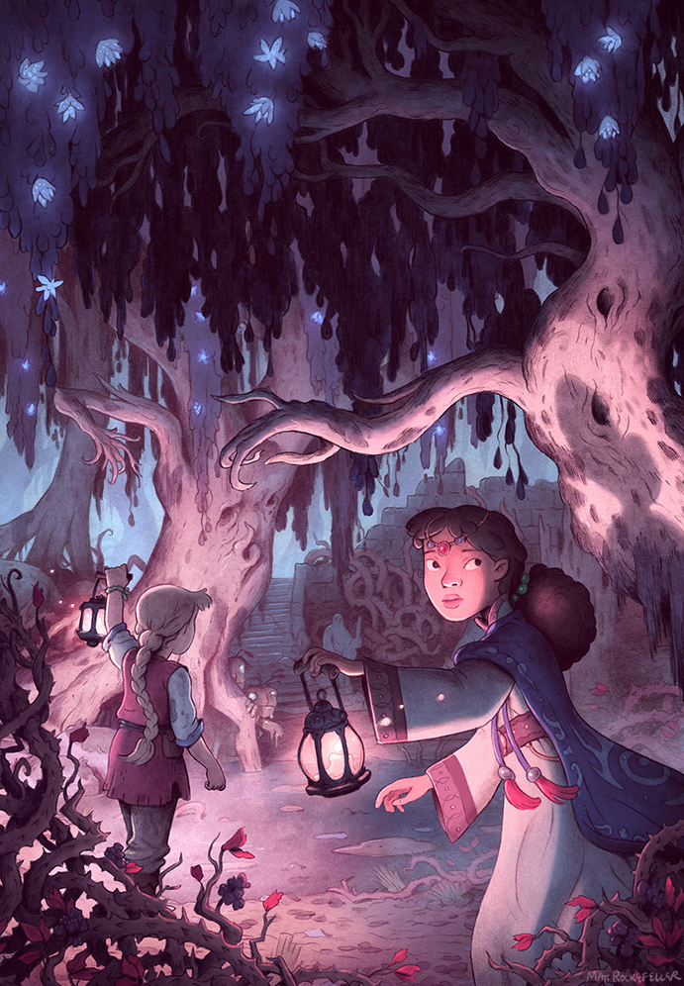

Create a Paragraph using Fronted Adverbials

Slide 2
Have a look at the picture
What time is it?
How are they walking?
What are they doing there?
How often do they go there?
(Perhaps they are looking for an Anglo-Saxon God? Which one I wonder.)
What can you see around the girls?
What type of noises can you hear?
What do you think it smells like?

Slide 3
What do you notice about the two sentences?
Similarities?
Differences?
1. Slowly and carefully, the two young girls travelled through the mysterious forest.
2. In the magical forest, the soft petals shimmered light from the delicate flowers.

Slide 4
Remember a fronted adverbial...
…is when a word or a phrase is put at the start of a sentence (followed by a comma), to explain how (manner), when (time) or where (place/location) something is being done.
Some words do end with an ‘ly’.
A man hammered the rock, carefully.
Carefully, a man hammered the rock.

Slide 5
Fronted adverbials hunt
Read the paragraph
Underline all the fronted adverbials
Challenge:
Which fronted adverbial tells you how, when or where?

Slide 6
Read through the paragraph and find all the fronted adverbials.
How, where or when?
STOP – do not look at next slide until you have found them.
Before the sunrise, I woke up and immediately ate my breakfast. In the blink of an eye, my breakfast had vanished from my plate. It was my favourite breakfast of Weetabix with strawberries and a dollop of Nutella so I had eaten it super speedily. After I had got dressed, I decided to go outside to play on my brand new, emerald green bike. It has front suspension so I can quickly cycle downhill on it. Before long, it began to rain so I reluctantly put my bike away in the shed and went back inside. In the kitchen, I could smell pizza bubbling away in the oven which made my tummy grumble.
Notes:
Drama input

Slide 7
Check your answers
Before the sunrise, I woke up and immediately ate my breakfast. In the blink of an eye, my breakfast had vanished from my plate. It was my favourite breakfast of Weetabix with strawberries and a dollop of Nutella so I had eaten it super speedily. After I had got dressed, I decided to go outside to play on my brand new, emerald green bike. It has front suspension so I can quickly cycle downhill on it. Before long, it began to rain so I reluctantly put my bike away in the shed and went back inside. In the kitchen, I could smell pizza bubbling away in the oven which made my tummy grumble.

Slide 8
Our bank of fronted adverbials.
Fronted adverbials mat
How (manner) | When (time) | Where (location)
Sadly, As fast as they could, Unexpectedly, Mysteriously, Without a sound, Bravely, | Immediately, In a blink of an eye, All of a sudden, Eventually, Later that day, After a while, | In the hidden depths of the forest, Under the moonlight, Down by the waterfall, Everywhere she looked, Behind the large tree, Far away,

Slide 9
Your turn
Write 5 sentences or a paragraph using fronted adverbials.

