Slide 1
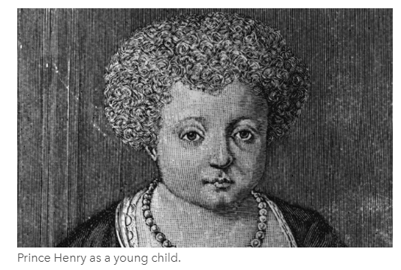
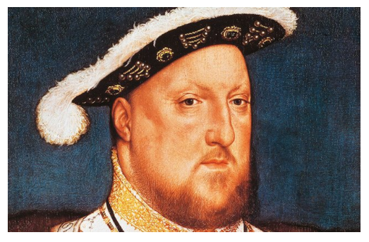
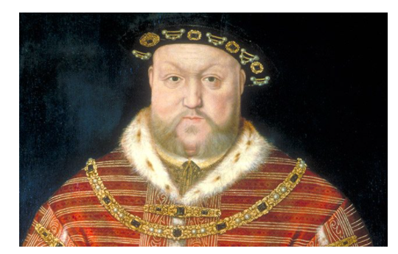
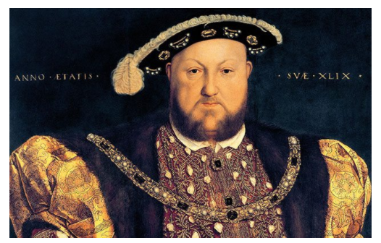
Henry VIII Fact File

Slide 2
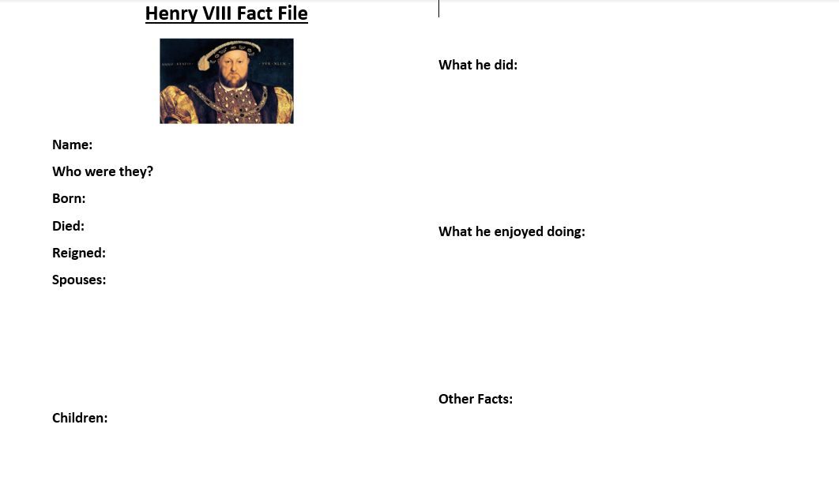

Slide 3
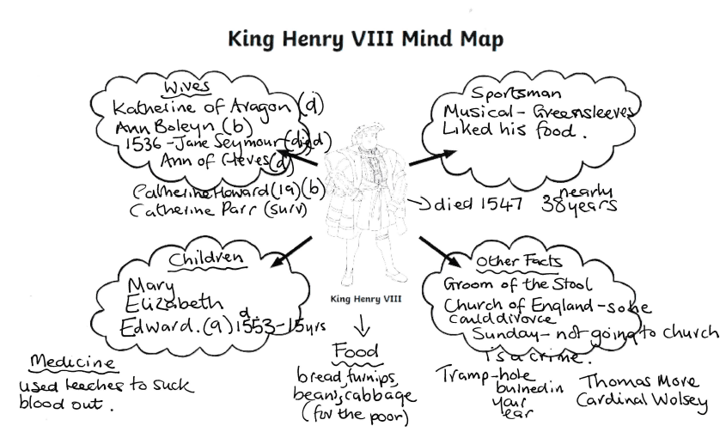

Slide 4
Henry VIII was a famous Tudor king. Most people remember him for having six different wives.
Henry VIII had many interests – he loved sports and music, he was a good fighter in a battle, and he was well educated. He began the English Reformation that established the Church of England and he had three children who each went on to rule England after he died.

Slide 5
Henry VIII was born on 28 June 1491 in London, at Greenwich Palace.
Henry became the King of England at age 17 in 1509, when his father, Henry VII, died.
Just before Henry VIII became king, he married Catherine of Aragon.
Henry VIII divorced Catherine of Aragon in 1533, and married Anne Boleyn.
Henry VIII grew up as a Catholic, but established the Protestant Church of England when the Pope, the head of the Catholic Church, wouldn’t let him divorce Catherine of Aragon.
Henry VIII married four more times – he had six wives in total.
From his six marriages, Henry VIII only had three children who lived. Each of them (Edward VI, Mary I and Elizabeth I) in turn, ruled England after he died.

Slide 6
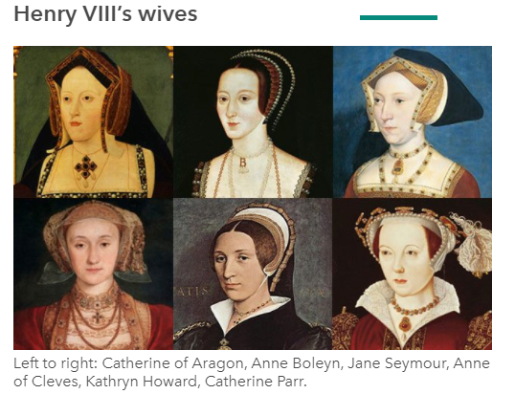
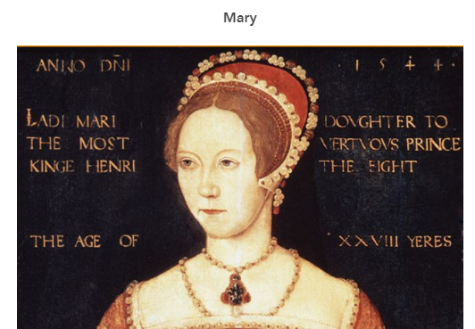
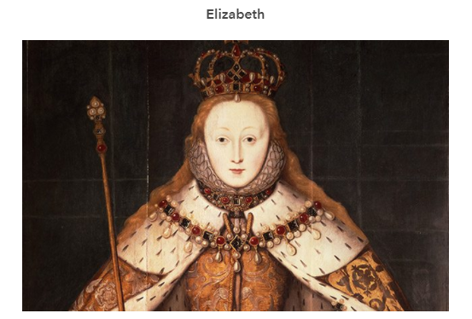
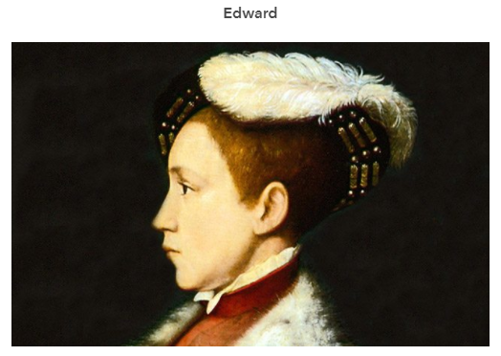

Slide 7
Henry VIII enjoyed being outdoors and getting exercise. He loved hunting, playing games like tennis, dancing and reading. He also loved eating, and became very fat as he got older and couldn’t exercise as much.
Henry loved luxury – he was very well dressed, and wore velvet robes with gold trim and jewels, and rebuilt and redecorated his rooms at Hampton Court Palace at least six times! In 1540, Hampton Court was the most modern and magnificent palace in the world.
He died in 1547, and is buried at Windsor Castle next to his favourite wife, Jane Seymour.

Slide 8
Henry was not born to be king – he became the heir to the throne at age 11 when his older brother Arthur died.
Described as ‘a golden prince’, Henry wrote music and poetry when he was a young man.
Henry VIII wanted people to be good at shooting a bow and arrow. In fact, he made it the law that no one age 24 or older could shoot at a target less than 200 metres away – that’s longer than a football pitch!
Henry was very tall for Tudor times: he was 1.87m tall (6ft 2in) at a time when the average man in London was 1.70m (5ft 5in).
To help you remember about King Henry VIII’s six wives and what happened to them, learn this mnemonic: ‘Divorced, beheaded, died. Divorced, beheaded, survived.’
One of Henry VIII’s hobbies was falconry, which is a kind of hunting using trained birds of prey called hawks. He also loved jousting, wrestling and playing tennis.
As well as establishing the Church of England, Henry allowed the Bible to be translated into English and published.

Slide 9
