Slide 1
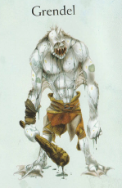
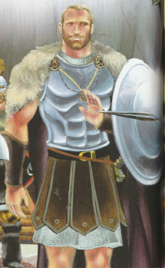
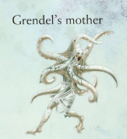
LO: to identify powerful descriptive words and phrases
Beowulf
Choose the character that you want to write a description about.

Slide 2
Grendel
Grendel’s huge bulk towered over all others. Just like his bold mother, he was pure evil. As he always fought bare-handed, his body dripped in the blood of each of his warrior victims.
From his huge, square jaw stumpy, brown decaying teeth protruded viciously like old rusty knives. His eyes were completely charcoal black and grey spit oozed out of his disgusting, slimy mouth. Spiky and hard hair trailed down his slimy warty back.
As he stomped towards Hereot, the ground shook and shuddered beneath him as if foretelling the horror that was to follow. Each foot had two hard horny nails that dug up the ground as he passed. Roaring with anger at being awoken, he ripped open the sacred doors of Hereot and entered…
Underline or copy the powerful words and phrases that you want to magpie.

Slide 3
Beowulf
It was said that Beowulf was the greatest and most courageous of all warriors. The magnificent warrior stood prouder and taller than many of his brave companions. Underneath his clothing, strong muscles gave an indication of his powerful strength (equal to thirty men it was said). His eyes were kind but determined – once he had decided on a course of action no-one could deter him. Golden hair plaited and tied fell down to his waist.
He moved with an ease and grace yet if needed he could spring immediately into action. Always alert to danger and the need to protect those under his care. He was fearless and determined to drive out evil once and for all, to bring peace and joy. Grendel needed to be stopped and Beowulf knew he was the one to do it.
Underline or copy the powerful words and phrases that you want to magpie.

Slide 4
Grendel’s Mother
Grendel’s mother roared with pain and anger. Her beloved son had been murdered and she was out for revenge. Her long tentacles tingled with the anticipation of squeezing the life from her victims. Slime drooled from her gaping mouth as she left the ghostly swamp and her lair. Her howling echoed around her, terrifying any who heard it. Two red pools of shocking eyes shone menacingly into the darkness, warning those in her path that she was on the move. Half crawling, half flying she made her way to Heorot and the celebrating warriors (unaware of the danger lurking outside).
Underline or copy the powerful words and phrases that you want to magpie.

Slide 5
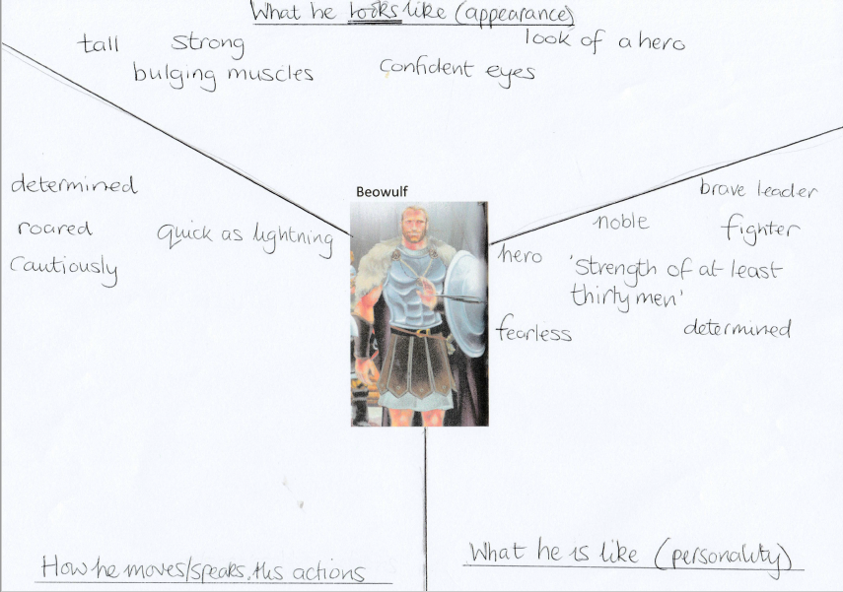
Add the words and phrases that you have found. What others can you think of?

Slide 6
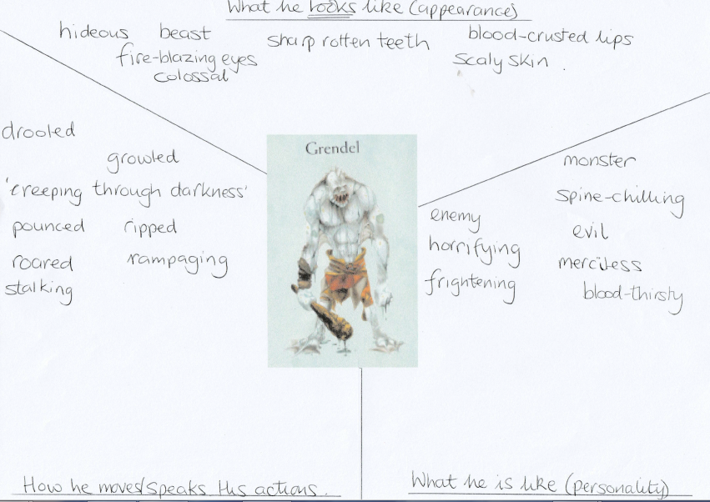
Add the words and phrases that you have found. What others can you think of?

Slide 7
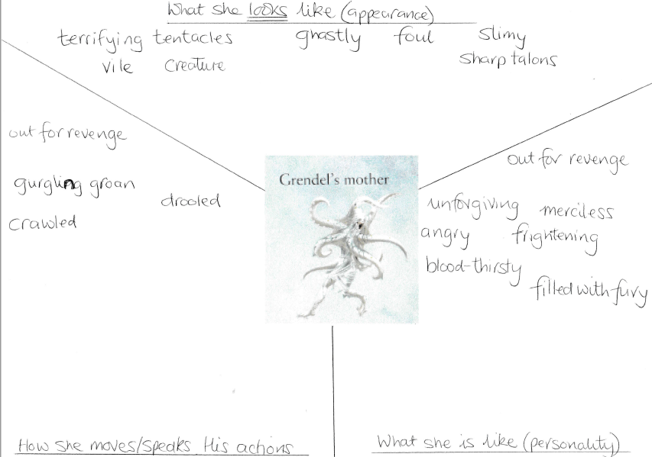
Add the words and phrases that you have found. What others can you think of?

