Slide 1


Welcome to Year 1
Cherry Class
Ms Healy
Mrs Keating, Ms Molloy, Mrs Martin, Mrs Henderson

Slide 2
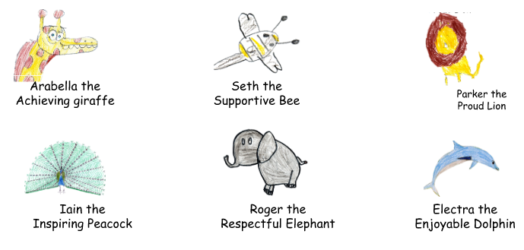

Our Values
Each half term, we will focus on one of our A.S.P.I.R.E. values. Certificates are given during Aspire assemblies to children who have shown this value throughout the week.
Achieve, Support, Pride, Inspire, Respect, Enjoy
The Aspire Animals
In 2021, we introduced the Aspire animals to help our children understand our school values. The animals were designed by the children and are displayed in classrooms throughout the school.

Slide 3
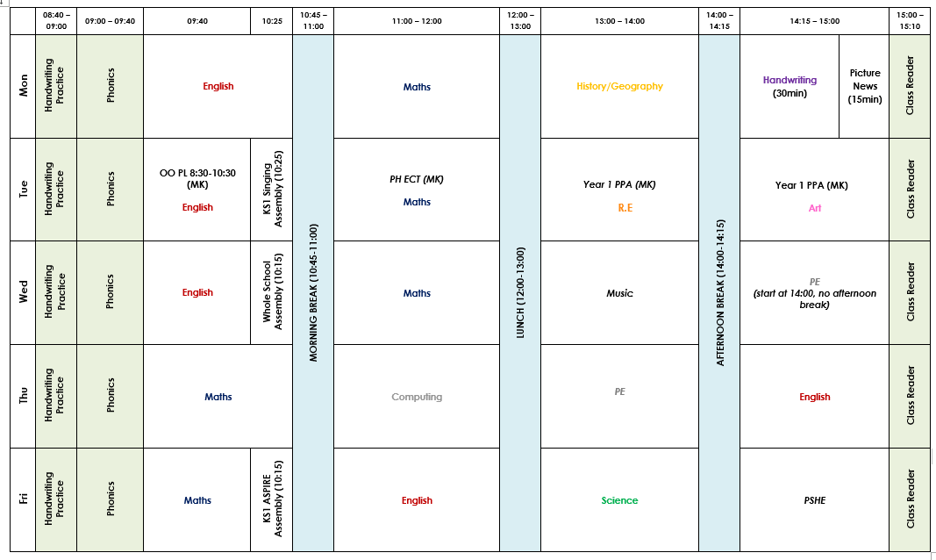
Our timetable
PE: Wednesday , Thursday
Home learning: Monday
Spelling : Tuesday
Library: Monday
Phonics book change: Friday
*Show & tell is sadly not part of Year 1 unless it is ASPIRE related (homework/Extra-curricular achievements

Slide 4

Topics for the Year
Autumn 1 | Autumn 2 | Spring 1 | Spring 2 | Summer 1 | Summer 2
Traditional tales | Home and away | Animals and us | Toys | Growing and changing. | The world is your oyster
*School trips/workshops – we would love to know if you have an in date DBS to support these valuable learning experiences

Slide 5
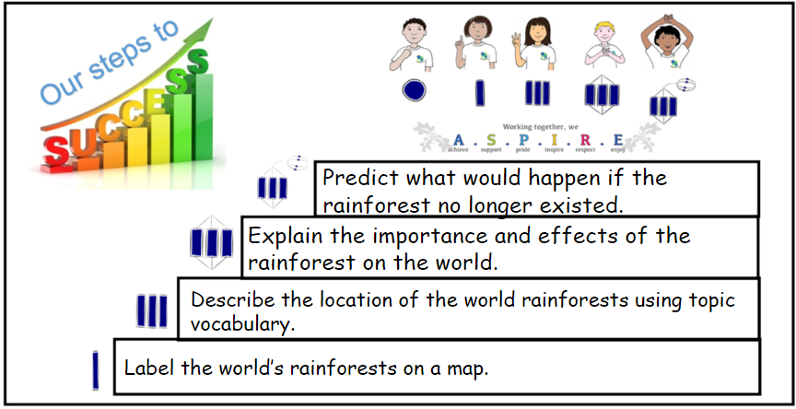




Zones of regulation

Slide 6

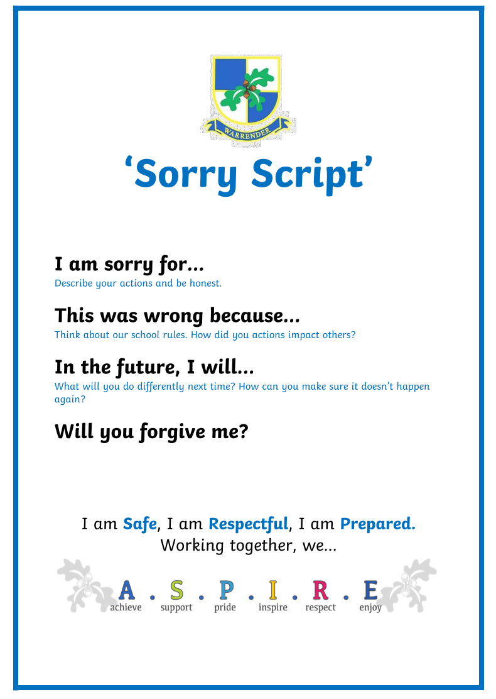

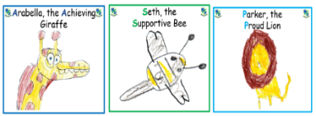


Behaviour
Positive behaviour system- restorative approach
We have a weekly ASPIRE assembly where up to two children from each class can be awarded a certificate, linking to that half terms value and a wild card.
3 school rules
Sorry scripts
Level 1-5 stages for poor choices
3 ASPIRE certificates weekly

Slide 7

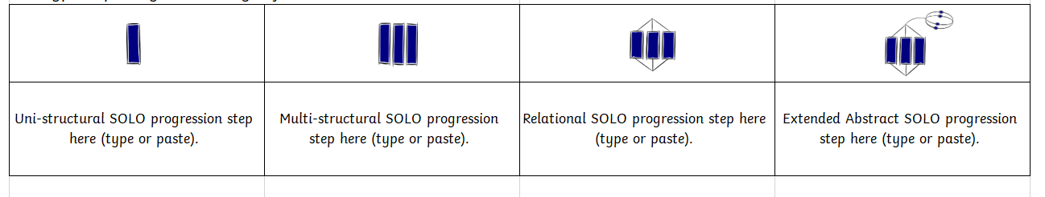
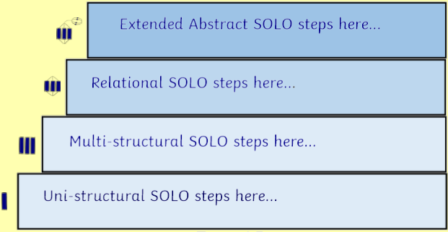
SOLO taxonomy
As a school, we recently included a pedagogical approach called Solo Taxonomy into our teaching. Each lesson is planned to follow a sequence through the following steps:
Each lesson is planned in consideration with this pedagogy and helps support the children to achieve the main objective of the lesson. Not every child will reach all stages of the lesson, however the scaffolds have been planned to help them achieve as well as challenge and extend some learners.

Slide 8
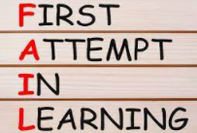

How we teach?
We foster an environment where pupils feel safe to take risks and attempt new learning, free from the fear of failing.
We use different techniques such as The Learning Pit and F.A.I.L. These are displayed within the classroom to remind pupils that there is value in a challenge and that mistakes form the building blocks on the path to success.
“Mistakes are how we learn!”

Slide 9

Resources
Stationery is provided so please keep all pencil cases at home.
Please bring in bookbags daily with water bottles in hands to avoid any spillages on.

Slide 10



Reading
On Mondays during our library session, they can choose two books to read for pleasure.
Two phonics books will be sent home on Fridays. These include only words the pupils have learnt so they will be able to read them independently. These should be kept in their book bags.
Reading Buddies has been introduced this year. Year 5 will inspire Year 1 by reading with them.
Whole class reading takes place daily*.
The children should be reading a minimum of 5 times a week at home and the reading record should be signed each time, allowing us to keep track of home reading.
*Subject to time.

Slide 11

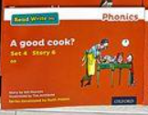
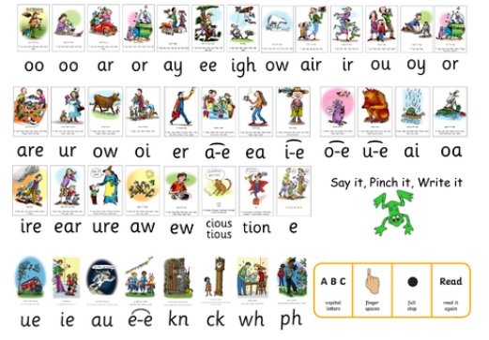
Read Write Inc - Phonics
This half term we will be hosting a parent workshop on how to support phonics learning at home. Date to be confirmed.
Ruth Minskin videos can also be found YOUTUBE
Phonics assessments take place every half term and pupils are placed into groups based on sounds that are secure in.
In June they will take a national test for their phonics assessment.
If any of the RWI books are lost of damaged you will be asked to replace the book or donate towards the cost of ordering new books.

Slide 12

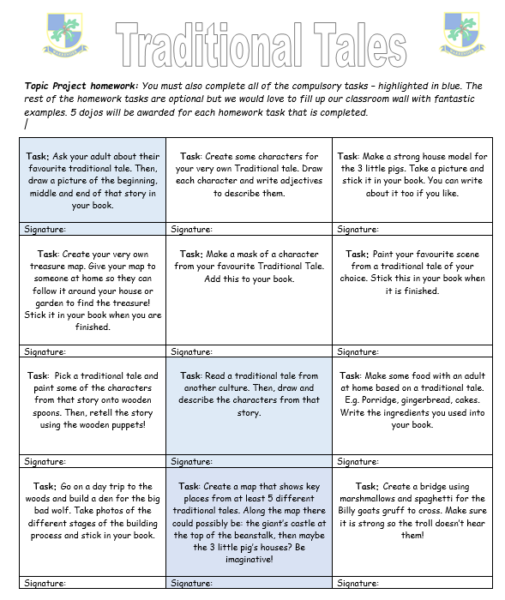

Home learning
The homework is due in on Monday.
Weekly Mathletics is assigned.
This is a consolidation.
Logins and how to set up accounts given at parents evening.

Slide 13


Spellings
On Tuesday we will have our weekly spelling test. These will expose children to all the phonics sounds and two common exception words.
Each week they will increase in difficulty, but we will plan in activities to revise them during the school day.
To support independence our weekly spellings are displayed with the corresponding Widget.
These core symbols are also utilised within our learning so becoming familiar with these will also support their writing.

Slide 14
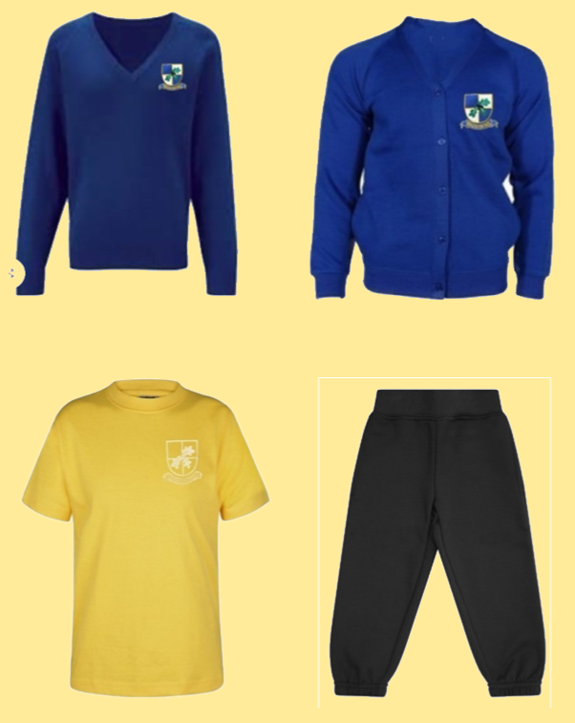
Uniform and PE
Please clearly name every piece of your child’s uniform.
Only trainers on P.E. day
On PE days, no jewellery is to be worn and earrings cannot be taped up.
Only stud gold/silver earring – no hoops or fancy earrings
Hair must be tied back.
No hoodies for P.E. This is all due to health and safety.
If black shorts are worn under dresses, these need to short and not longer than the dress e.g cycling shorts are too long)
If your child comes in wearing incorrect uniform, a green slip will be sent home.

Slide 15

How do we contact the teacher?
Small messages or updates can be given at the door after all the children have been dismissed.
Any collection changes or medical appointments please call the office, and they will pass any messages on.
‘Handle with care’ written notes are always welcome.
If you would like to share/discuss anything more in depth regarding your child, please arrange a meeting via the school website QR code. I will be in touch within 48hours by phone to arrange an appointment.
Our school policy is that we do not reply to direct-messages on dojo.

Slide 16

Thank you for listening
Do you have any questions?

