Slide 1

Welcome to Year 1

Slide 2
Elm class teachers
Mrs Ormerod (Tuesday to Friday)
Mrs Keating (Monday to Wednesday)
Mrs Ralfs
Cover teachers:
Miss Noel, Mr Hunter and Miss Taylor

Slide 3
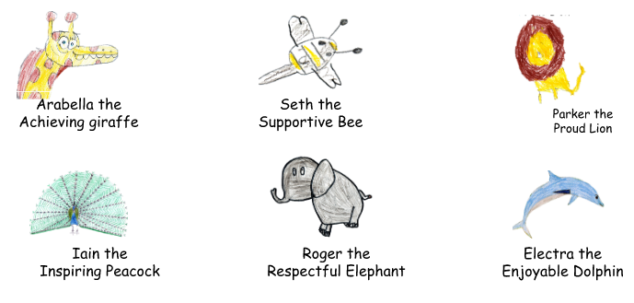

School vision and values
Each half term, we will focus on one of our A.S.P.I.R.E. values. Certificates are given during Aspire assemblies to children who have shown this value throughout the week.
Achieve, Support, Pride, Inspire, Respect, Enjoy
The Aspire Animals
In 2021, we introduced the Aspire animals to help our children understand our school values. The animals were designed by the children and are displayed in classrooms throughout the school.

Slide 4
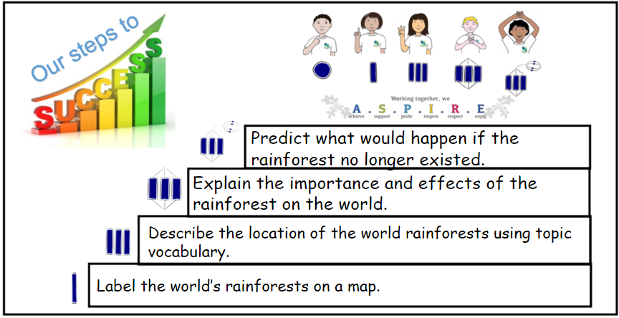





Zones of regulation

Slide 5

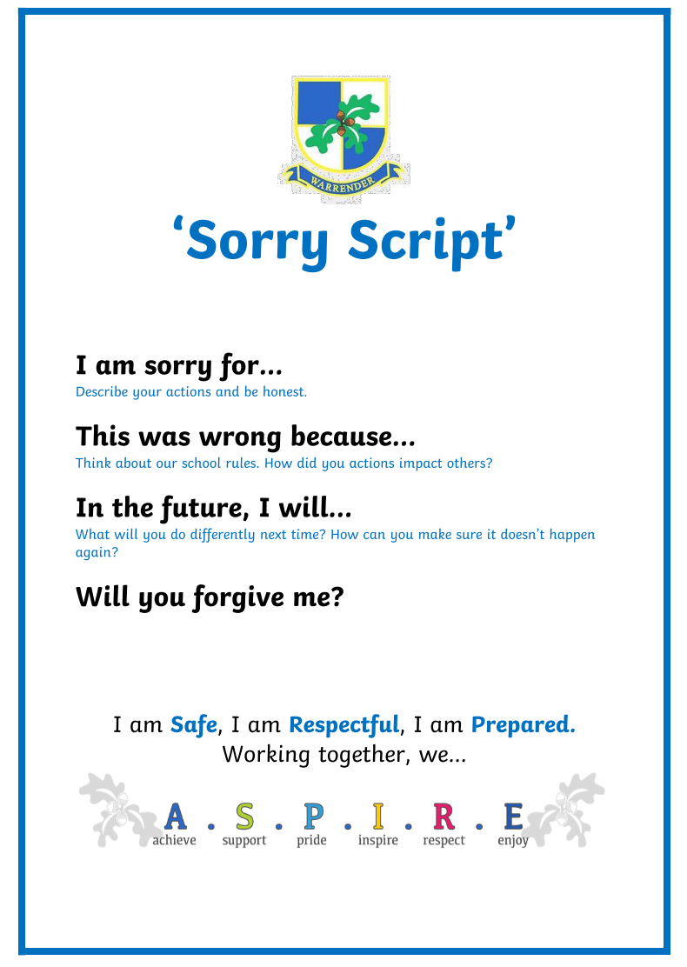
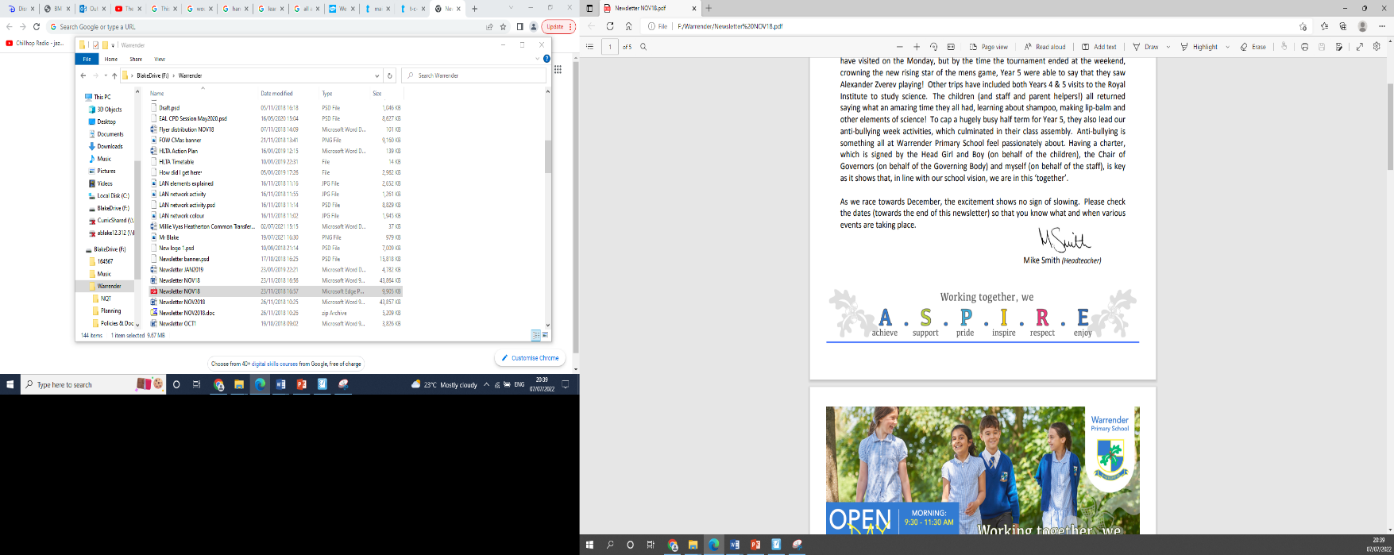
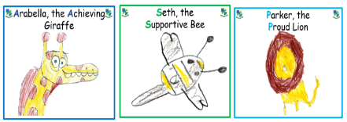




Behaviour
- Positive behaviour system
We have a weekly Aspire assembly where up to 2 children from each class can be awarded a certificate, linking to that half terms aspire value and a wild card
Refer to 3 school rules and sorry scripts
Level 1-5 stages for poor choices
Please also refer to the school behaviour policy
3 ASPIRE certificates weekly

Slide 6
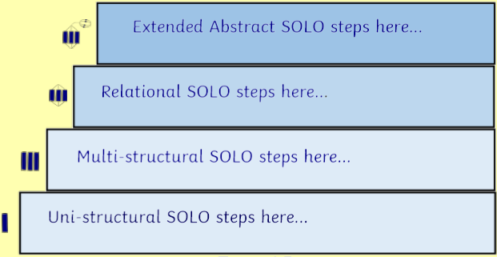
SOLO taxonomy
As a school, we recently included a pedagogical approach called Solo Taxonomy into our teaching. Each lesson is planned to follow a sequence through the following steps:
Each lesson is planned in consideration with this pedagogy and helps support the children to achieve the main objective of the lesson. Not every child will reach all stages of the lesson, however the scaffolds have been planned to help them achieve as well as challenge and extend some learners.

Slide 7

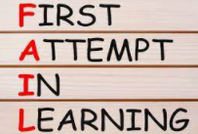
How we teach?
In order to make learning accessible for all children, we use different techniques such as the Learning Pit and F.A.I.L. These are displayed within the classroom so they can help the children be successful in their learning everyday.

Slide 8

Resources
Stationery is provided so please keep all pencil cases at home.
Please bring in bookbags daily and a water bottle.

Slide 9
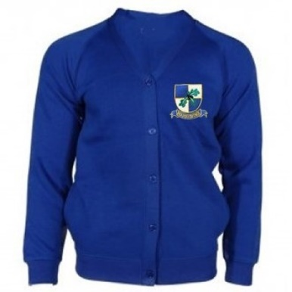

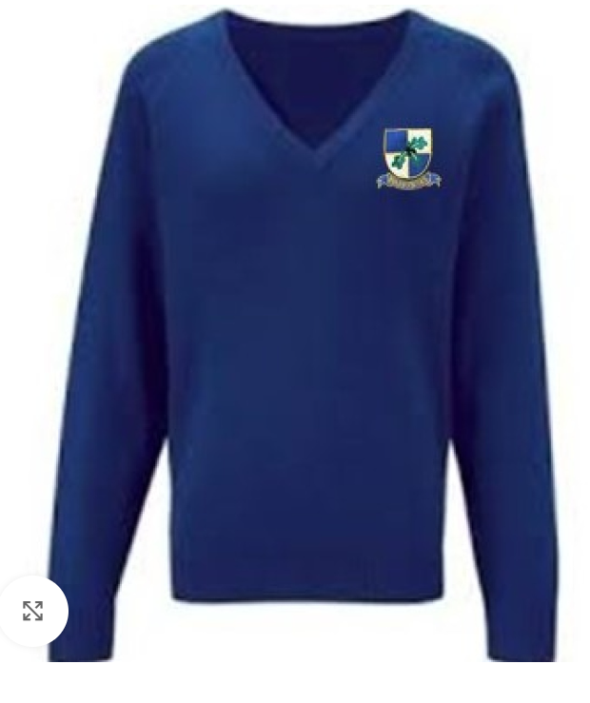

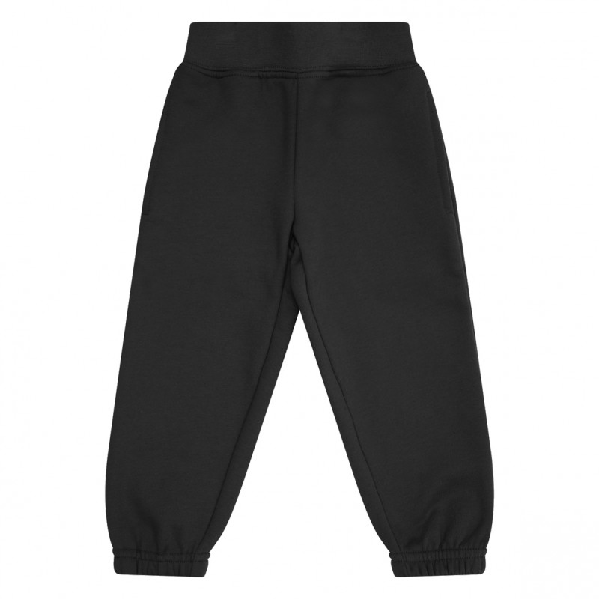
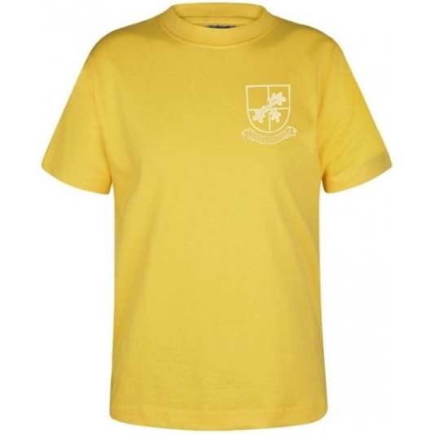
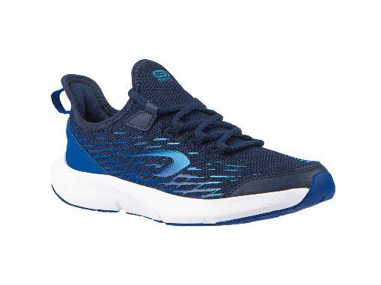
Uniform and PE Kit
Please clearly name every piece of your child’s uniform.
Only trainers on P.E. day
On PE days, no jewellery is to be worn and earrings cannot be taped up.
Only stud gold/silver earring – no hoops or fancy earrings
Hair must be tied back
No hoodies for P.E. This is all due to health and safety.
If black shorts are worn under dresses, these need to short and not longer than the dress
If your child comes in wearing incorrect uniform, a green slip will be sent home

Slide 10
The topics we teach
Autumn 1 Traditional tales | Spring 1 Animals and us | Summer 1 Growing and changing
Autumn 2 Home and away Trip to the greengrocers | Spring 2 Toys Toy Workshop | Summer 2 The world’s your oyster Trip to the London aquarium
*School trips/workshops – we would love to know if you have an in date DBS to support these valuable learning experiences

Slide 11
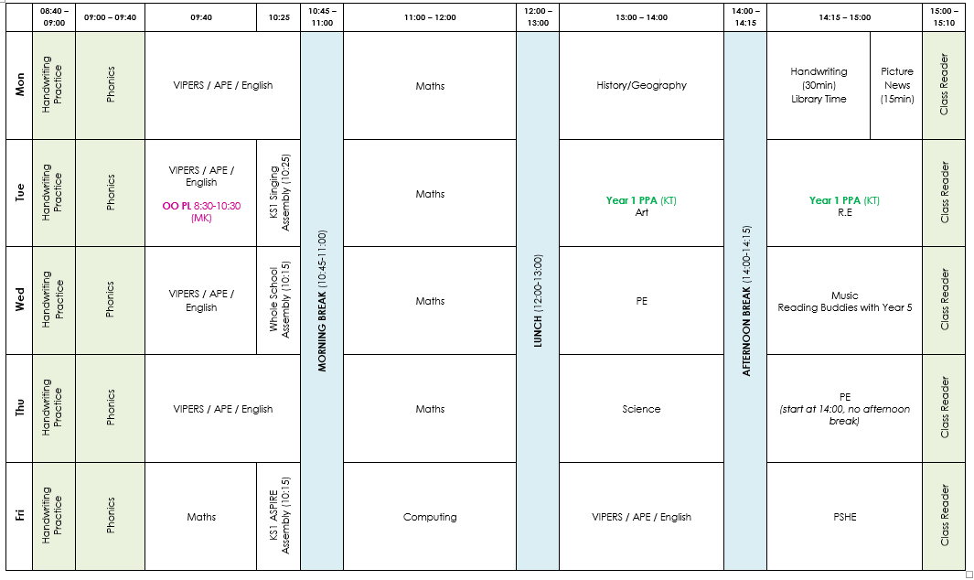
Elm Class timetable
PE: Wednesday , Thursday
Home learning: Monday
Spelling : Tuesday
Library: Monday
Phonics book change: Friday

Slide 12

Phonics
Phonics will be assessed every half term and children will be grouped according to their level
We follow the Read Write Inc phonics programme.
The children will be sent home with 2 phonics books every Friday. Please make sure they are returned to school on this day.
The children will complete a phonics assessment test in June.
This half term we will be hosting a parent workshop on how to support phonics learning at home. Date to be confirmed.

Slide 13

Reading books
Children will also be sent home with an Oxford reading tree book and two library books every week. A message will be written in the yellow reading record book stating when this ORT book will be changed by an adult.
If any of the RWI books are lost or damaged you will be asked to donate towards the cost of ordering a new book.
The children should be reading a minimum of 5 times a week at home and the reading record should be signed each time, allowing us to keep track of home reading.

Slide 14
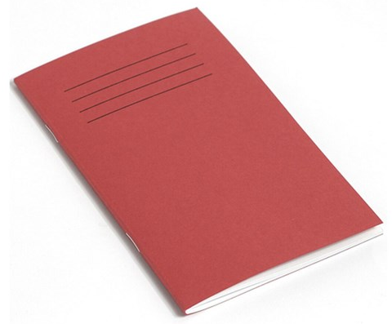
Spellings
Spelling tests will be on a Tuesday and then the book will be handed back either on the same day or on Wednesday.
The red books are for the children to use in school. If possible, use separate paper at home when the children are practising.

Slide 15
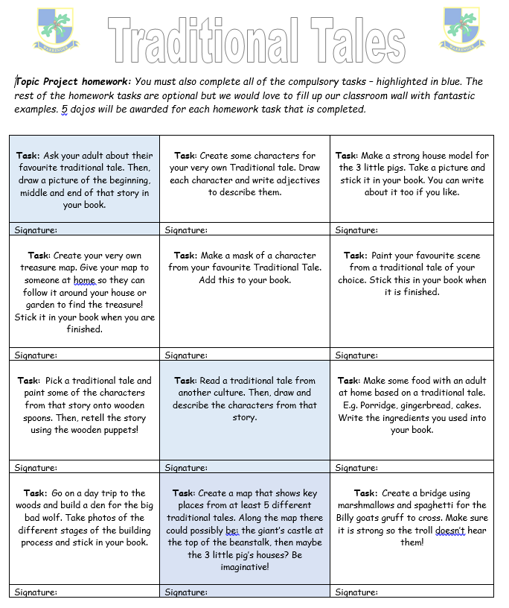
Homework
Home learning grids will be given out each half term.
Homework to be handed in on a Monday. It will be marked and sent back later in the week.
Please upload any photos to the dojo portfolio.
Each piece of homework is worth 5 dojos – although bonus dojo points are sometimes on offer!
Mathletics – logins will be given out at parents evening.

Slide 16

Communication
We will be sending out a Class story at the end of the week. Feel free to comment on that post with any further questions.
For any quick questions or queries, please find me on the playground, once the class has been dismissed.
If you are unable to speak to us at the door, please complete the parent consultation form, found on the school website.
Our school policy is that we do not reply to direct-messages on dojo.

Slide 17
Thank you all for coming today!
Does anyone have any questions?

