Slide 1


Welcome to Year 6
Meet the Teacher

Slide 2
Year 6 Team
Oak Class
Mrs Walsh (Monday to Wednesday)
Mrs Close (Wednesday to Friday)
Sycamore Class​
Mrs Evans (Monday, Tuesday, Thursday, Friday )
Mr Wright Wednesday
Mrs Rogan
Mr Hunter
Mrs Braithwaite
Mr Bornman
Miss Noel

Slide 3


Slide 4

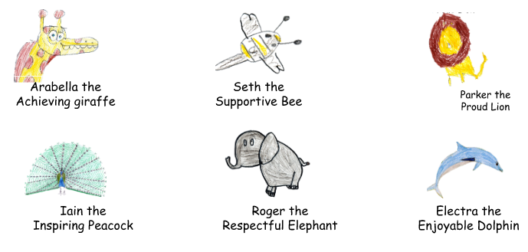

Our Values
Each half term, we will focus on one of our A.S.P.I.R.E. values. Certificates are given during Aspire assemblies to children who have shown this value throughout the week.
Achieve, Support, Pride, Inspire, Respect, Enjoy
The Aspire Animals
In 2021, we introduced the Aspire animals to help our children understand our school values. The animals were designed by the children and are displayed in classrooms throughout the school.

Slide 5




Zones of regulation

Slide 6

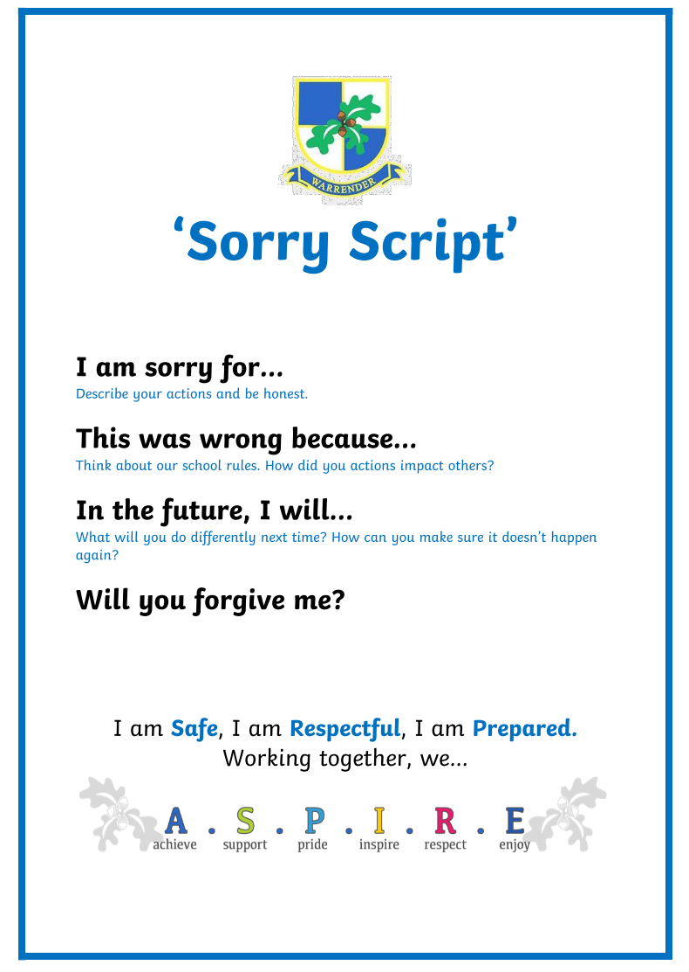
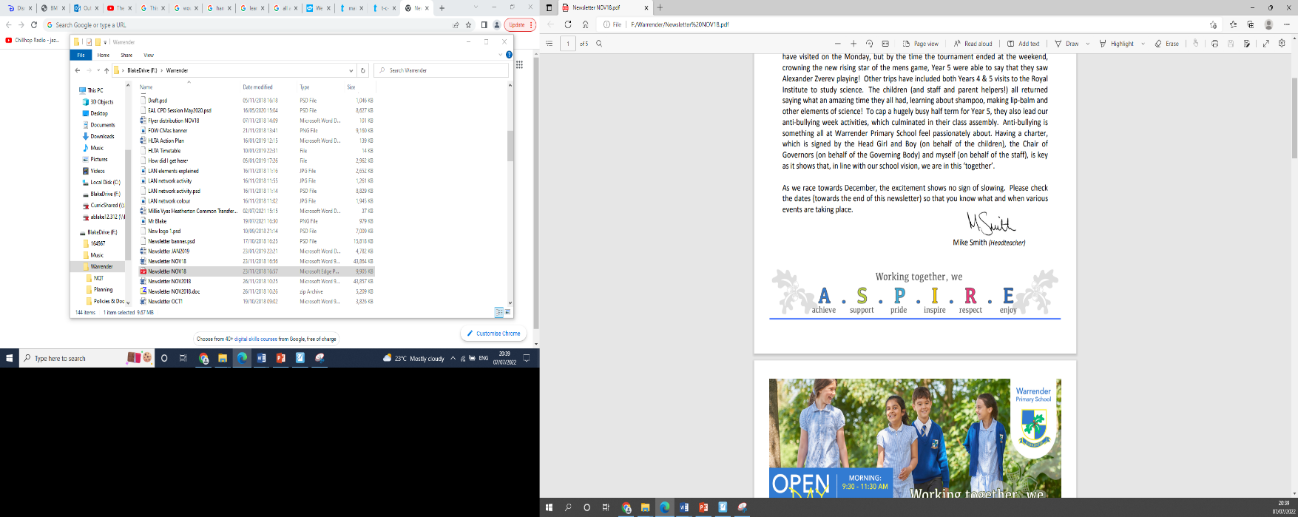
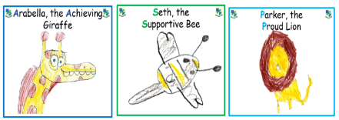



Behaviour
- Positive behaviour system
We have a weekly Aspire assembly where up to 2 children from each class can be awarded a certificate, linking to that half terms aspire value and a wild card
3 school rules and sorry scripts
School Behaviour Policy -Level 1-5 stages for poor choices
Mobile phones
Inappropriate use of social media
3 ASPIRE certificates weekly

Slide 7


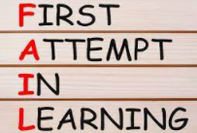
How we teach?
In order to make learning accessible for all children, we use different techniques such as the Learning Pit and F.A.I.L. These are displayed within the classroom so they can help the children be successful in their learning everyday.

Slide 8
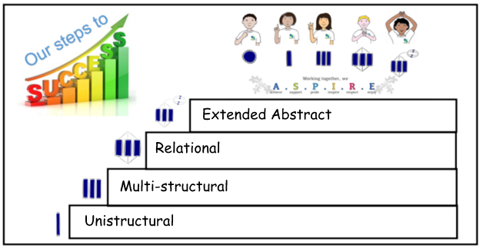
SOLO taxonomy
As a school, we recently included a pedagogical approach called Solo Taxonomy into our teaching. Each lesson is planned to follow a sequence through the following steps:
Each lesson is planned in consideration with this pedagogy and helps support the children to achieve the main objective of the lesson. Not every child will reach all stages of the lesson, however the scaffolds have been planned to help them achieve as well as challenge and extend some learners.

Slide 9






Homework books are sent home on Wednesday.
They are due in on Monday.
If homework has not been completed for that week, it does not need to be handed in.
We encourage a minimum of 4 pieces of homework to be completed across the half term.
Weekly Mathletics is assigned by the class teacher.
Insert picture of home work grid

Slide 10
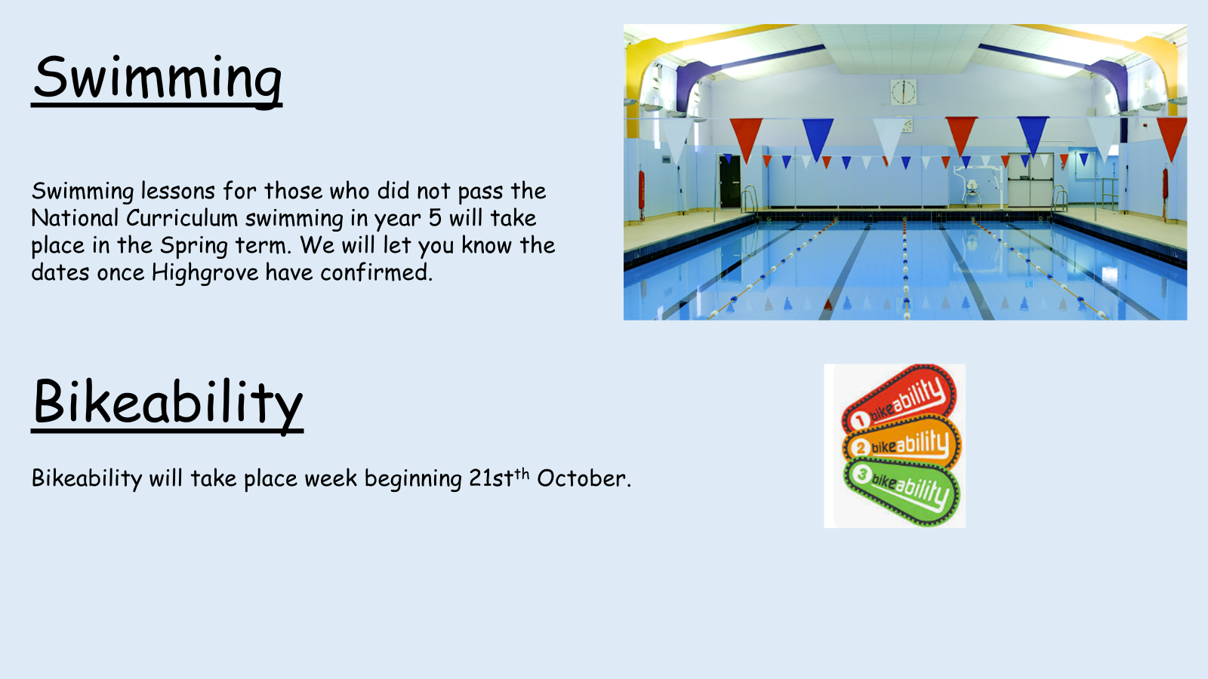

Slide 11

Stationery
Some stationery is provided by the school.
Children should bring in their own pencil case with a pencil and a blue ink pen – no blue biro
Please make sure it is small enough for their tray and does not distract from their learning.

Slide 12

Reading
Each class has a weekly library slot where they can choose a book to read for pleasure, which can be taken home.
We do weekly Vipers reading comprehension sessions as a whole class.
Reading Buddies is with the reception class.
Whole class reading takes place daily*.
*Subject to time.

Slide 13


Spellings

Slide 14
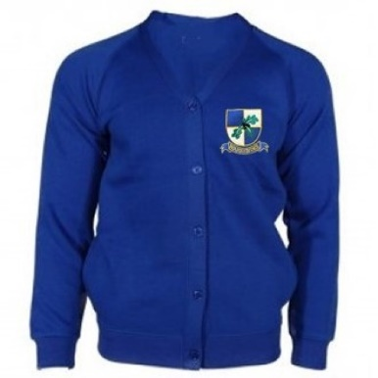

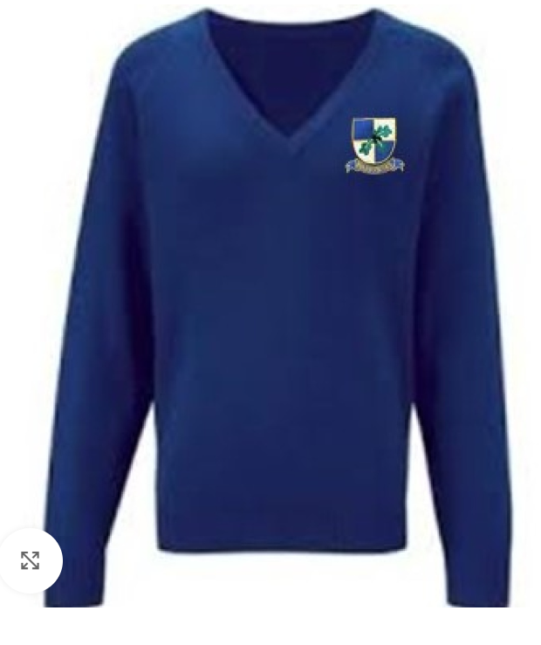


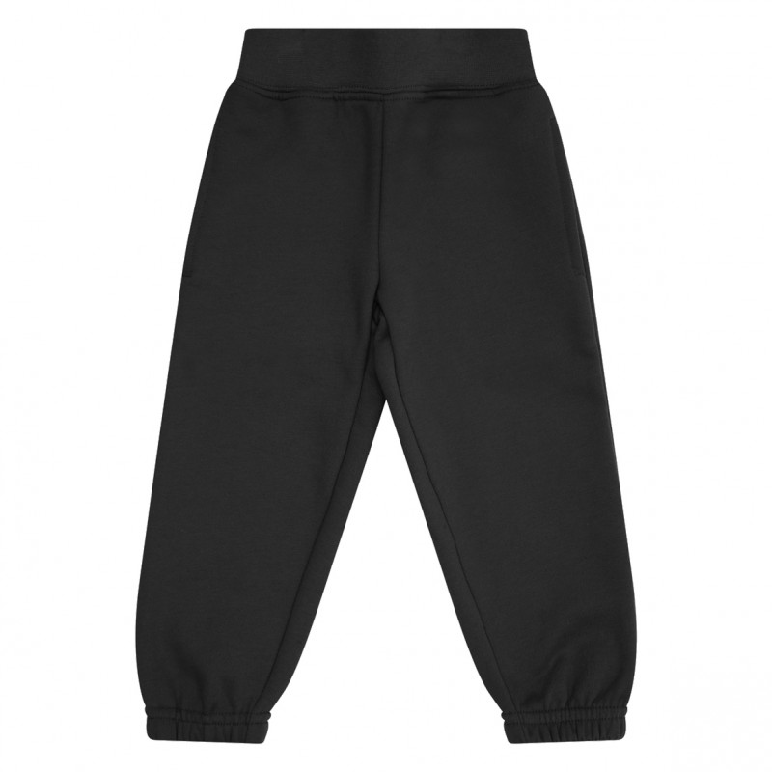
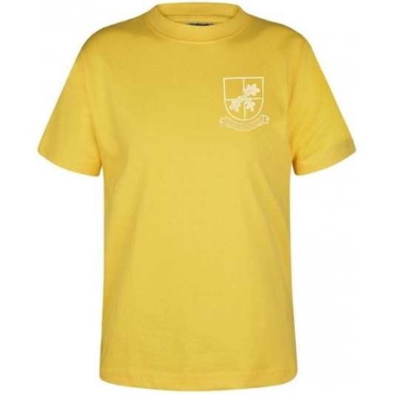
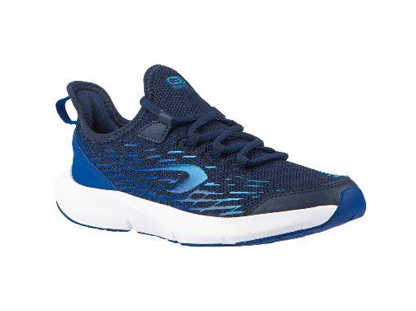
Uniform and PE
Please clearly name every piece of your child’s uniform.
Only trainers on P.E. day – Mondays and Thursdays
On PE days, no jewellery is to be worn and earrings cannot be taped up.
Only stud gold/silver earring – no hoops or fancy earrings
Hair must be tied back.
No hoodies for P.E. This is all due to health and safety.
If black shorts are worn under dresses, these need to short and not longer than the dress eg cycling shorts are too long)
If your child comes in wearing incorrect uniform, a green slip will be sent home

Slide 15
Summary
Oak
Sycamore
Mrs Walsh (Mon,Tues,Weds) / Mrs Close (Weds,Thurs,Fri)
Library day - Thursday
PE days - Monday & Thursday
Homework - due in on Mondays
(only if work has been completed in them for marking.)
Spelling – Test on Friday, new spellings sent home on Monday
Uxbridge Bunker trip – Wednesday 16th October 2024
Royal Courts of Justice – Monday 3rd February 2025
Residential dates – w/b 9th June
Mrs Evans (Mon,Tues,Thurs,Fri) / Mr Wright (Weds)
Library day - Tuesday
PE days - Monday & Thursday
Homework - due in on Mondays
(only if work has been completed in them for marking.)
Spelling – Test on Friday, new spellings sent home on Monday
Uxbridge Bunker trip – Thursday 17th October 2024
Royal Courts of Justice – Monday 3rd February 2025
Residential dates – w/b 7th July

Slide 16


